Slide 1
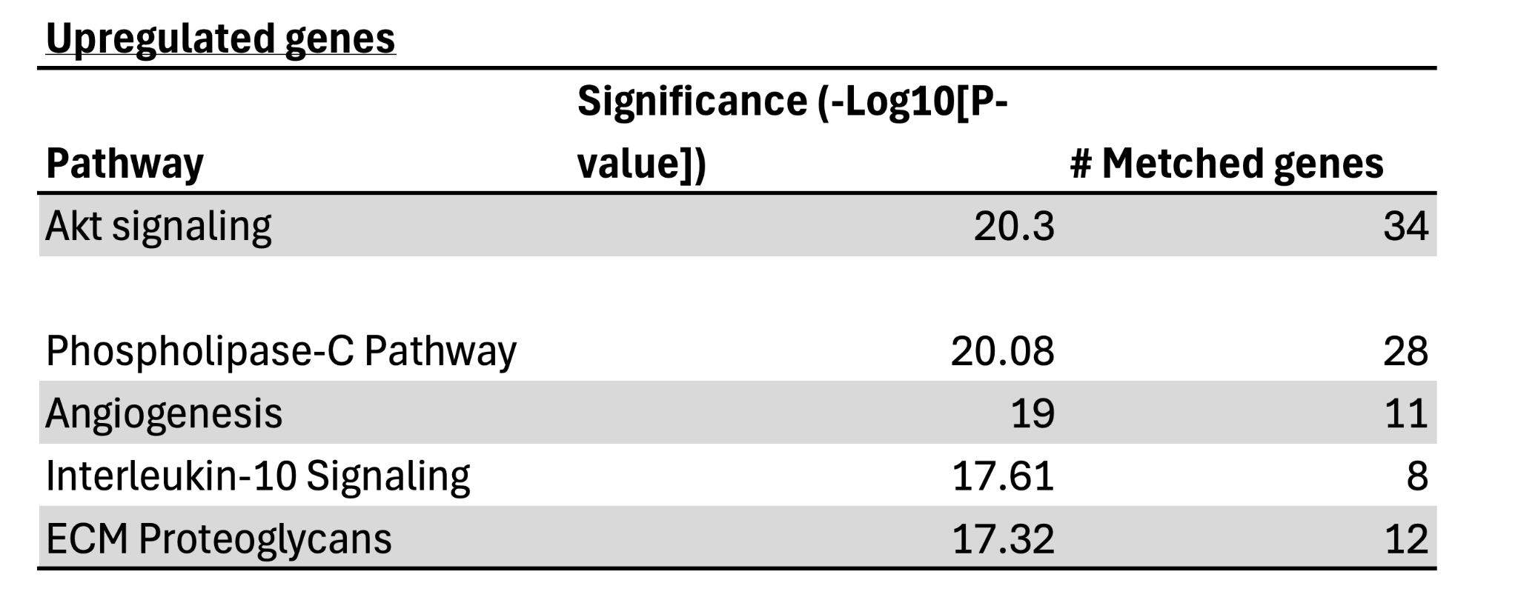
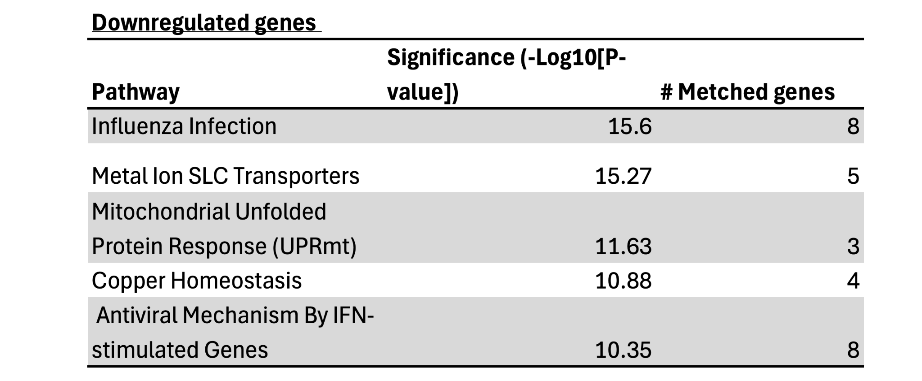
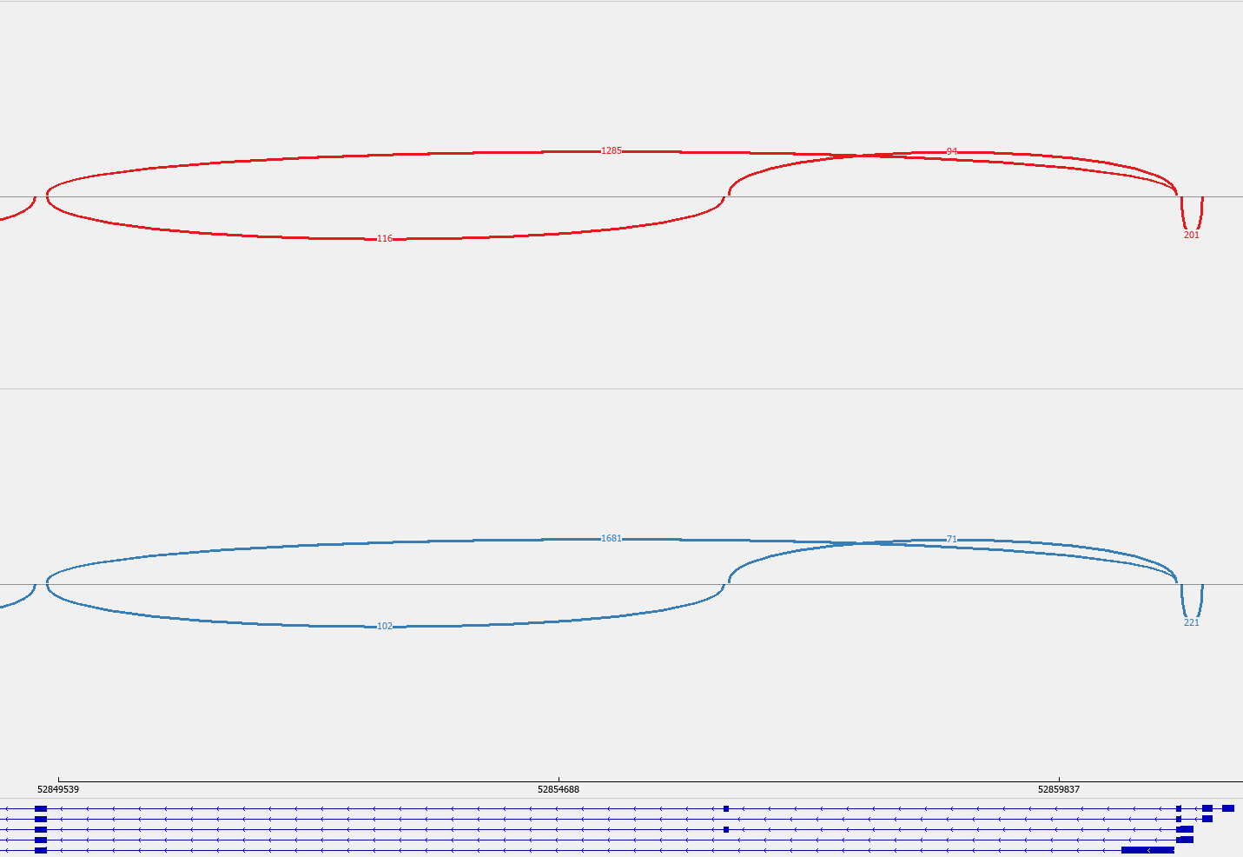
Sup. Fig. 1
A
Event Type | All Significant Events | Significant Events WT Higher Inclusion | Significant Events SF3B1 MUT Higher Inclusion
SE | 8953 | 4437 | 4516
A5SS | 1098 | 510 | 588
A3SS | 3583 | 1531 | 2052
MXE | 7408 | 3480 | 3928
RI | 1094 | 664 | 430
B
C
ARPP19
chr15: 52856387-52856443
SF3B1^{WT}
1681
71
102
SF3B1^{K700E}
1285
94
116

Slide 2
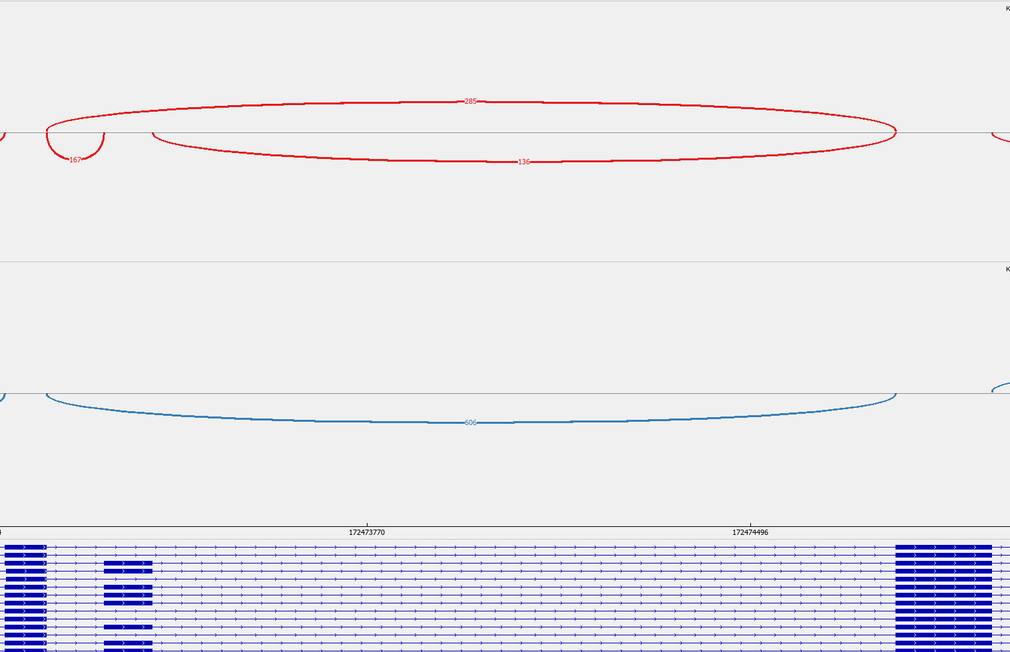
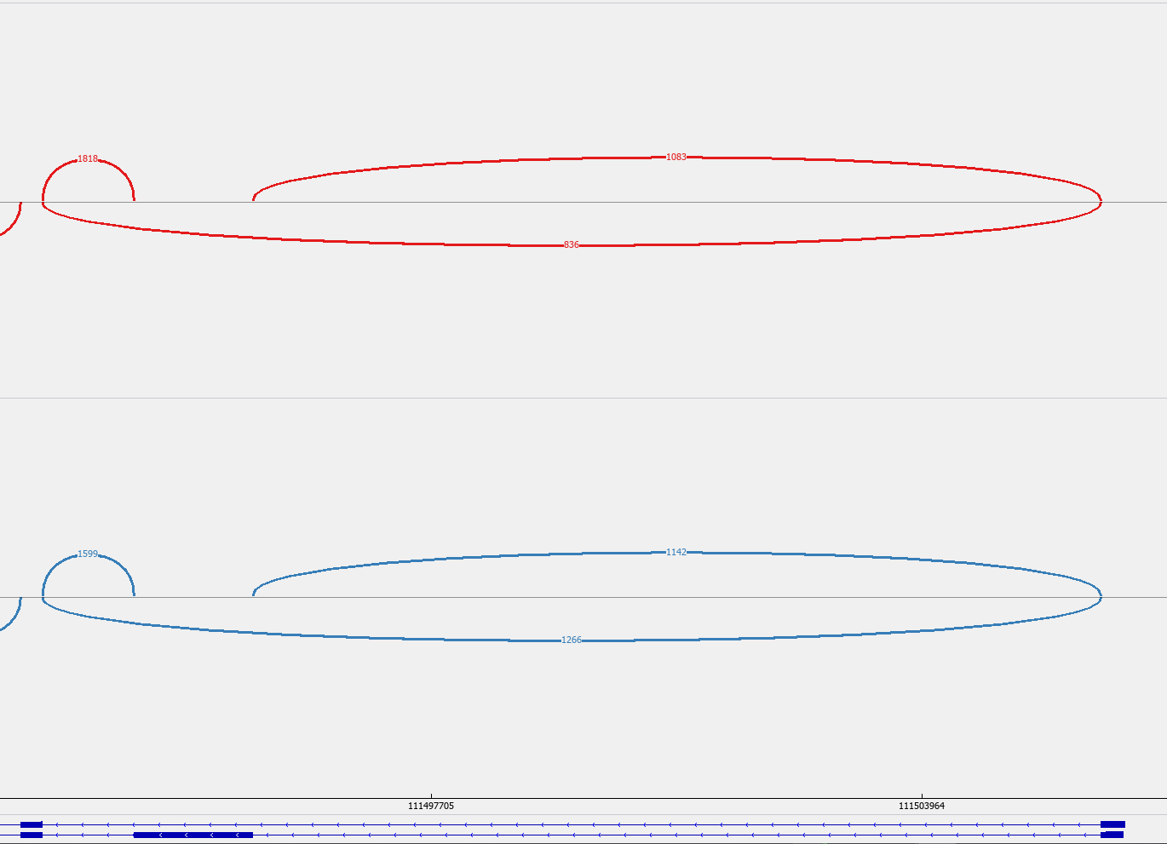
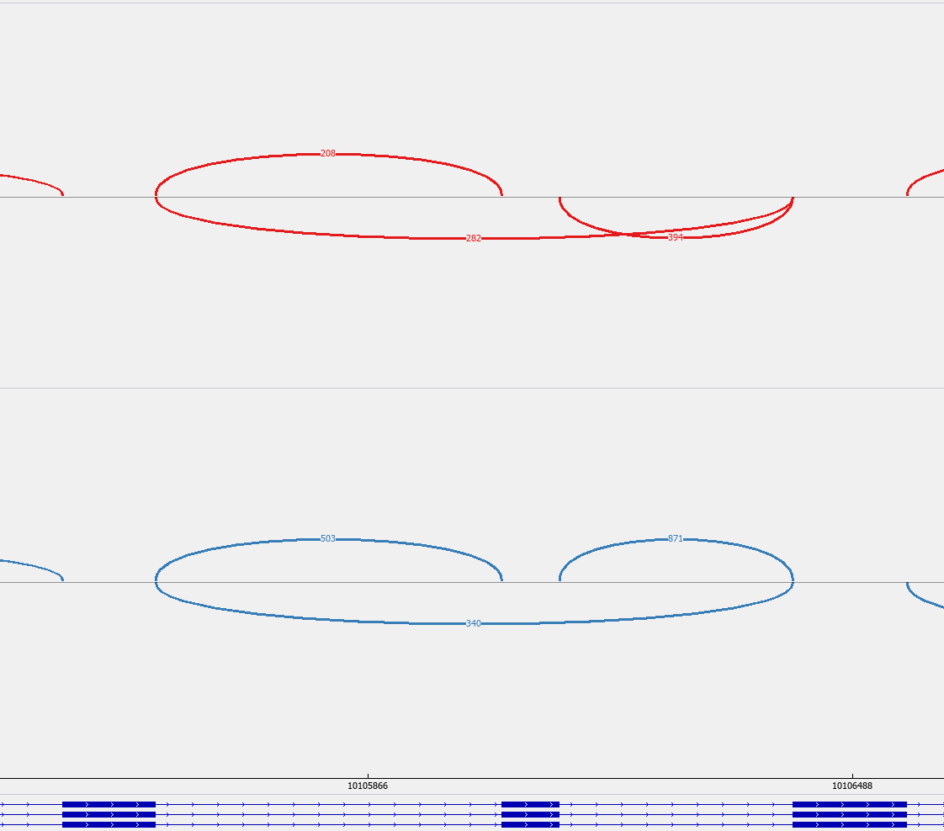
D
ECT2
chr3: 172473272-172473365
SF3B1^{WT}
606
SF3B1^{K700E}
285
167
136
E
LRIF1
chr1: 111493909-111495440
SF3B1^{WT}
1142
1599
SF3B1^{K700E}
1266
1818
1083
836
F
FANCD2
chr3: 10106039-10106113
SF3B1^{WT}
503
871
340
SF3B1^{K700E}
208
282
394

Slide 3
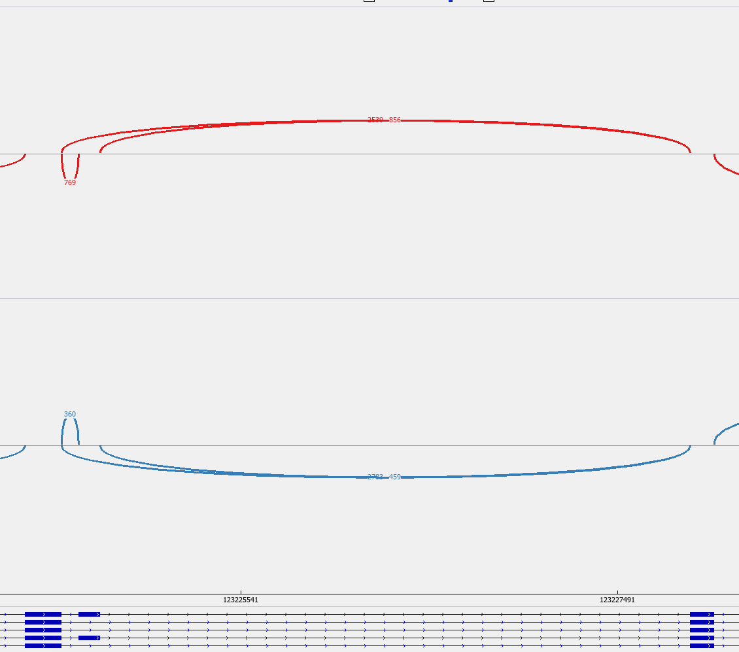
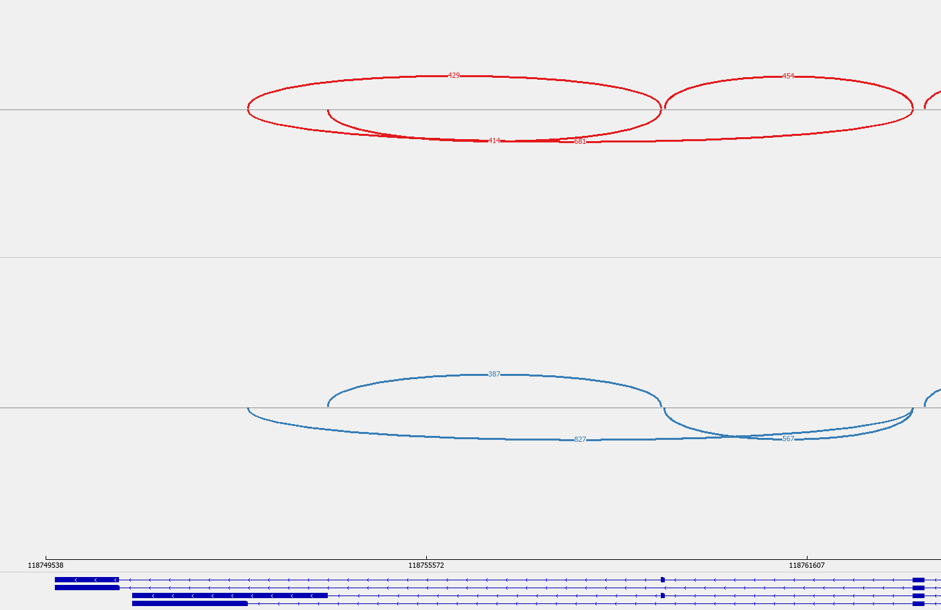
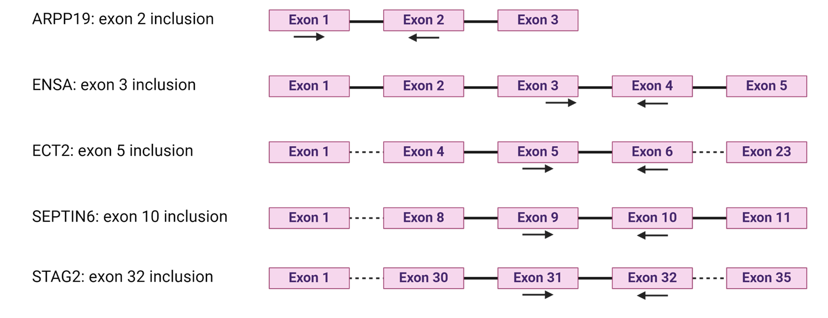
G
STAG2
chrX: 123224703-123224814
SF3B1^{WT}
2783
459
360
2539
SF3B1^{K700E}
856
769
H
SEPTIN6
chrX: 118759297-118759359
SF3B1^{WT}
387
827
567
SF3B1^{K700E}
429
454
414
681
I

Slide 4
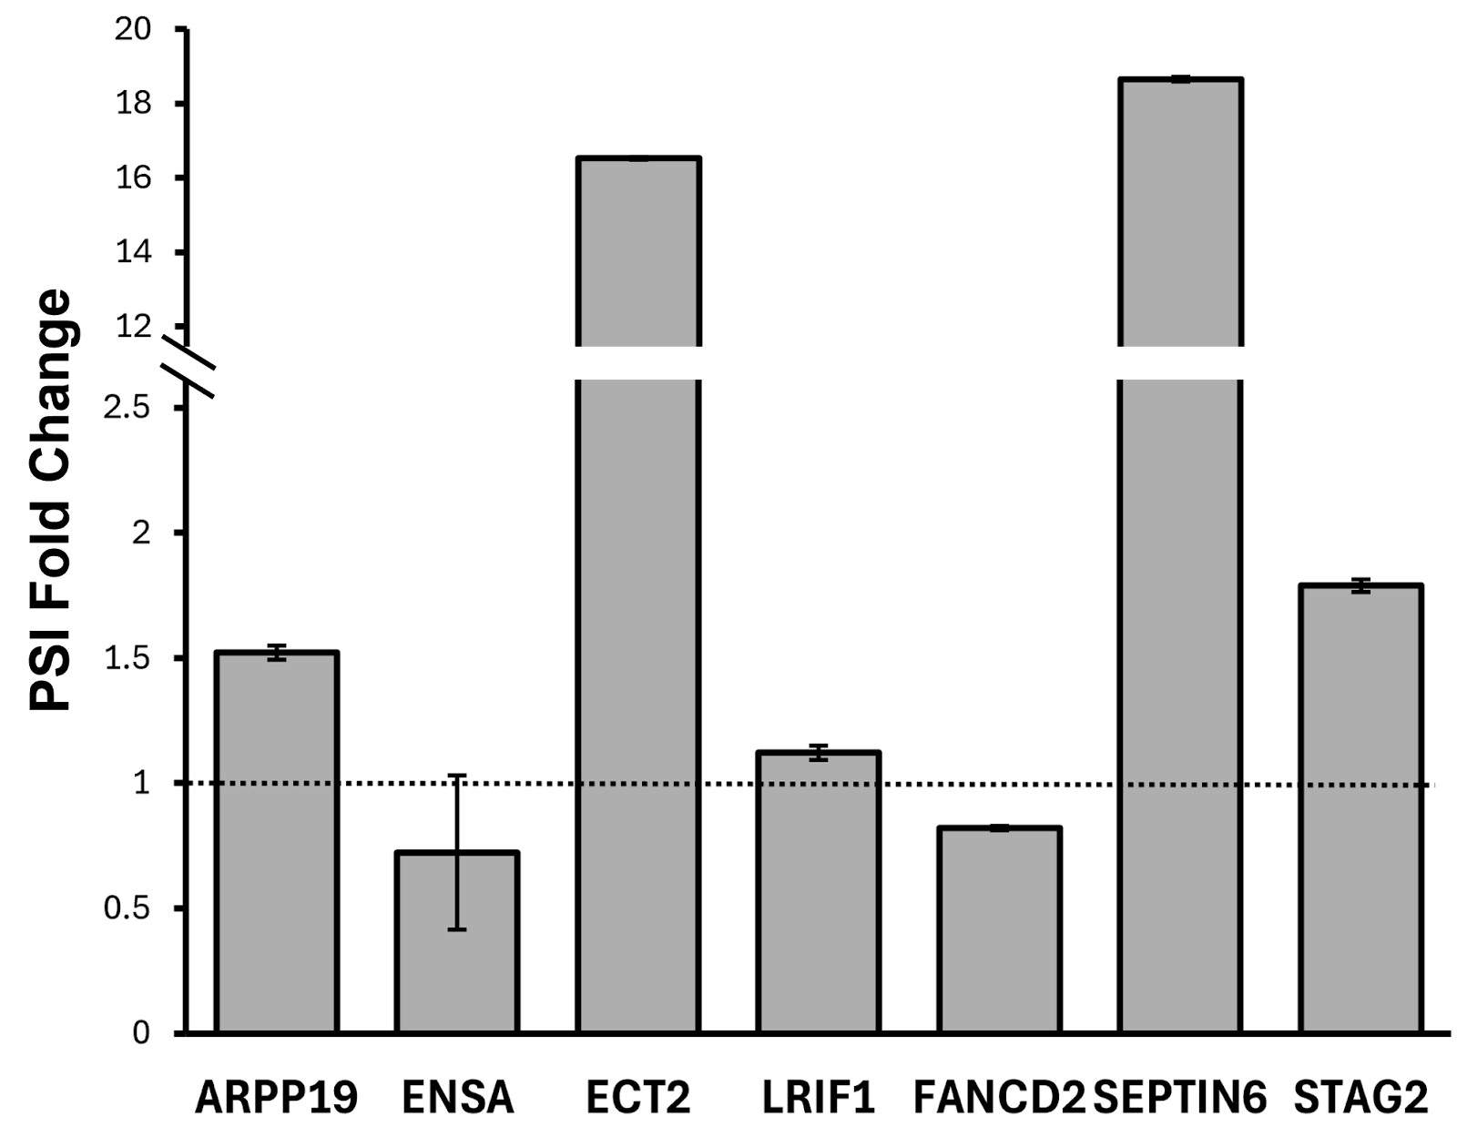
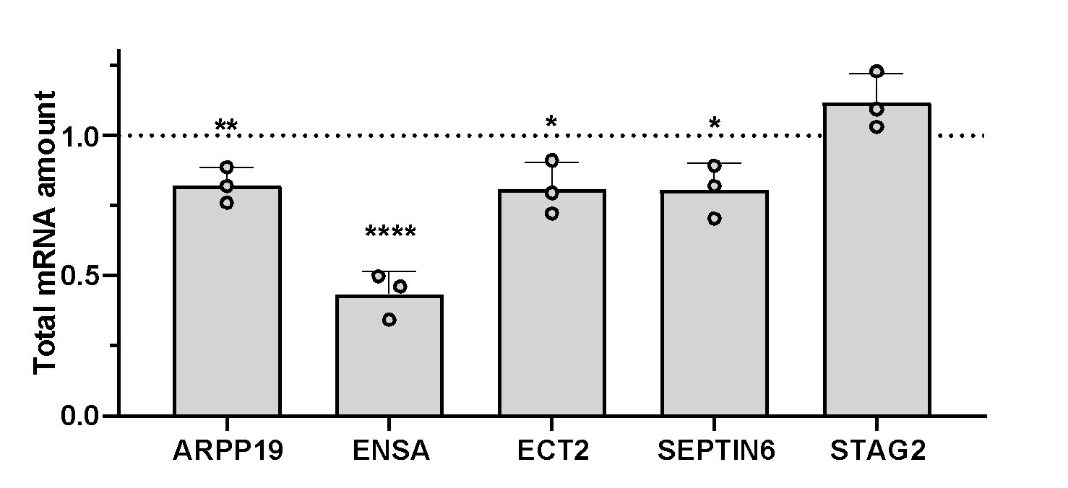
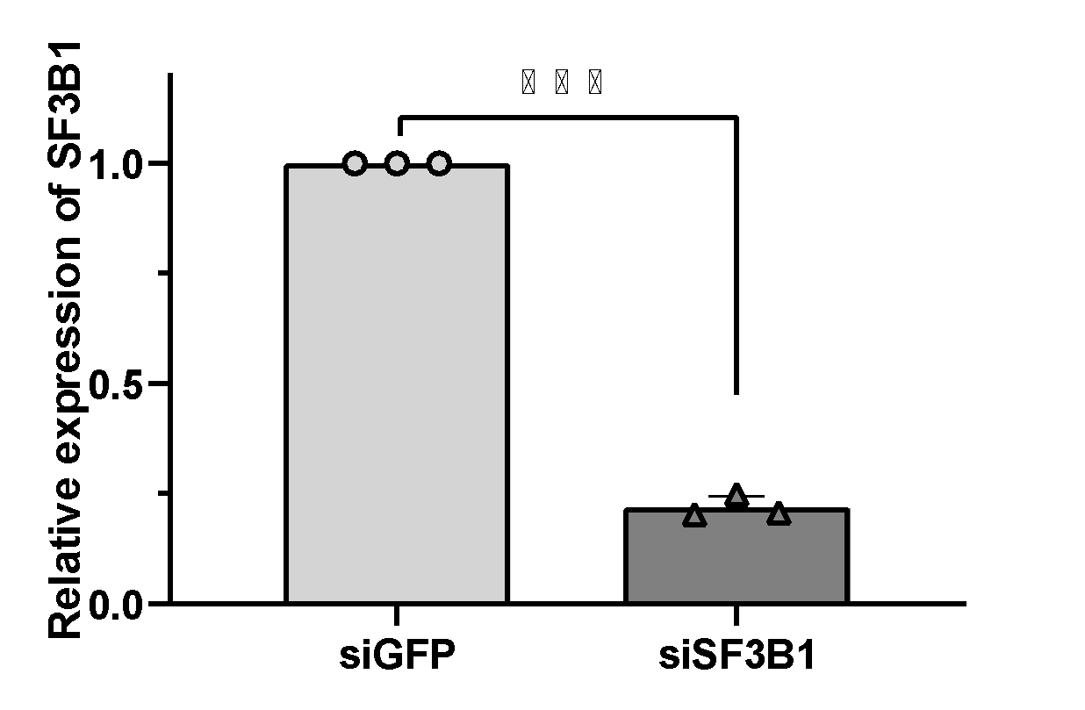
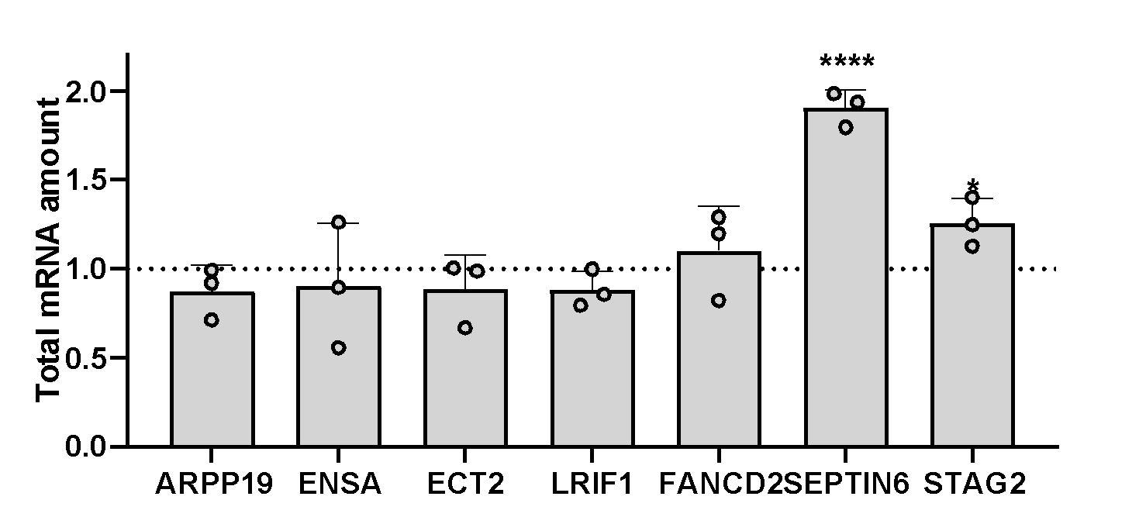
Sup. Fig. 2
A
B
C
D

Slide 5
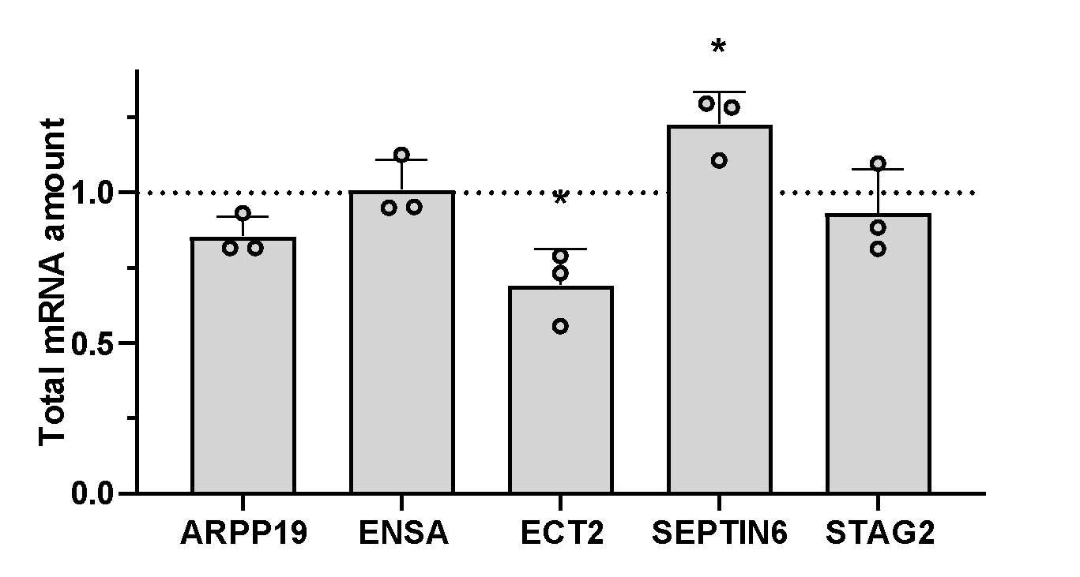
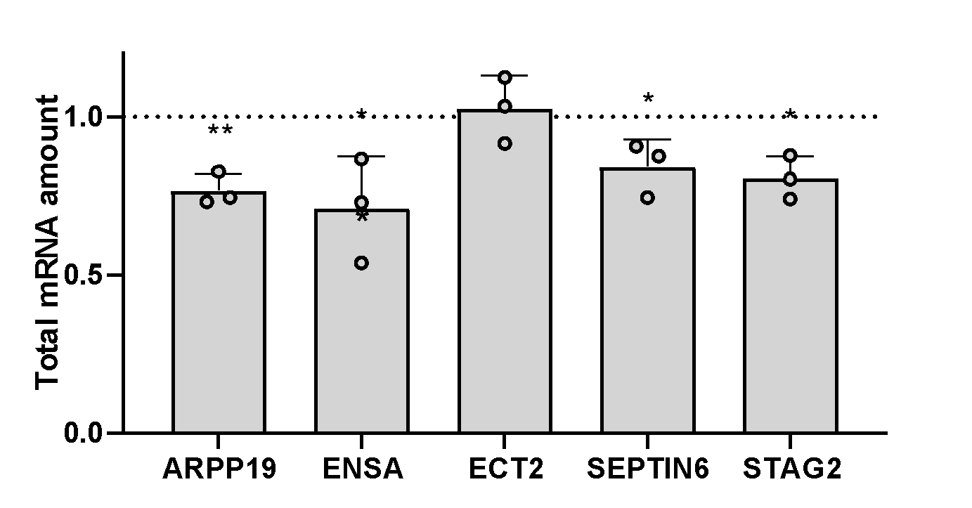
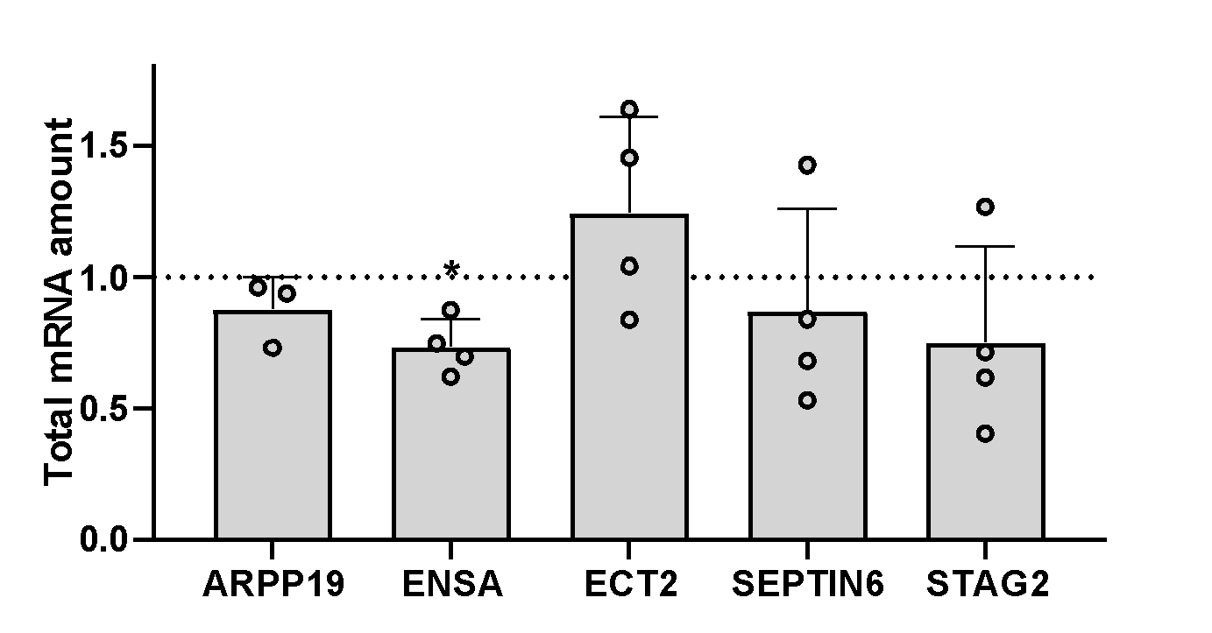
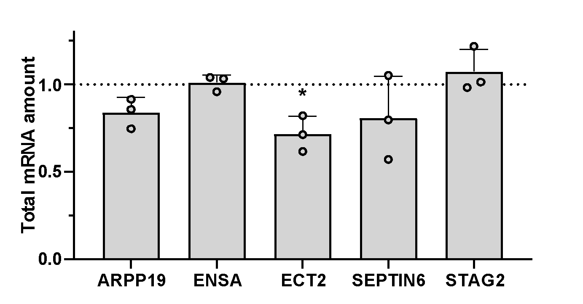
Sup. Fig. 3
A
B
C
D

Slide 6
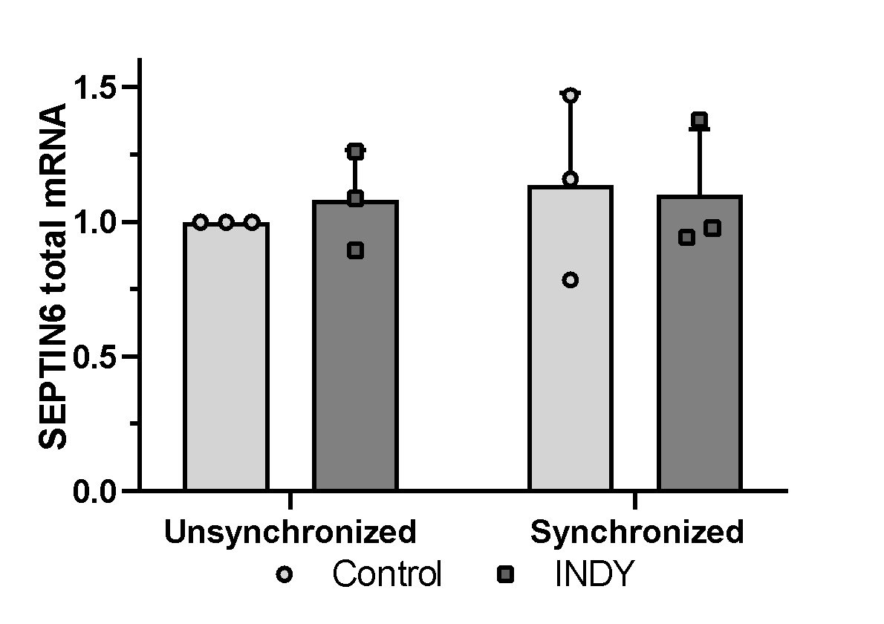
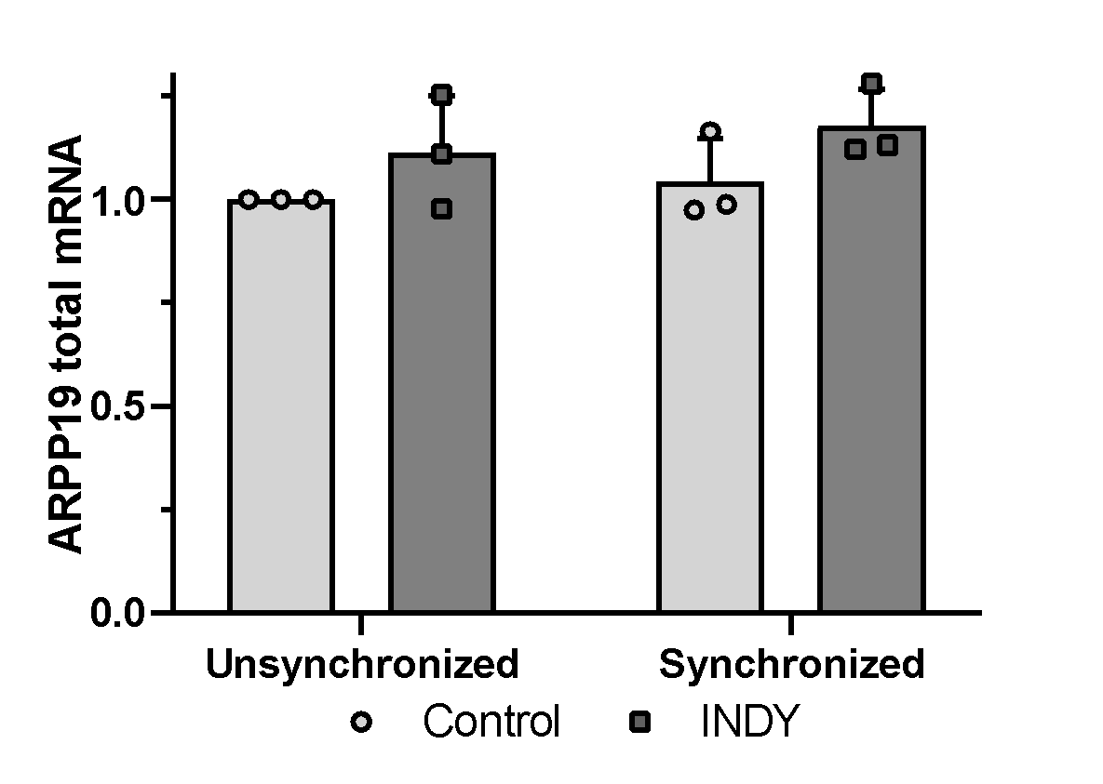
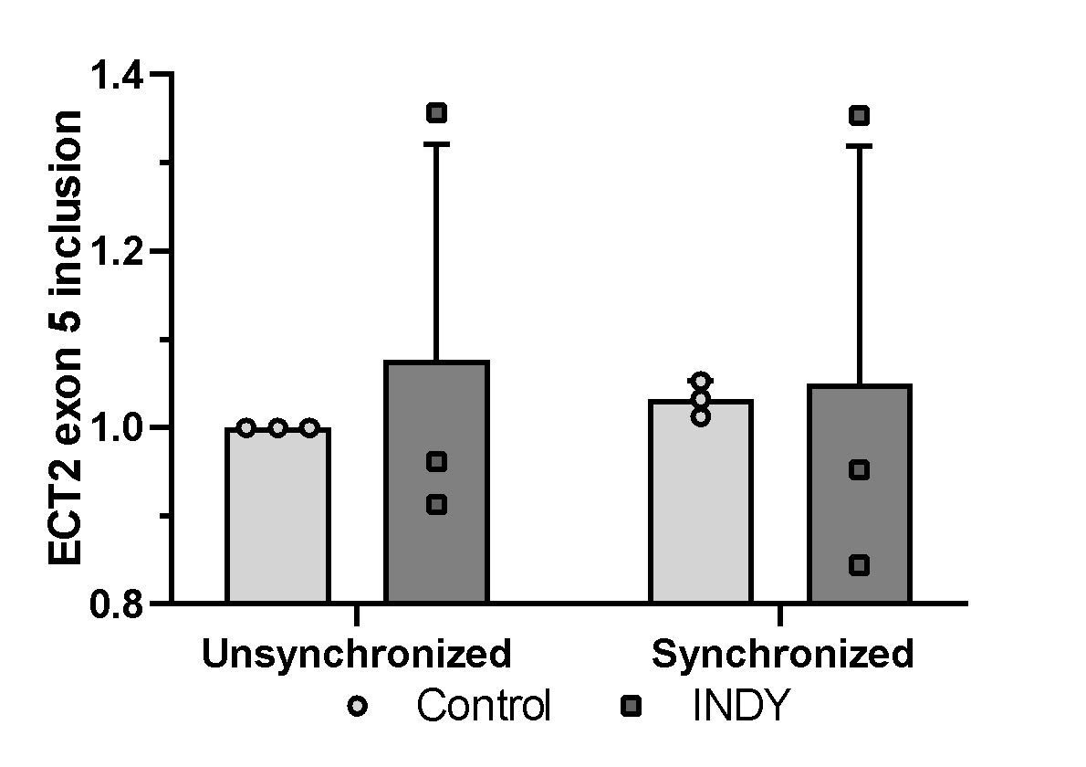
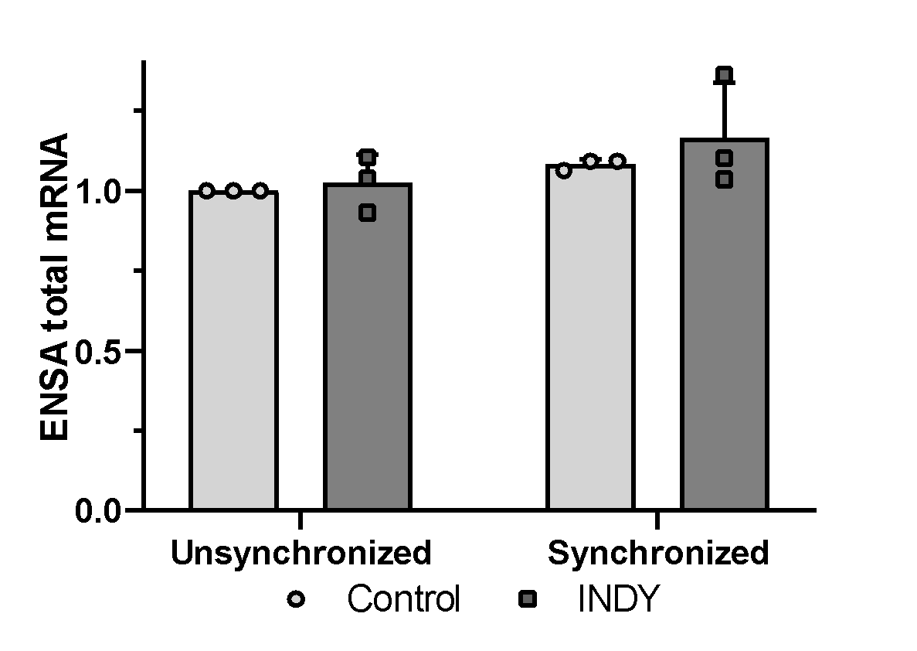
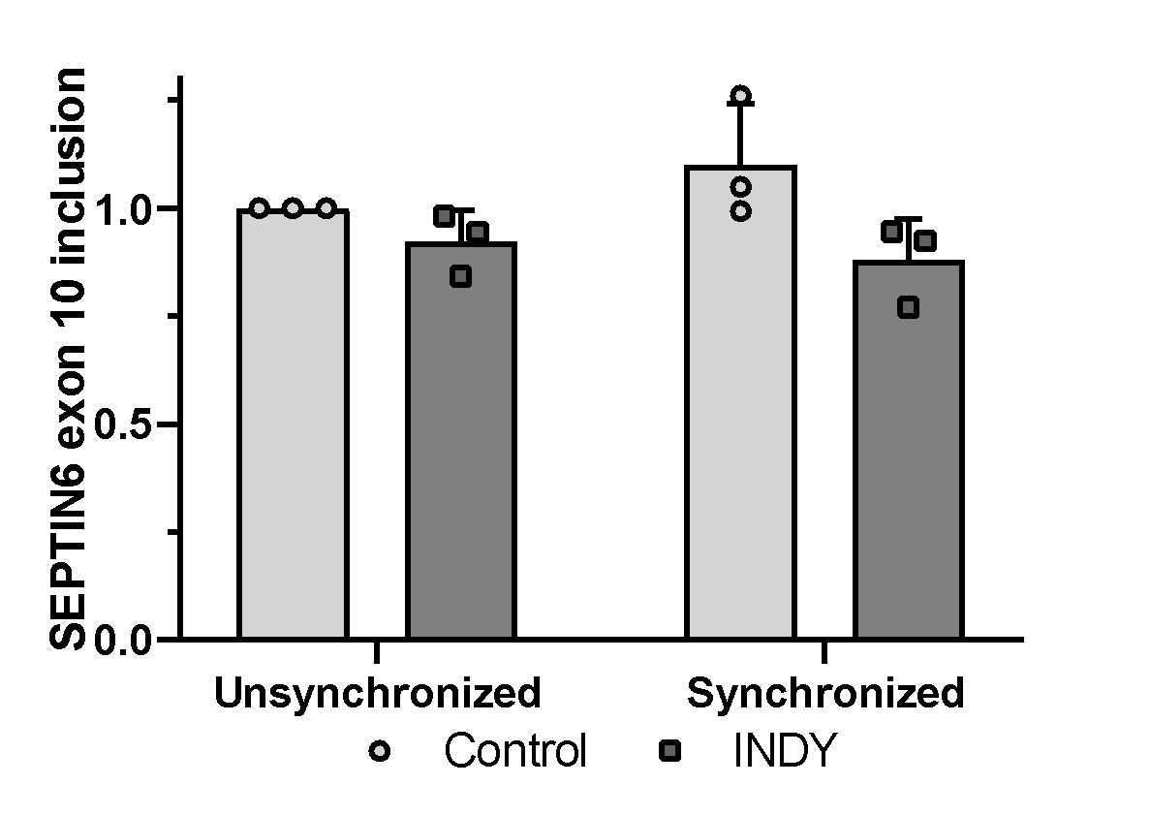
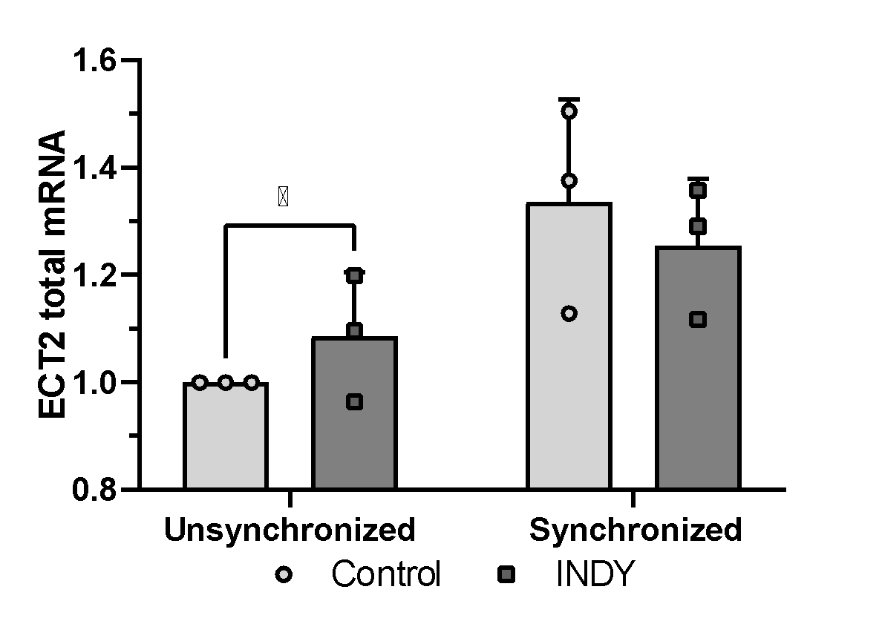
Sup. Fig. 4
A
B
C
D
E
F

Slide 7
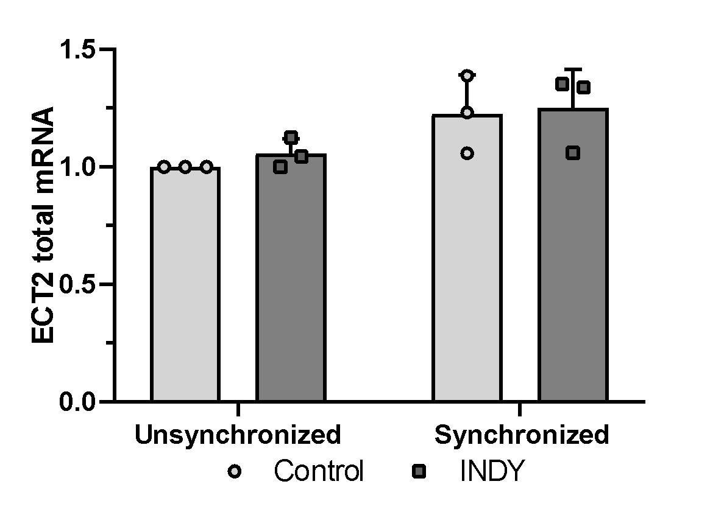
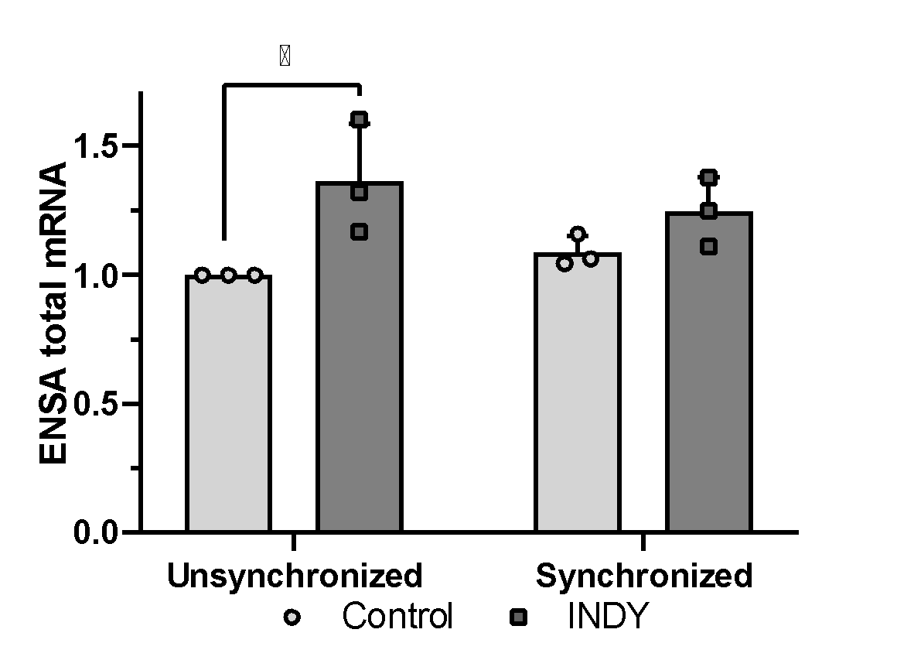
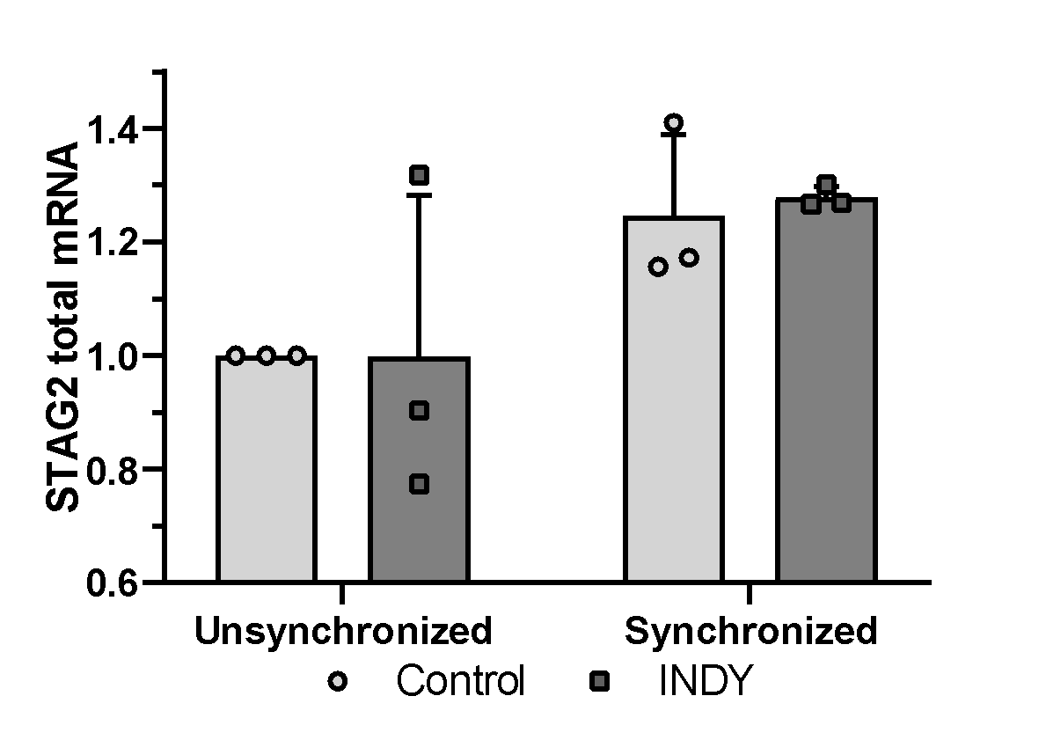
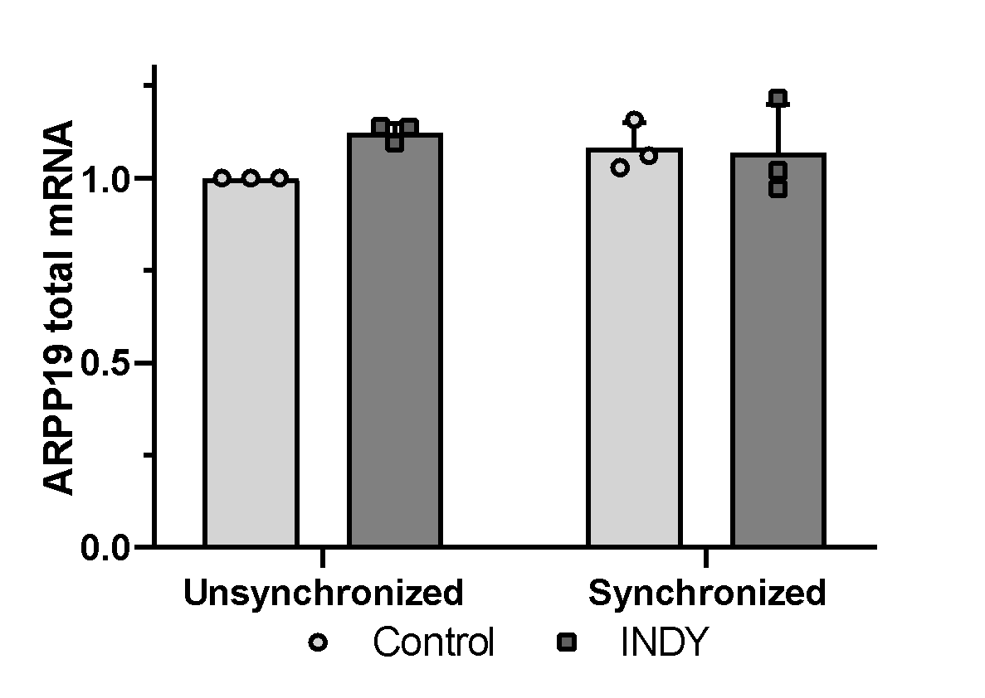
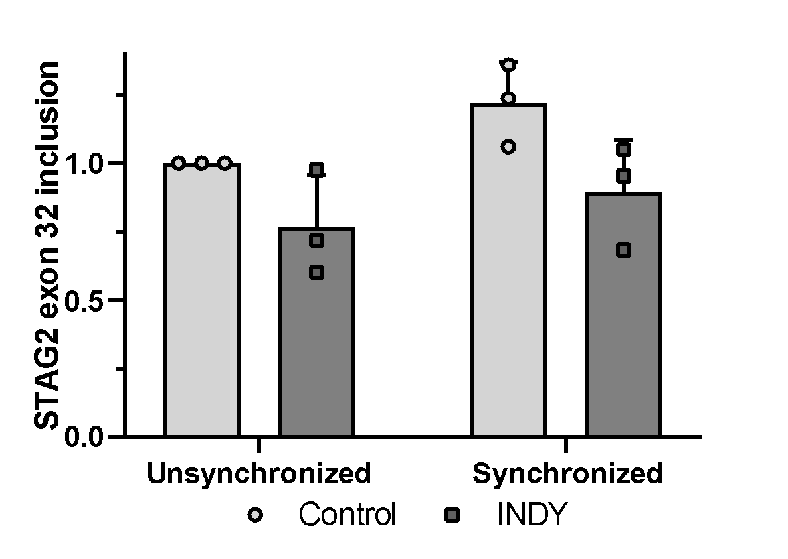
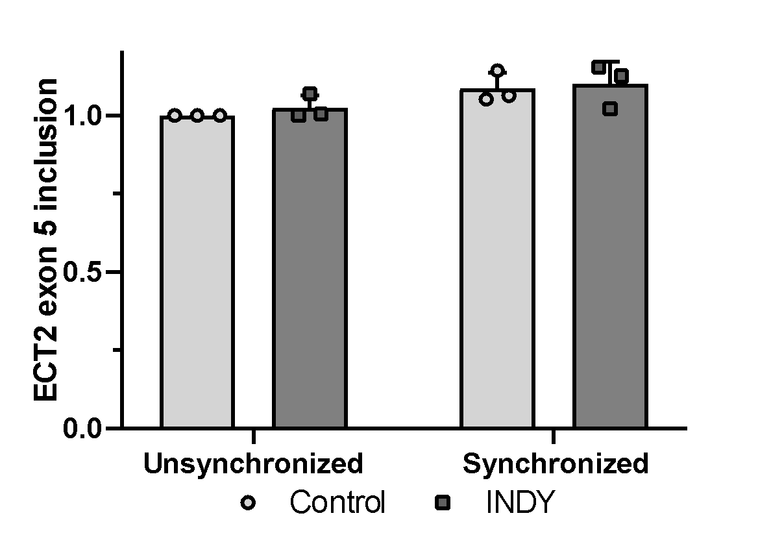
G
H
I
J
K
L

Slide 8
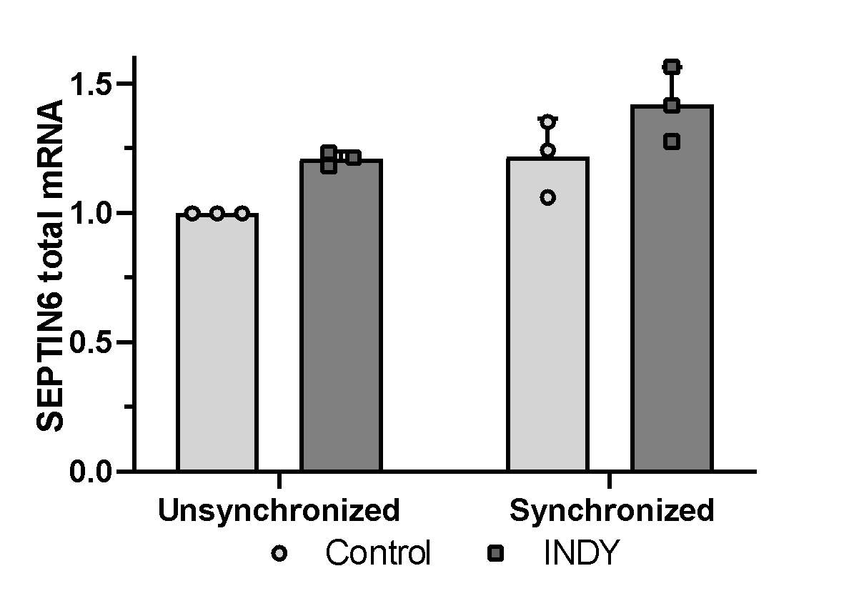
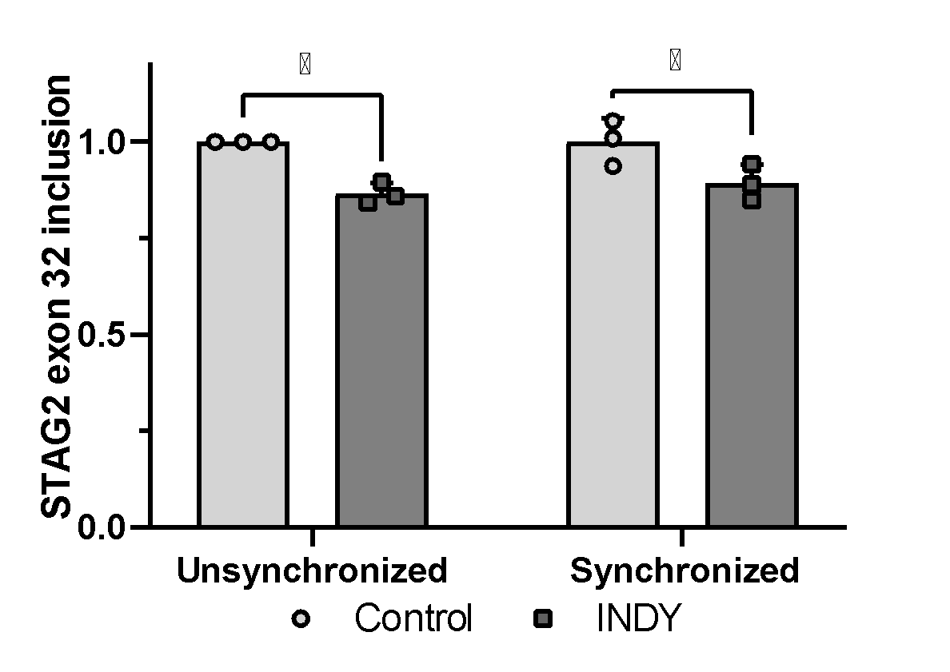
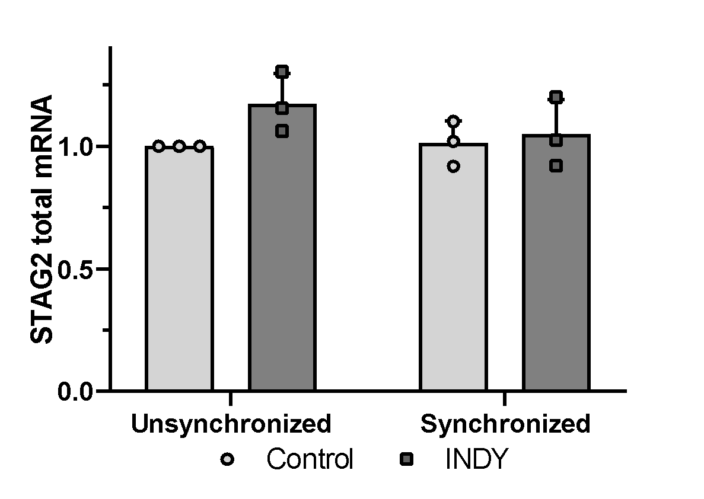
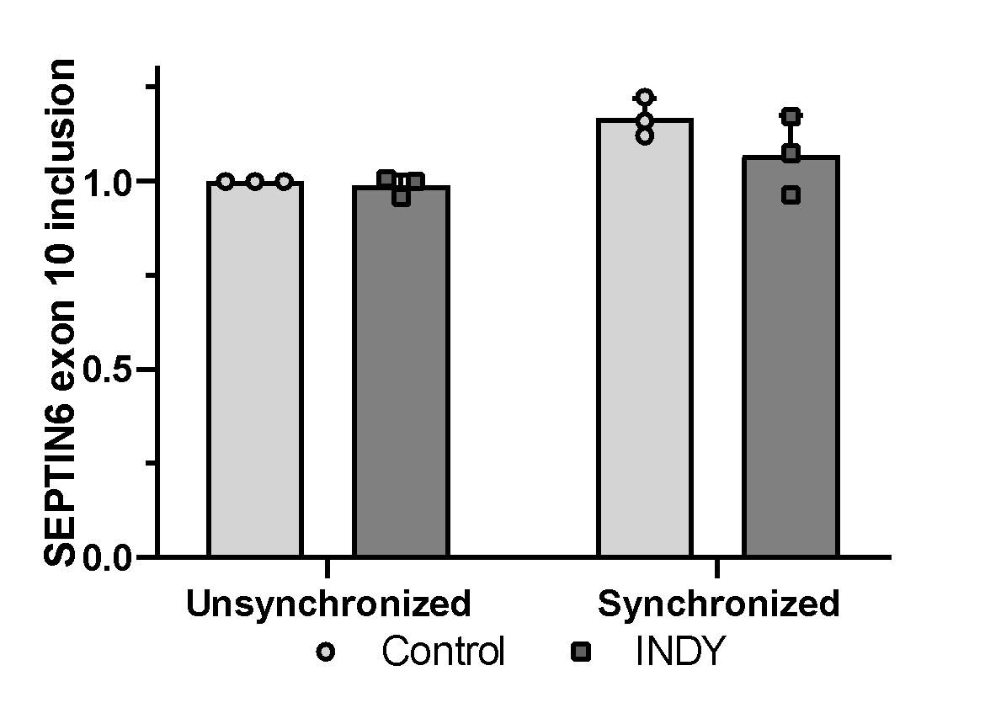
M
N
O
P

Slide 9
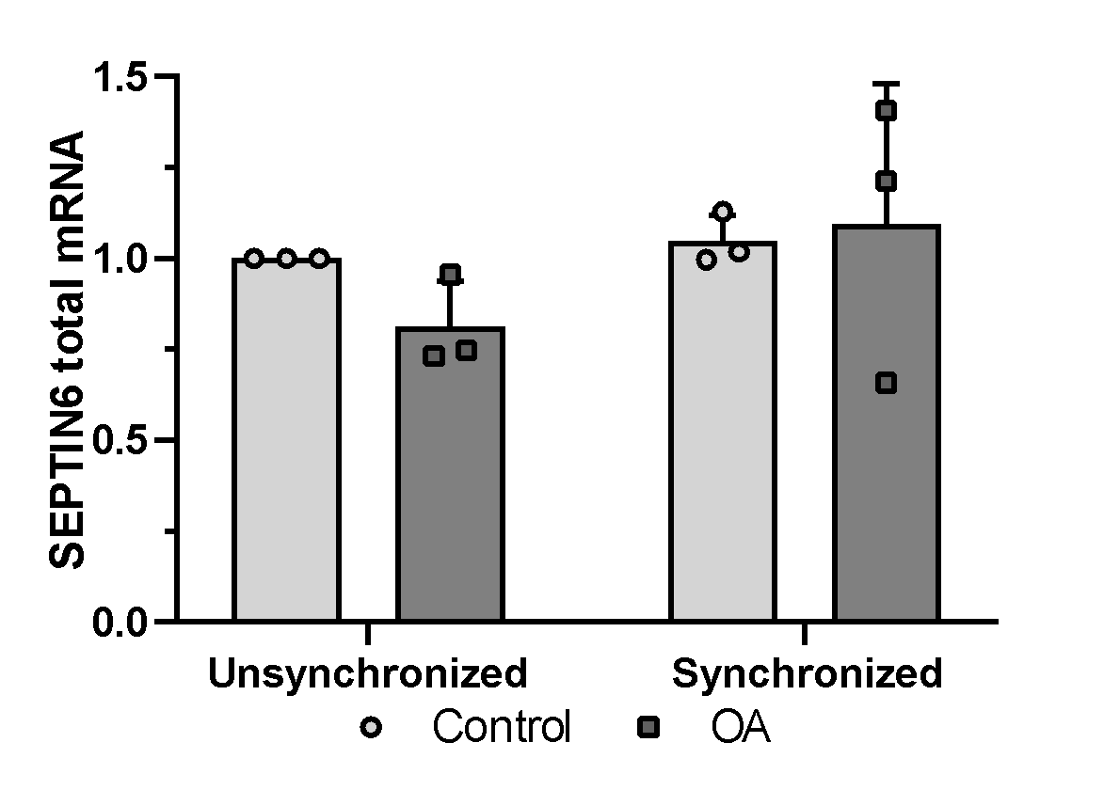
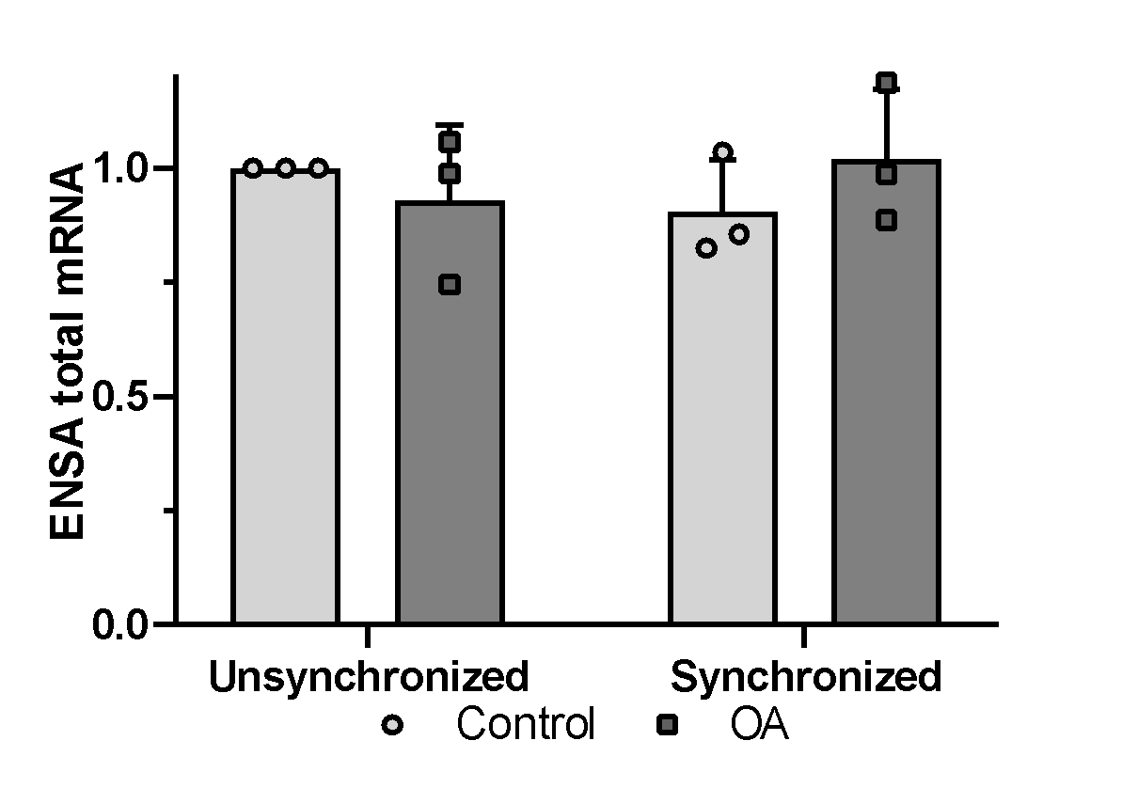
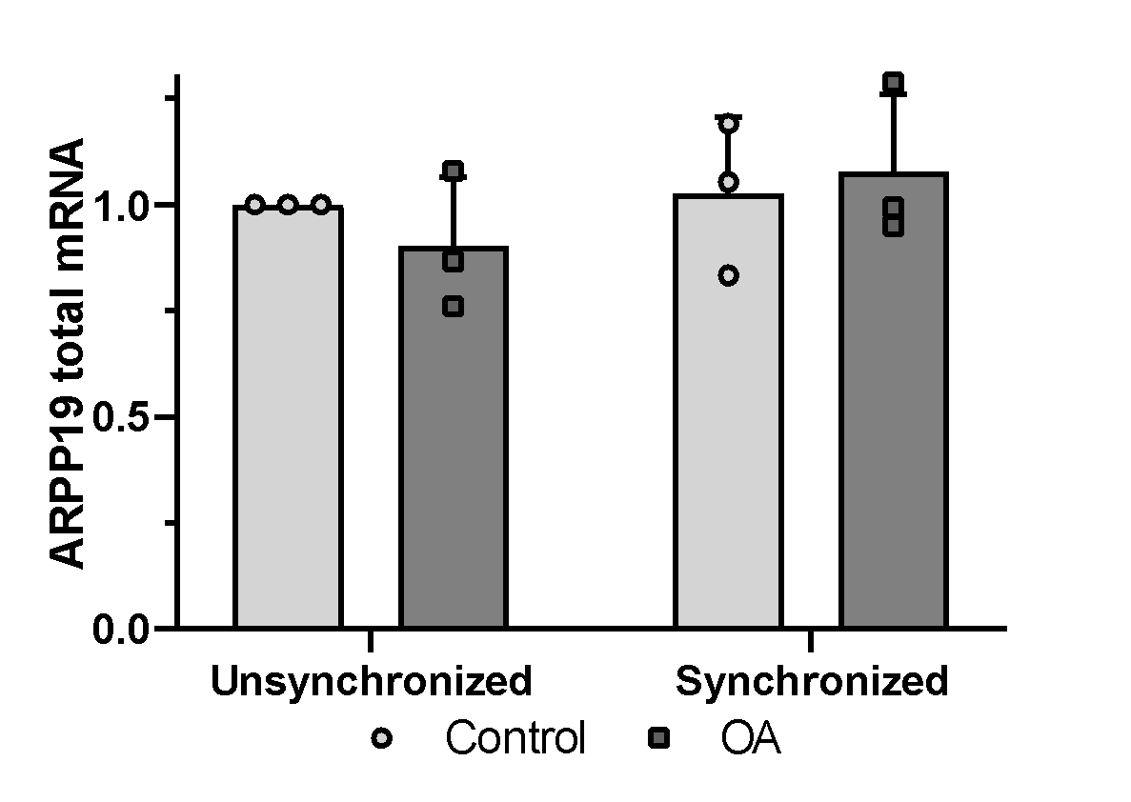
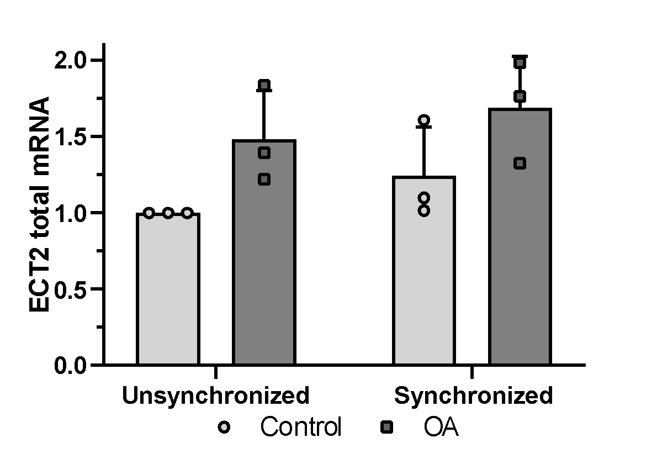
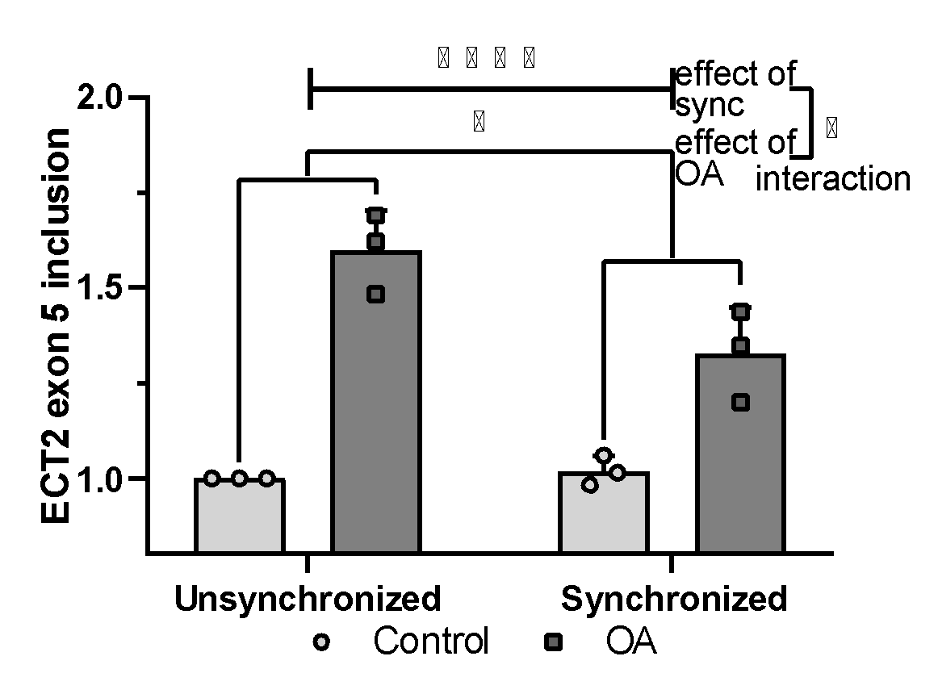
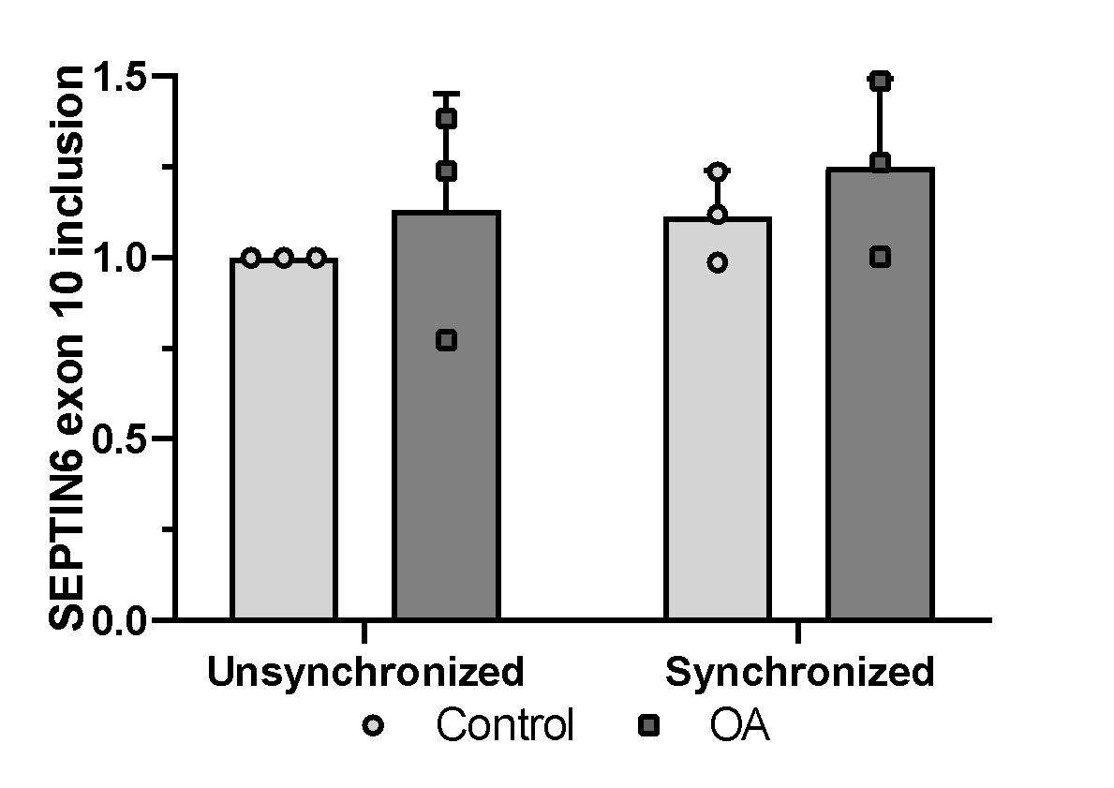
Sup. Fig. 5
A
B
C
D
E
F

Slide 10
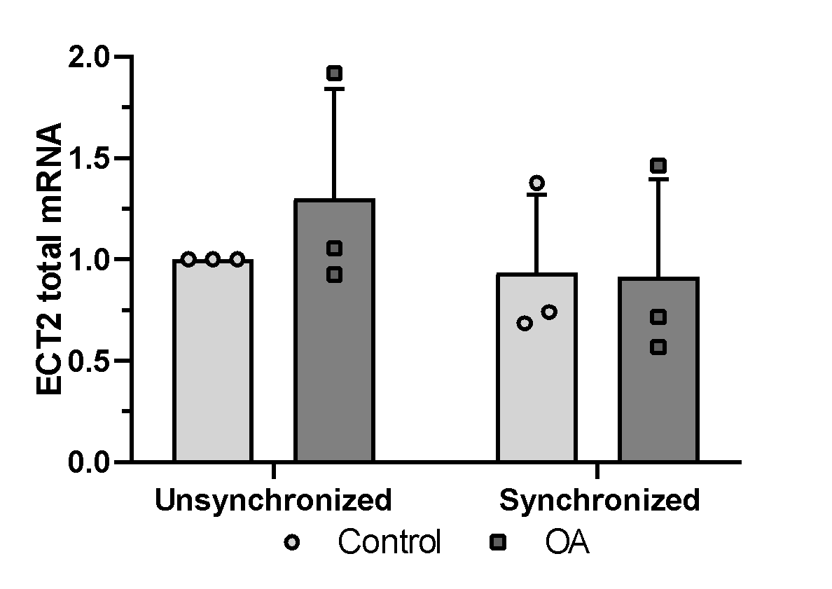
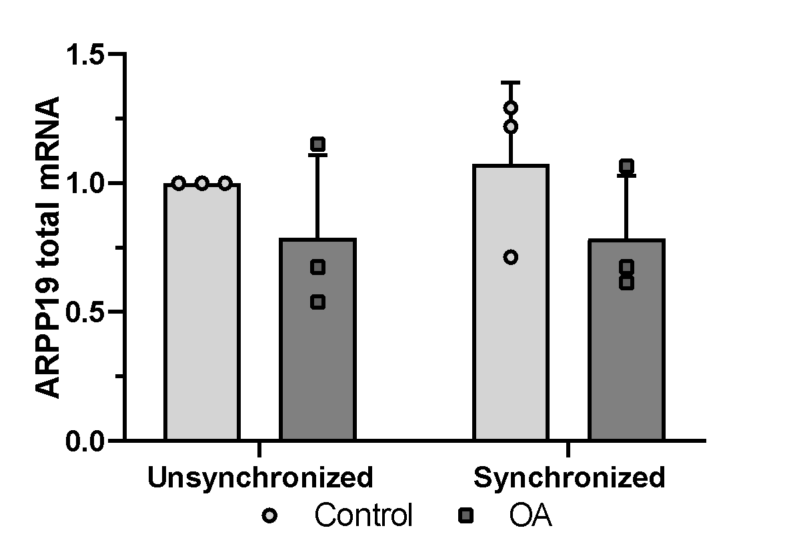
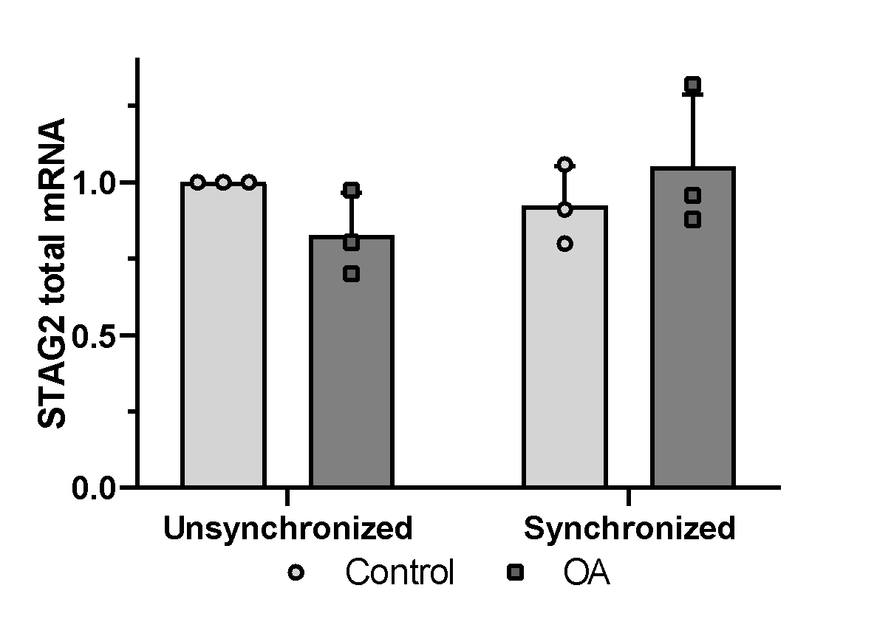
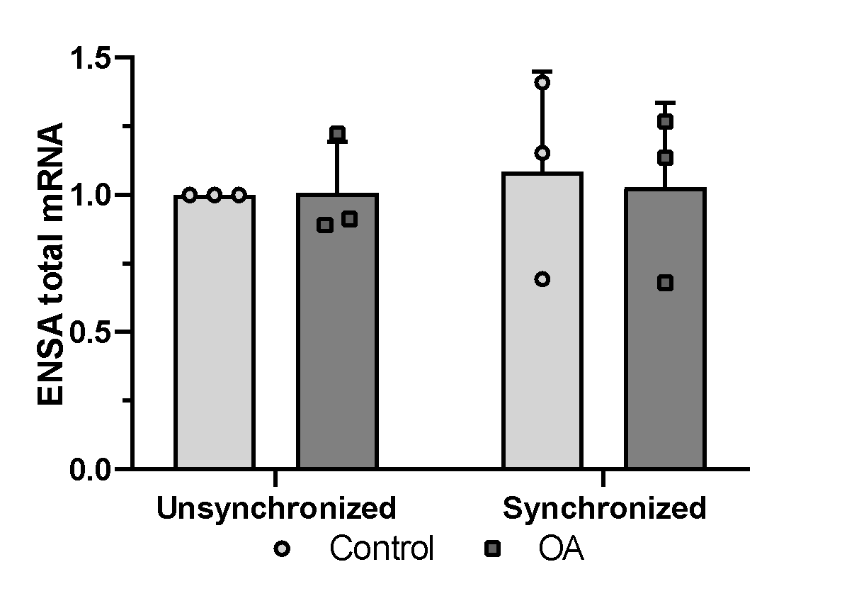
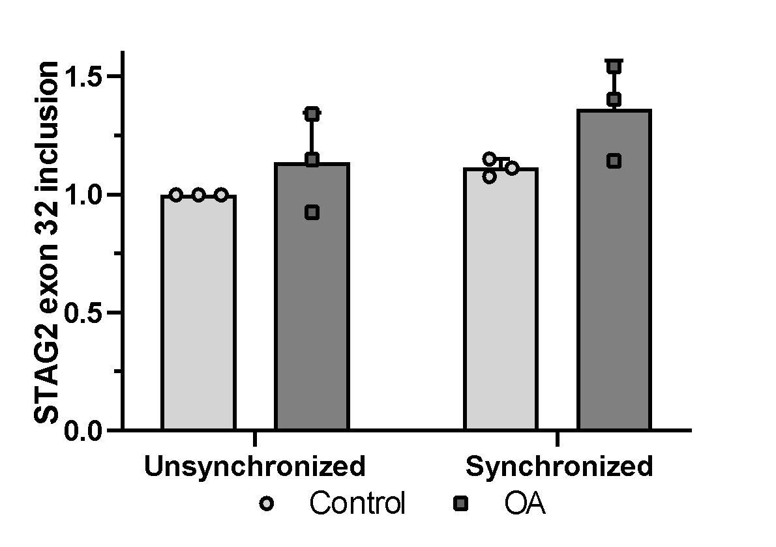
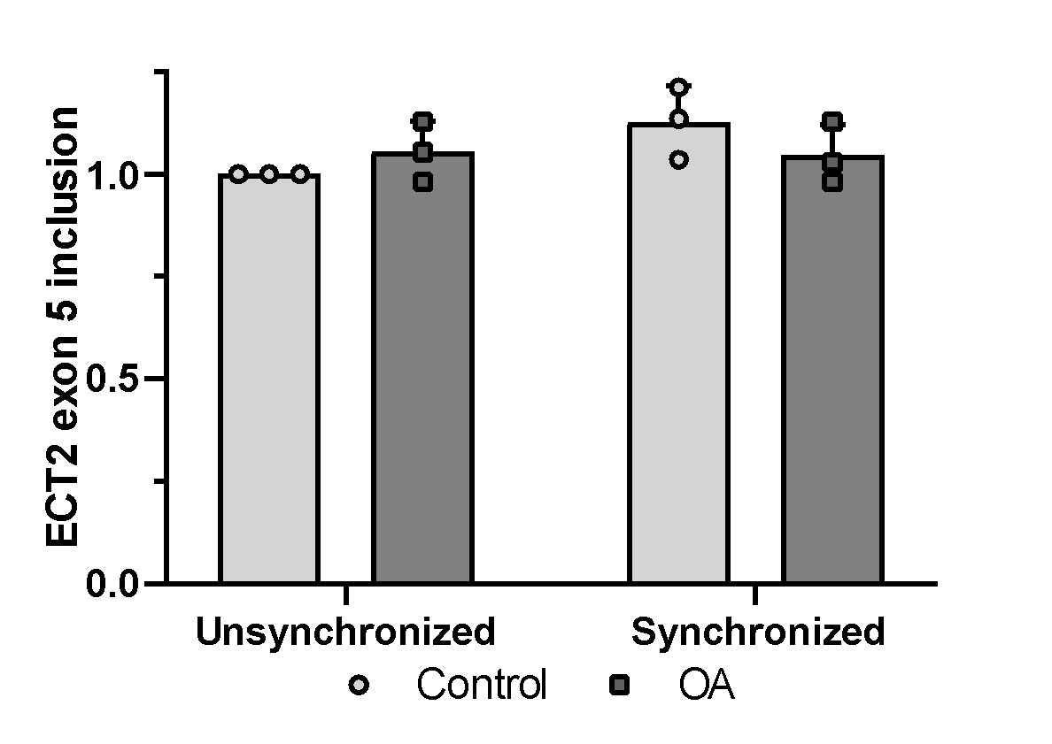
G
H
I
J
K
L

Slide 11
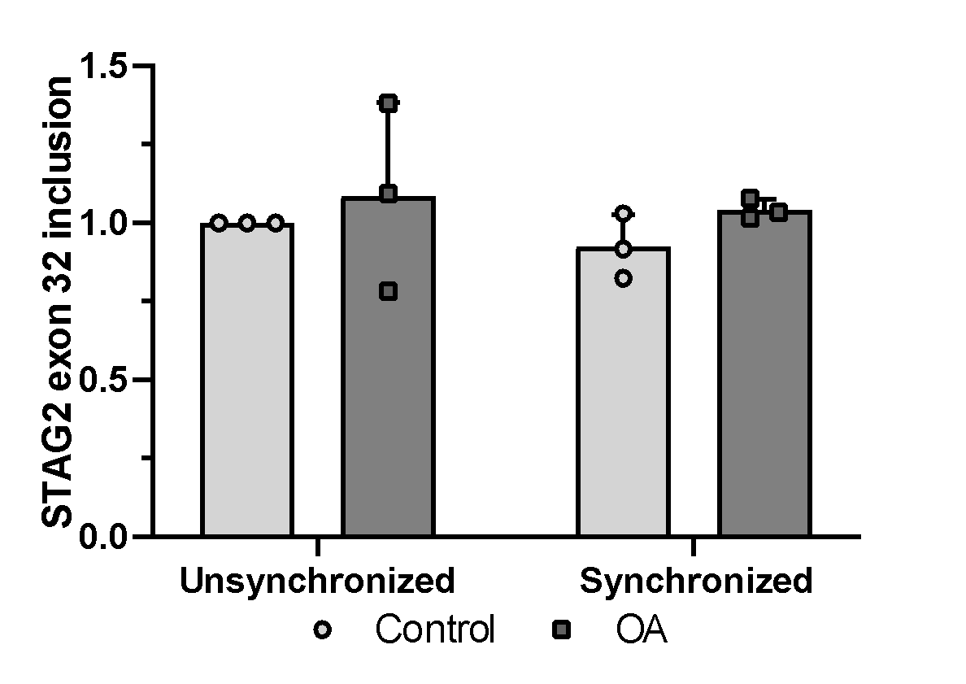
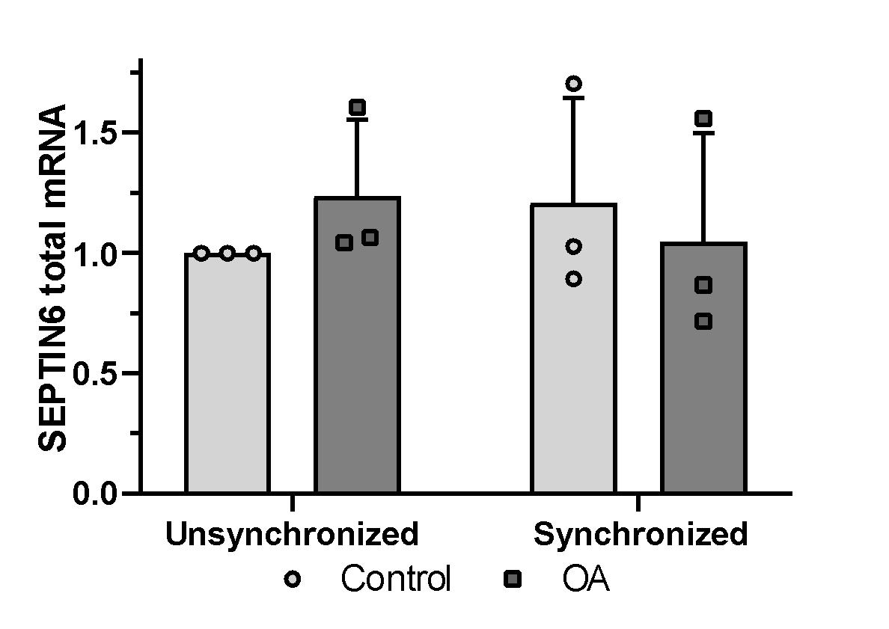
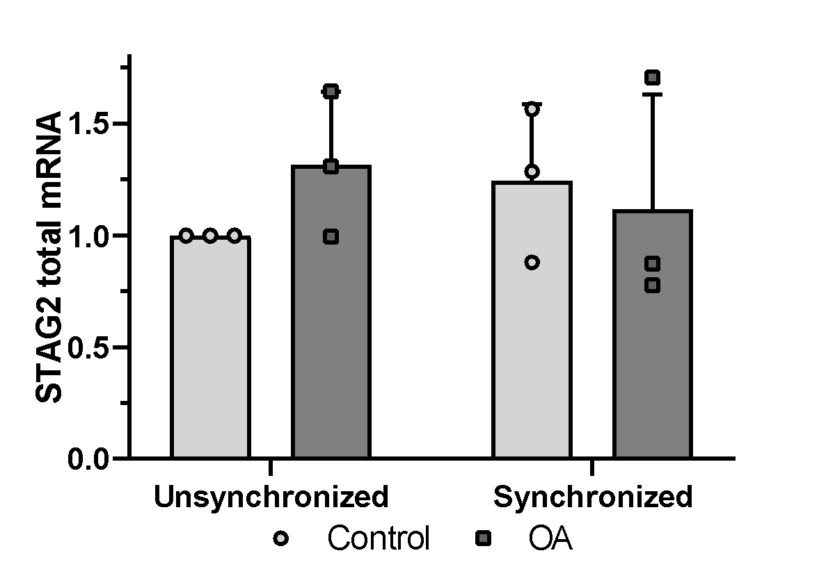
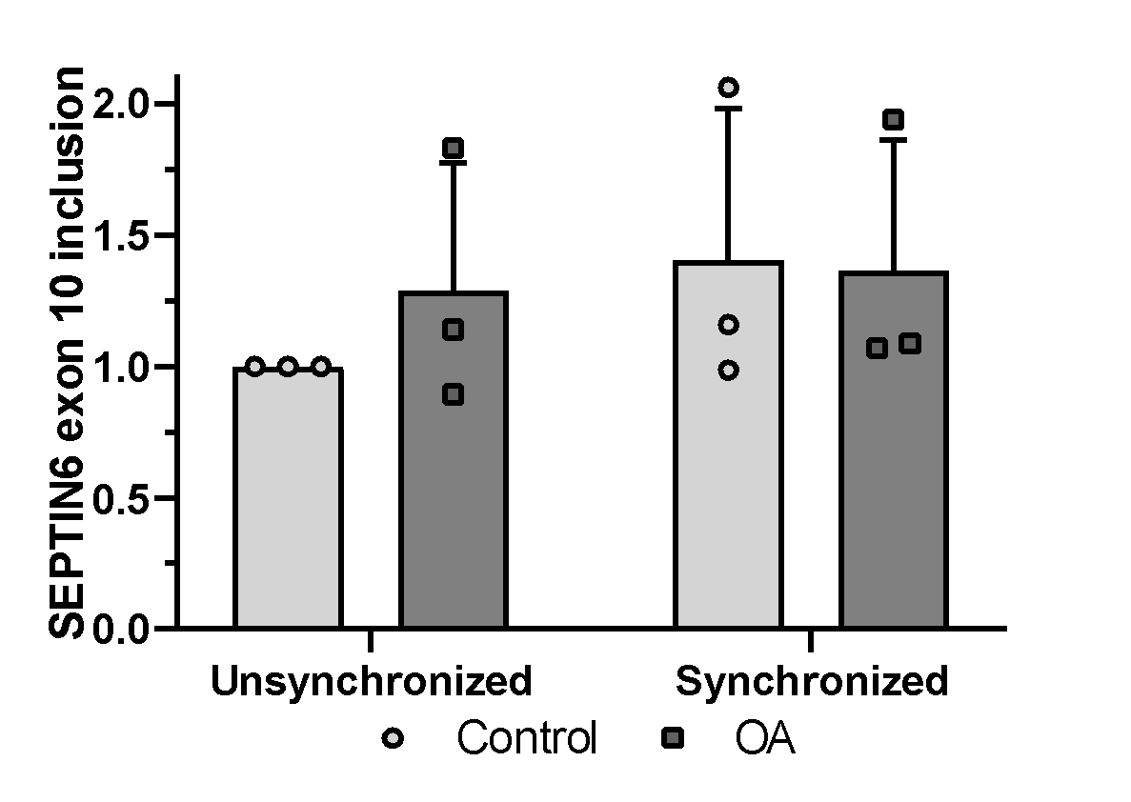
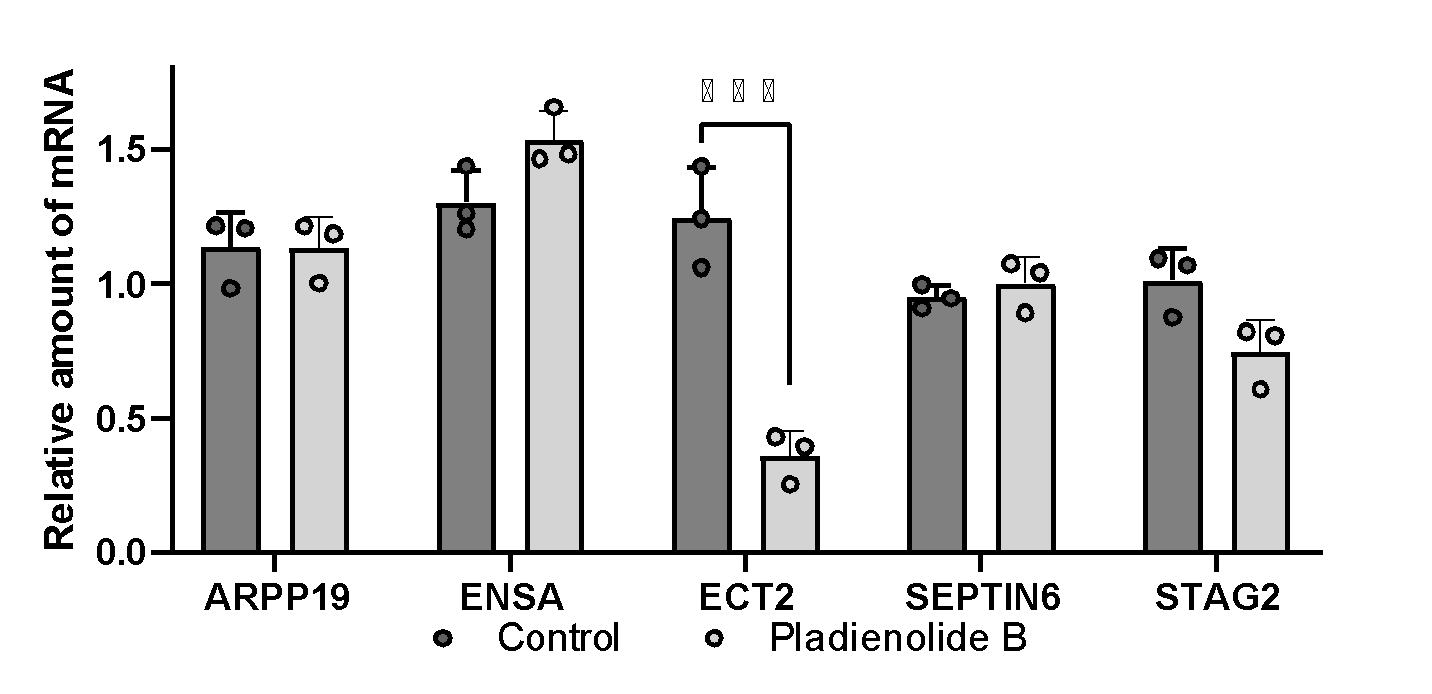
M
N
O
P
Q

Slide 12






Sup. Fig. 6
A
B
C
D
E
F

Slide 13









Sup. Fig. 7
GFP-empty
ENSA-short
A
ENSA-long
B
GFP
Tubulin
Nocodazole Release
C
G1: 2.62
S: 11.9
G2/M: 74.3
G1: 22.4
S: 21.1
G2/M: 60.9
Empty vector
G1: 0.57
S: 18.1
G2/M: 74.3
G1: 19.2
S: 17.3
G2/M: 66.6
ENSA-long
G1: 3.047
S: 29.7
G2/M: 67.3
G1: 21.8
S: 12.8
G2/M: 64.1
ENSA-short

