Slide 1
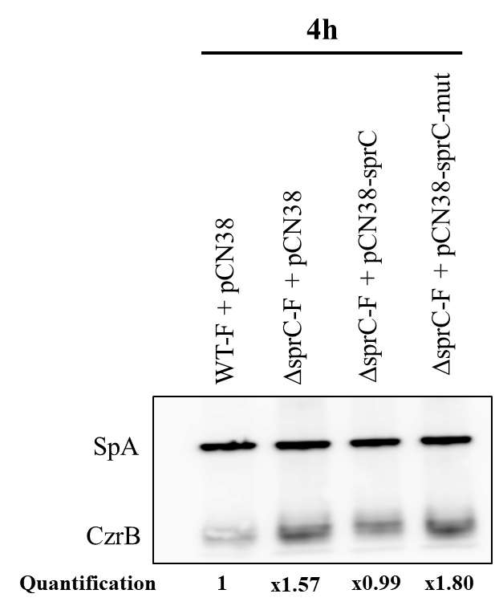
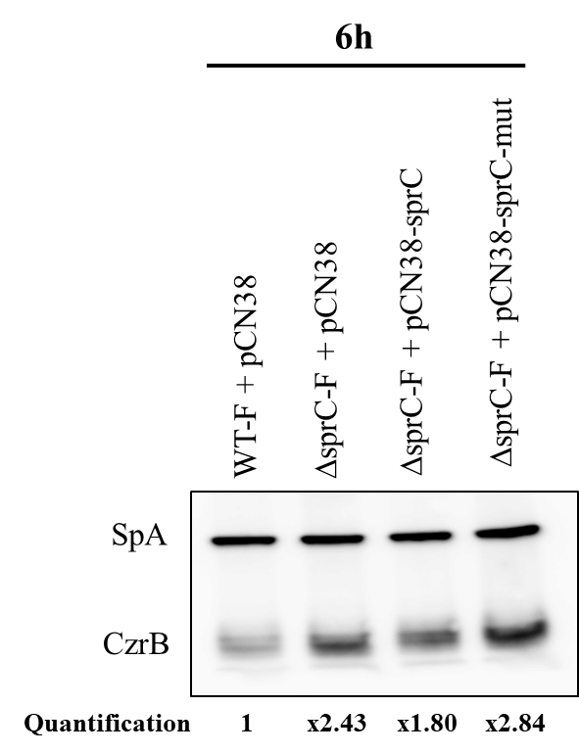
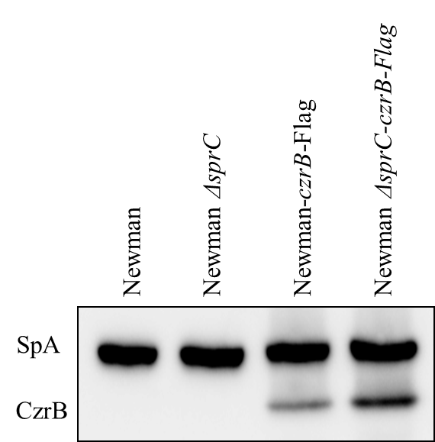
A
B
C
Supplemental Figure S6 : Western blot analysis of czrB expression level as a function of SprC expression. Western Blot analysis of czrB-FLAG expression level in membrane and wall fraction. Bacteria were grown for 2 h before an addition of 5 mM of ZnSO₄ and protein extractions were perform after (A) 4 h and (B) 6 h of additional growth. SpA was used as as an internal loading control. Values are the mean of four (4 h) and three (6 h) independent experiments. (C) Bacteria with or without Flag were grown for 4h with 3 mM of ZnSO₄ before protein extraction. The data presented is taken from one representative experiment among three.

