Slide 1
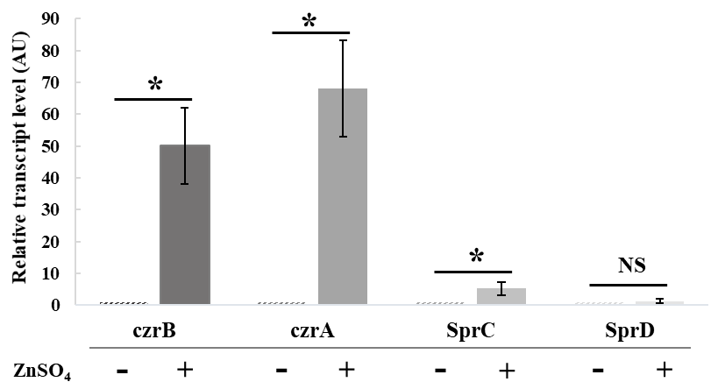
Supplemental Figure S5: Stress zinc experiments. Relative transcript level of czrB, czrA, SprC and SprD in presence or absence of ZnSO₄ (3 mM), determined with tmRNA as referent gene. The data were reproduced by four independent biological replicates with Welch test or Mann-Whitney test for statistical analysis (*p<0.05 ; NS = Non-Significant).

