Slide 1
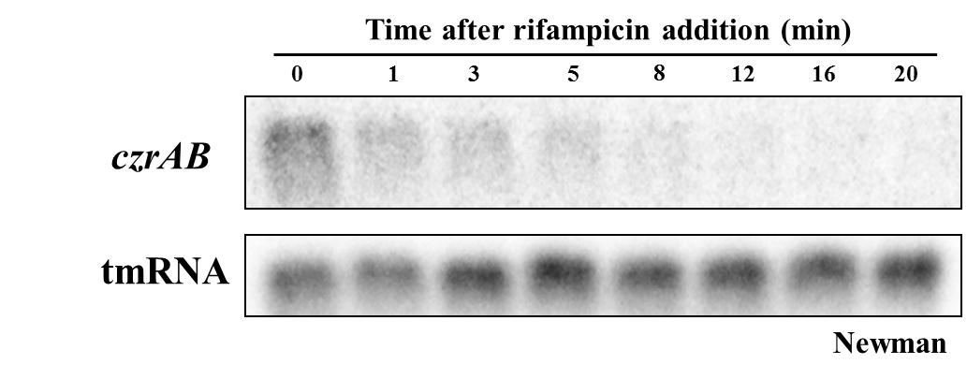
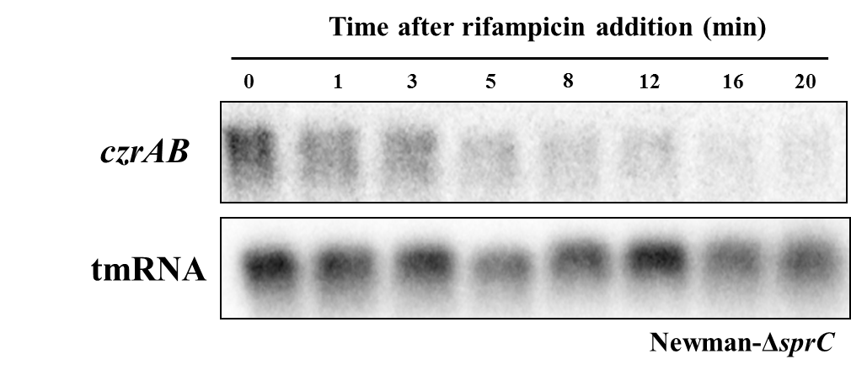
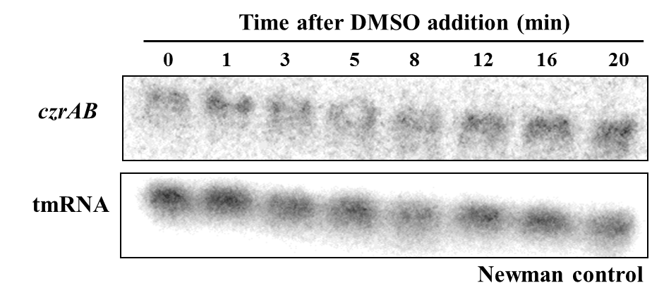
A
B
C
Supplemental Figure S4. Northern Blot analysis of czrAB transcript level after rifampicin addition (200µg/mL) in (A) Newman or (B) Newman-ΔsprC strain. (C) czrAB stability control without rifampicin. The data were reproduced by three independent biological replicates.

