Slide 1
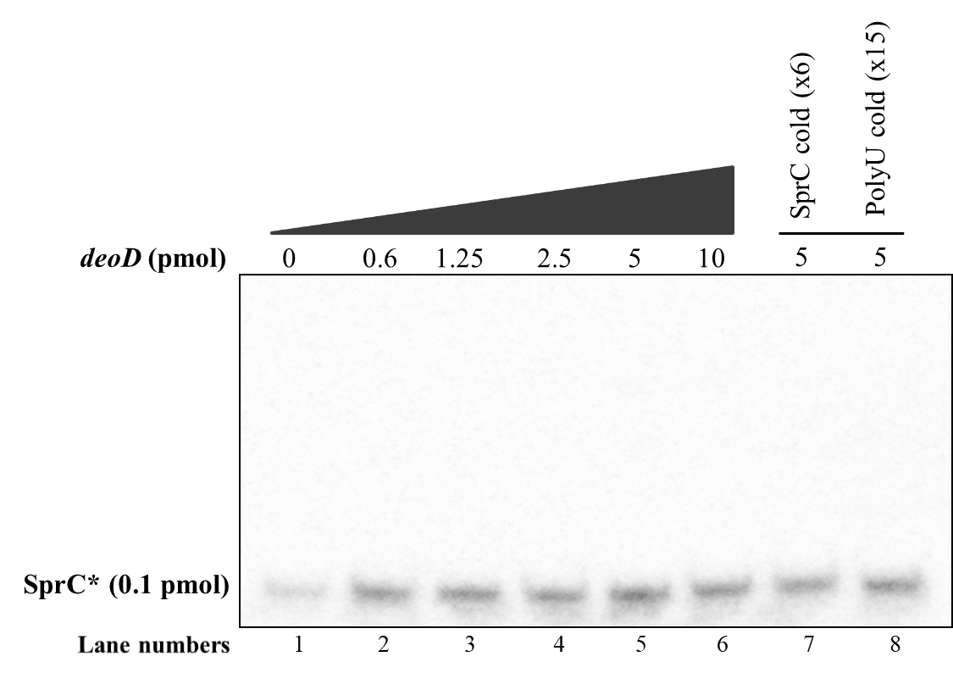
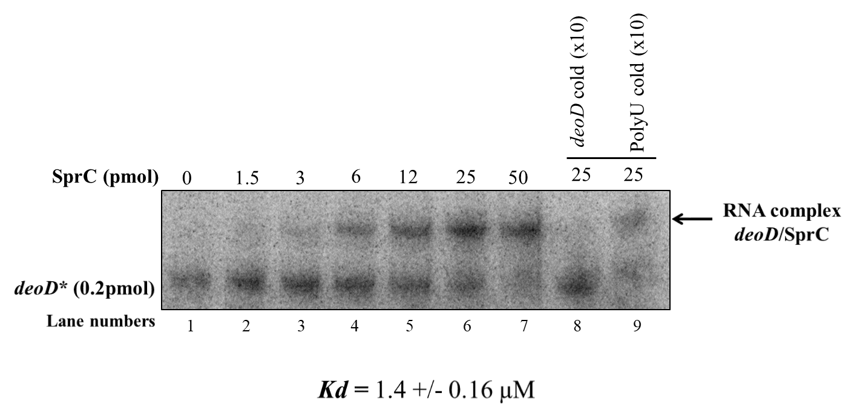
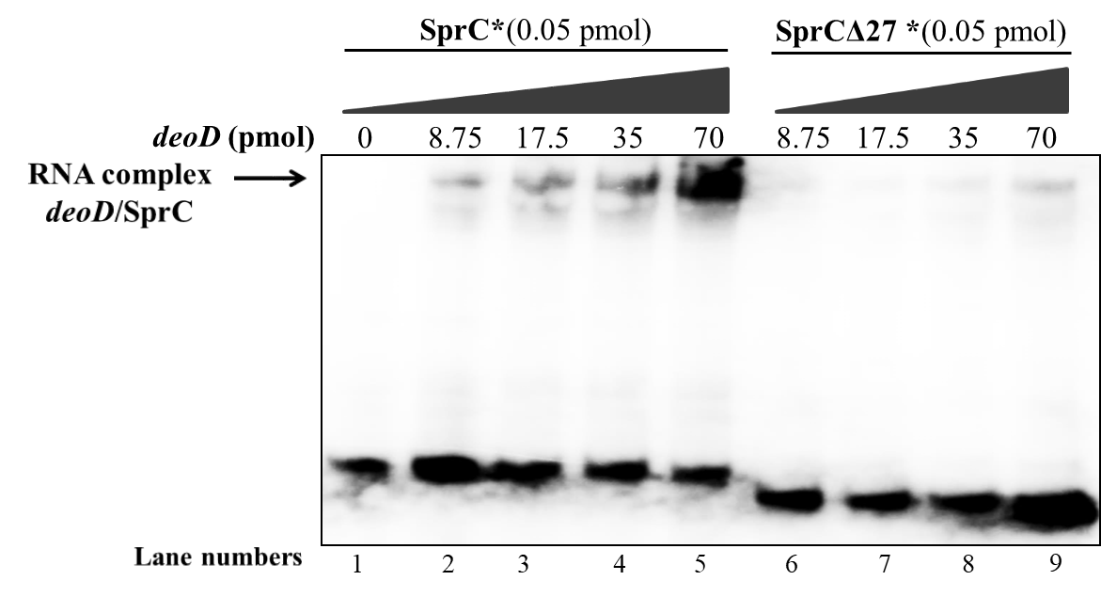
A
B
C
Supplemental Figure S3: Electrophoretic mobility shift assays to analyse pairing between SprC and deoD. (A) Gel retardation assay with radiolabeled SprC and deod transcript fragment (173 nts) (B) Gel retardation assay with radiolabelled deoD full lenght transcript (774 nts) and SprC. (C) Gel retardation assay with radiolabeled SprC or SprC deletion mutant and deoD mRNA (774 nts). The data were reproduced by three independent biological replicates.

