Slide 1
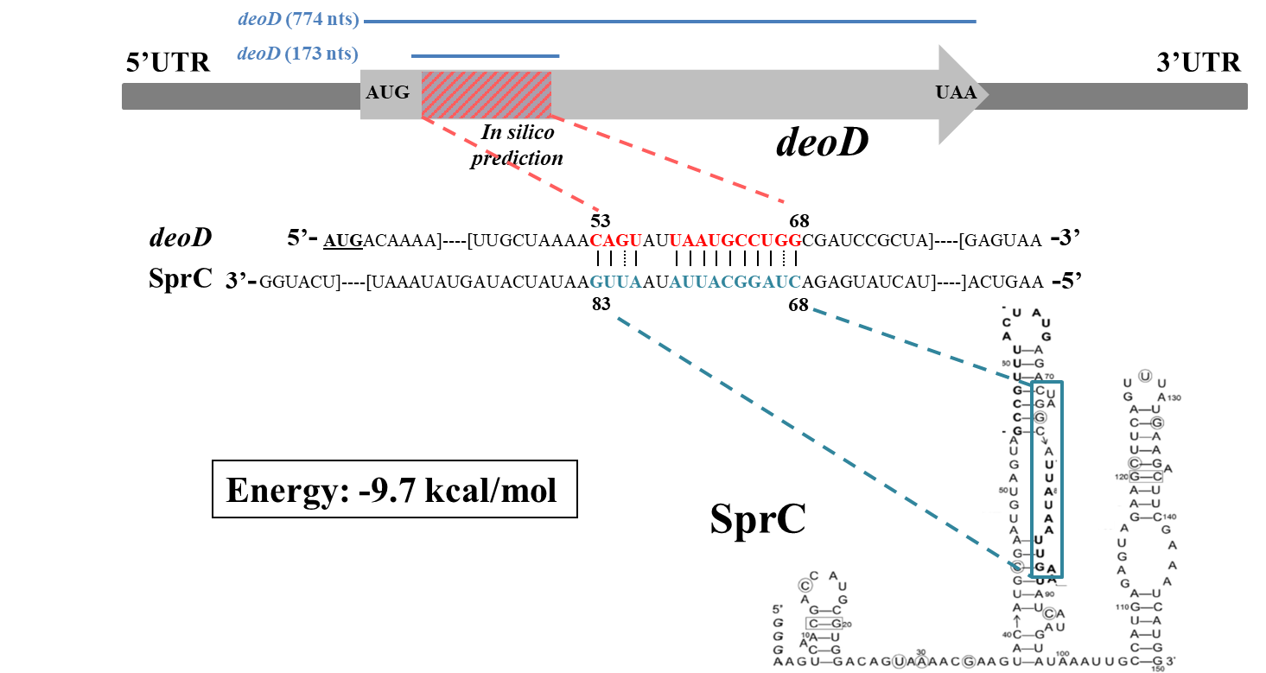
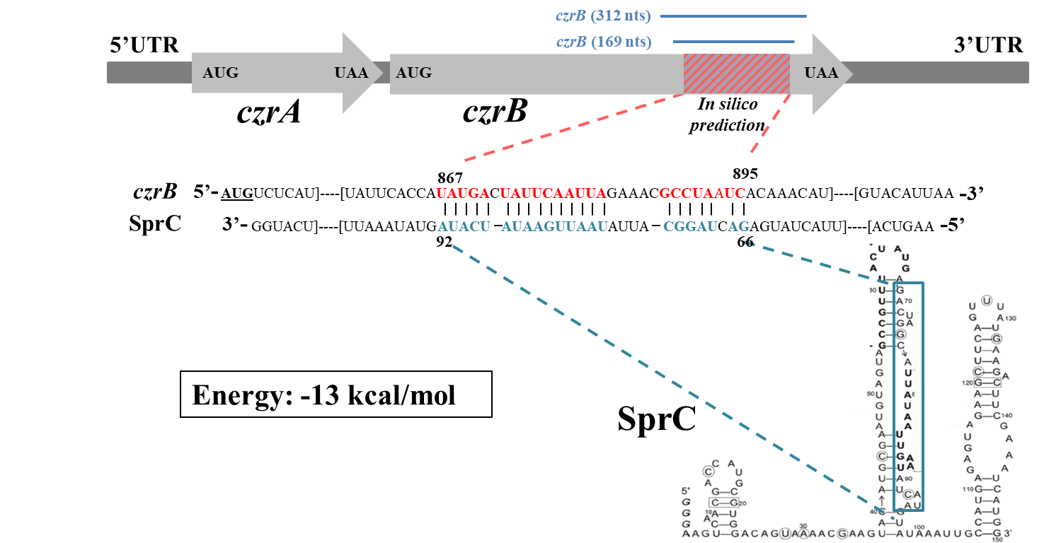
A
B
Supplementary Figure S2: In silico interaction prediction. Predicted interaction between SprC and (A) deoD or (B) czrB were generated by IntaRNA. In vitro transcription products are located above in blue. Secondary structure of SprC was obtained from Le Pabic et al. (PMID: 26240382)

