Slide 1
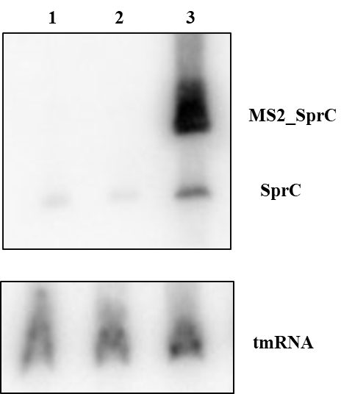
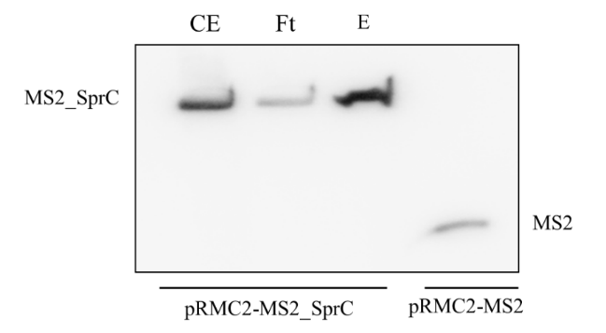
A
B
Supplementary Figure S1: (A) Northern blot showing the binding of MS2_SprC onto the amylose column. MS2 probes were used to detect the MS2_SprC construct in the different fractions (CE: Crude extract ; Ft: Flowthrough ; E:Elution). A control expressing only the MS2 tag was also used. (B) Northern blot showing MS2_Sprc fusion and endogenous SprC expression after 15 min anhydrotetracyclin induction.
1 = Newman ; 2 = Newman-pRMC2-MS2 ; 3 = Newman-pRMC2-MS2_SprC

