Slide 1
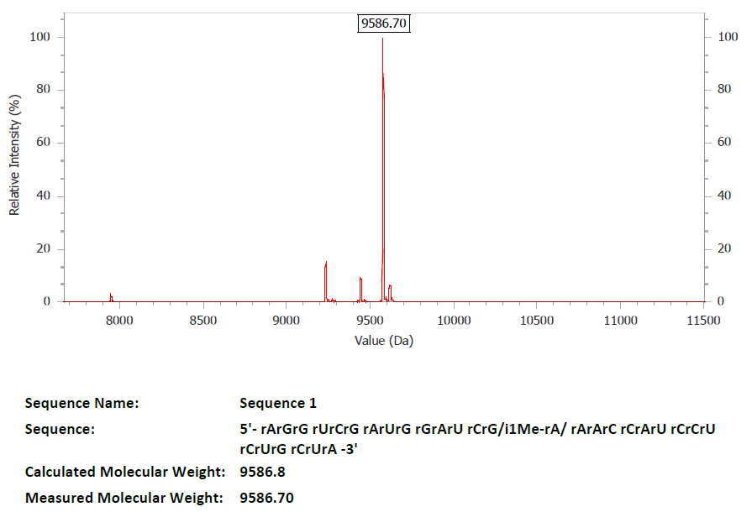
A
B
Figure S1. Additional analysis of the RNA templated ligation with A and m¹A RNA oligos in Fig. 2. (A) Relative ligation products of mixtures consisting of A- and m¹A-oligos, normalized to the sample with 100% A-oligo. Linear fit has a slope of 0.008±0.001, intercept 0.15±0.08, and r² of 0.90. (B). ESI-MS analysis of the m¹A-containing oligo.

Slide 2
A
B
Figure S2. Additional analysis of the RNA templated ligation with A2 and m¹A2 oligonucleotides in Fig. 3. (A) Relative ligation products of mixtures consisting of A2- and m¹A2-oligos, normalized to the sample with 100% A2-oligo. Linear fit has a slope of 0.01±0.001, intercept -0.01±0.03, and r² of 0.988. (B) Relative TL-qPCR product amounts of 5’ linker oligos with T, C, G, or A at the 5’ end. T-ending linker oligo with unmodified A2-oligo was used as the normalization control.

Slide 3
A
B
PF-*********CGAAT 5lkrT+5
PF-GTCTCACAT 5lkrT
CAGAGTGT"GCTTAACACAAAGCACCCA tRNA-mtVal-3p
CGAATTGTGTTTC-TR-PR
********GAGGGT-TR-PR
PF-ATCCTCTAAAGTT
ACACTTAGGAGATTTCAACTTAACTTGACCG tRNA-mtVal-5p
GAATTGAACTGGC-cy5-PR
PF-*********TTGTGCCT 5lkrT+4
PF-GGGCTGGGCAGAACT 5lkrT
ACCCACCCGACCCGTCTTG"AACACGGACCAAGGAGTCTAAACA tRNA-28s-3p
TTGTGCCTGGTTCCTC-TR-PR
********AGATTTGT-TR-PR
PF-CTCGCGTGCCC
GAGCGCACGGGGTCGGCGGCGAC tRNA-28s-5p
CAGCCGCCGCTG-cy5-PR
Figure S3. TL-qPCR of quantitation of human mitochondrial tRNA^{Val} m¹A9 and 28S rRNA m¹A1322. (A) Oligonucleotides and linkers used for the m¹A9 site of human mitochondrial tRNA^{Val} and m¹A1322 of human 28S rRNA. A separate pair of linkers (5p) were used as an internal control. (B) m¹A fraction for mt-tRNA^{Val} and 28S rRNA was determined to be 77±2% and 92±1%, respectively by TL-qPCR. Inset: modification index (MI) around these m¹A sites (±5nt) site measured by DM-tRNA-seq for mt-tRNA^{Val} (94%) and 28S rRNA (98%; sequencing data from NCBI GEO GSE66550).

