Slide 1
Supplemental figures

Slide 2
Suppl. Fig. 1
A
B

Slide 3
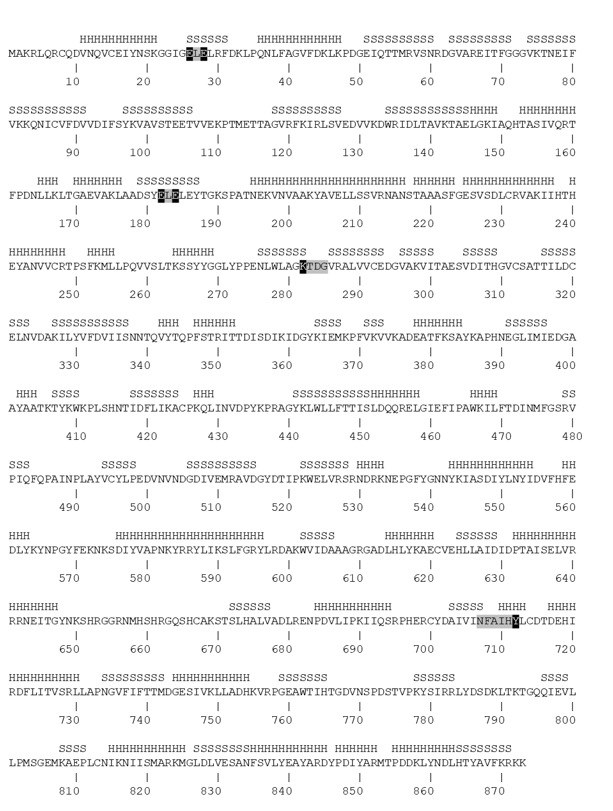
Suppl. Fig. 1
C

Slide 4
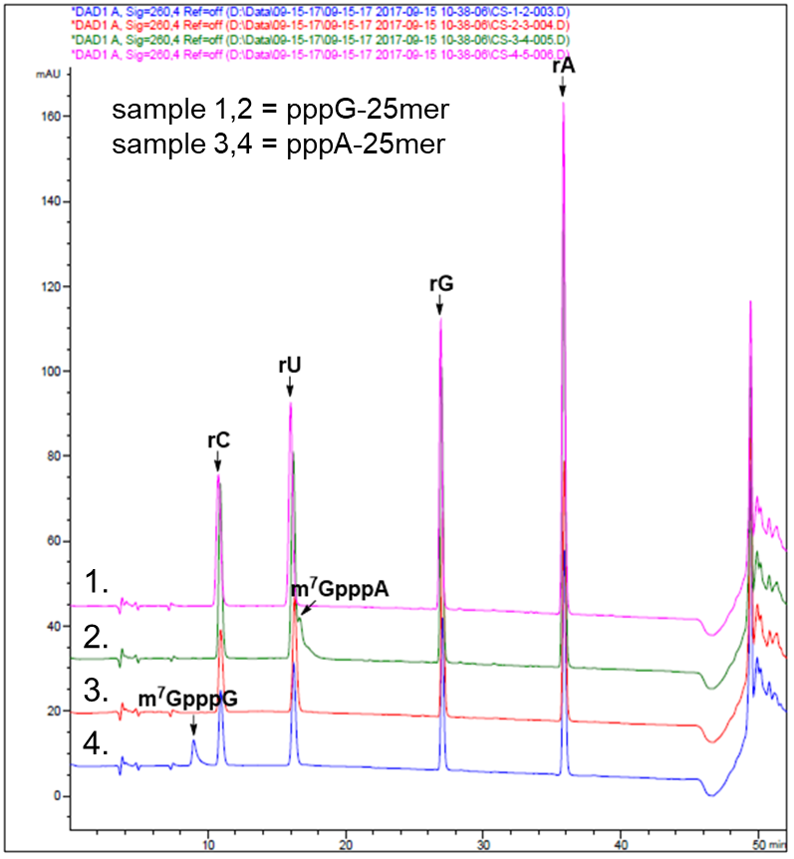
Suppl. Fig. 2A
 | FCE | m7GpppG | C | U | m7GpppA | G | A
Sample 1 | + | 1.055 | 6.000 | 6.023 | 0.000 | 5.331 | 6.637
Expected |  | 1 | 6 | 6 | 0 | 5 | 7
Sample 2 | - | 0.000 | 6.000 | 5.981 | 0.000 | 6.169 | 6.571
Expected |  | 0 | 6 | 6 | 0 | 6 | 7
Sample 3 | + | 0.000 | 6.000 | 6.081 | 0.784 | 4.973 | 6.652
Expected |  | 0 | 6 | 6 | 1 | 5 | 7
Sample 4 | - | 0.000 | 6.000 | 5.985 | 0.000 | 5.011 | 7.481
Expected |  | 0 | 6 | 6 | 0 | 5 | 8

Slide 5
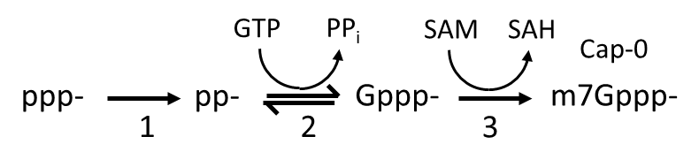
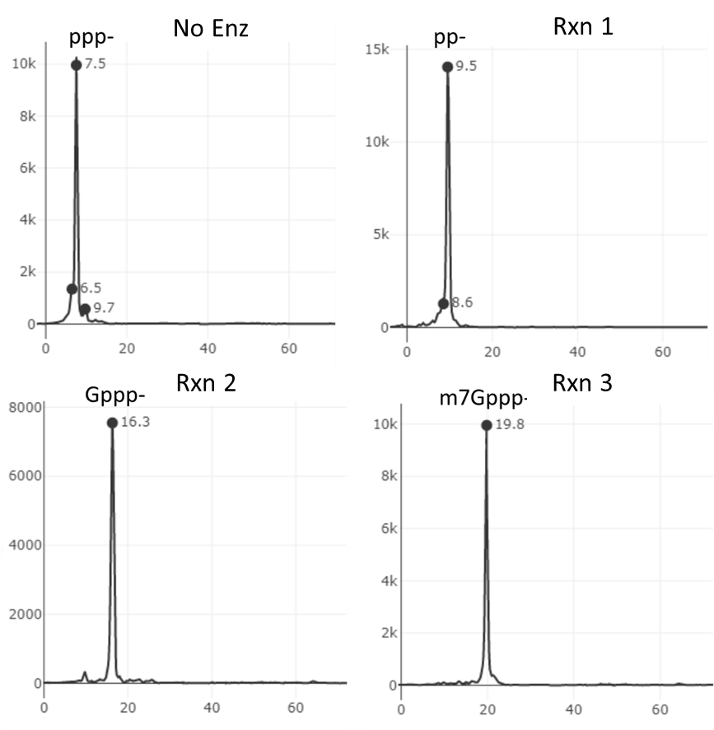
Suppl. Fig. 2B
Rxn | ppp25mer[FAM] | FCE | GTP | SAM | Expected product
No enz | + | - | - | - | ppp-
1 | + | + | - | - | pp-
2 | + | + | + | - | Gppp-
3 | + | + | + | + | m7Gppp-

Slide 6
Suppl. Fig. 3
SDS-PAGE analysis of the four FCE and VCE preparations
Ladder | FCE lot A | FCE lot B | VCE lot A | VCE lot B | Ladder
kDa
250 -
180 -
130 -
95 -
72 -
55 -
43 -
34 -
26 -
17 -
10 -

Slide 7
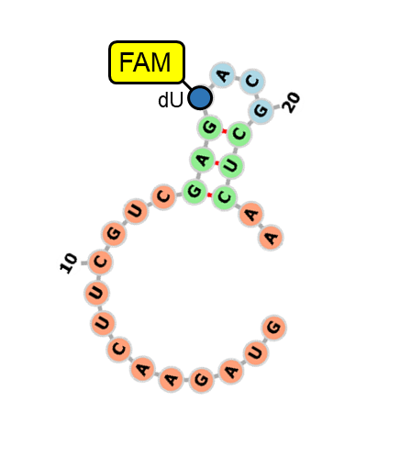
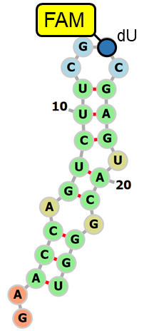
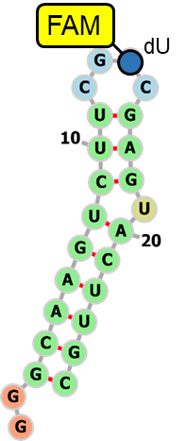
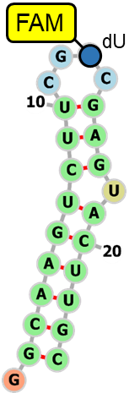
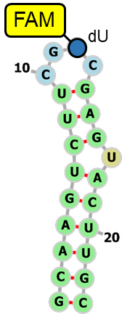
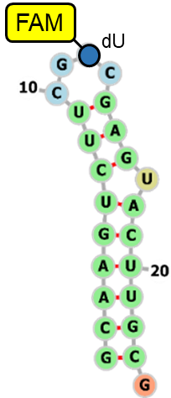
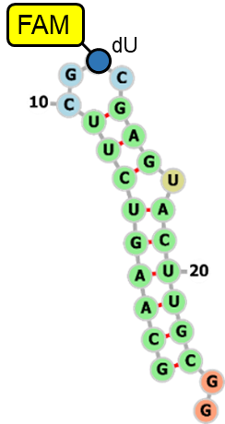
Suppl. Fig. 4
Detailed results of capping efficiency on structured RNA oligonucleotides.
FCE
VCE
Oligo | 1 | 2 | 3 | 4 | 5 | 6 | 7
MFE (kcal/mol) | -1.5 | -3.5 | -7.2 | -7.2 | -7.2 | -8.9 | -8.9
dT
dT
dT
dT
dT
dT
dT

Slide 8
Suppl. Fig. 5
One-pot Cap-1 incorporating using FCE and vaccinia 2’-O-methyltransferase.
FCE (nM) | 50 | 100 | 50 | 100
2’OMTase | - | - | + | +

