Slide 1
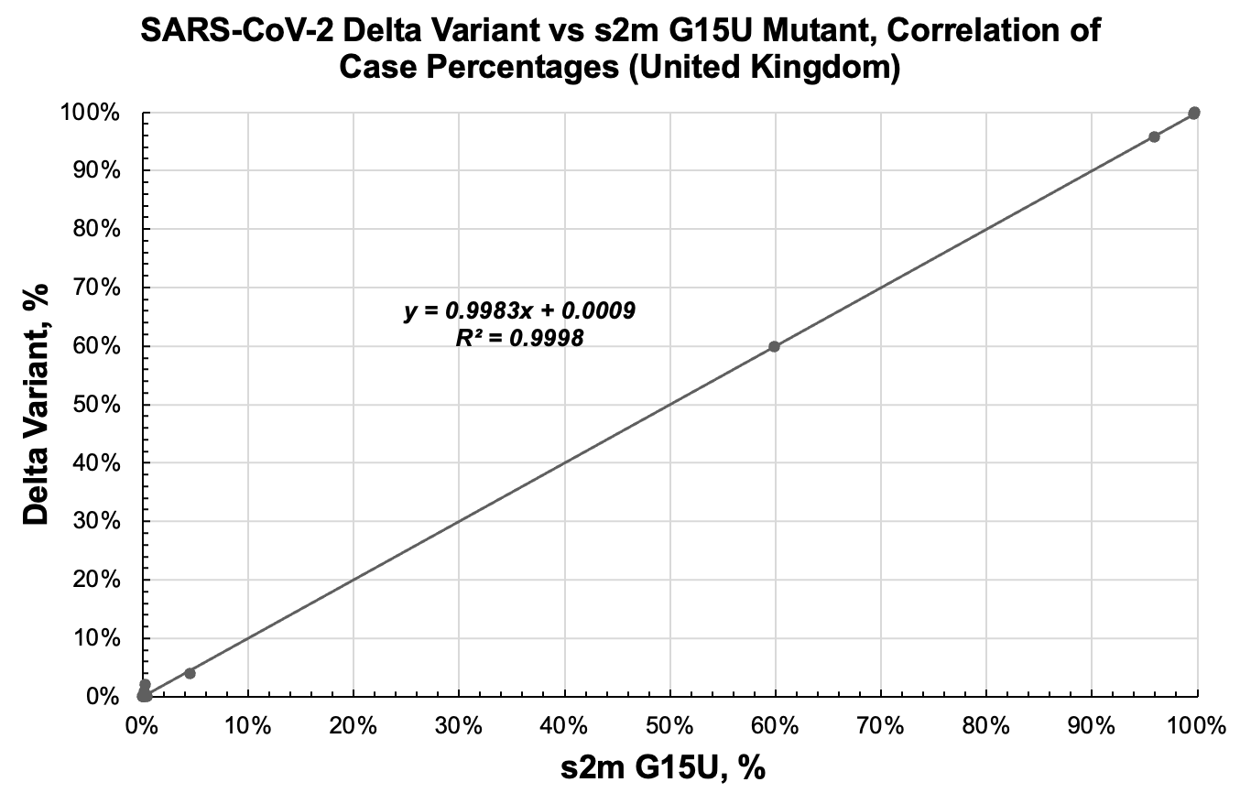
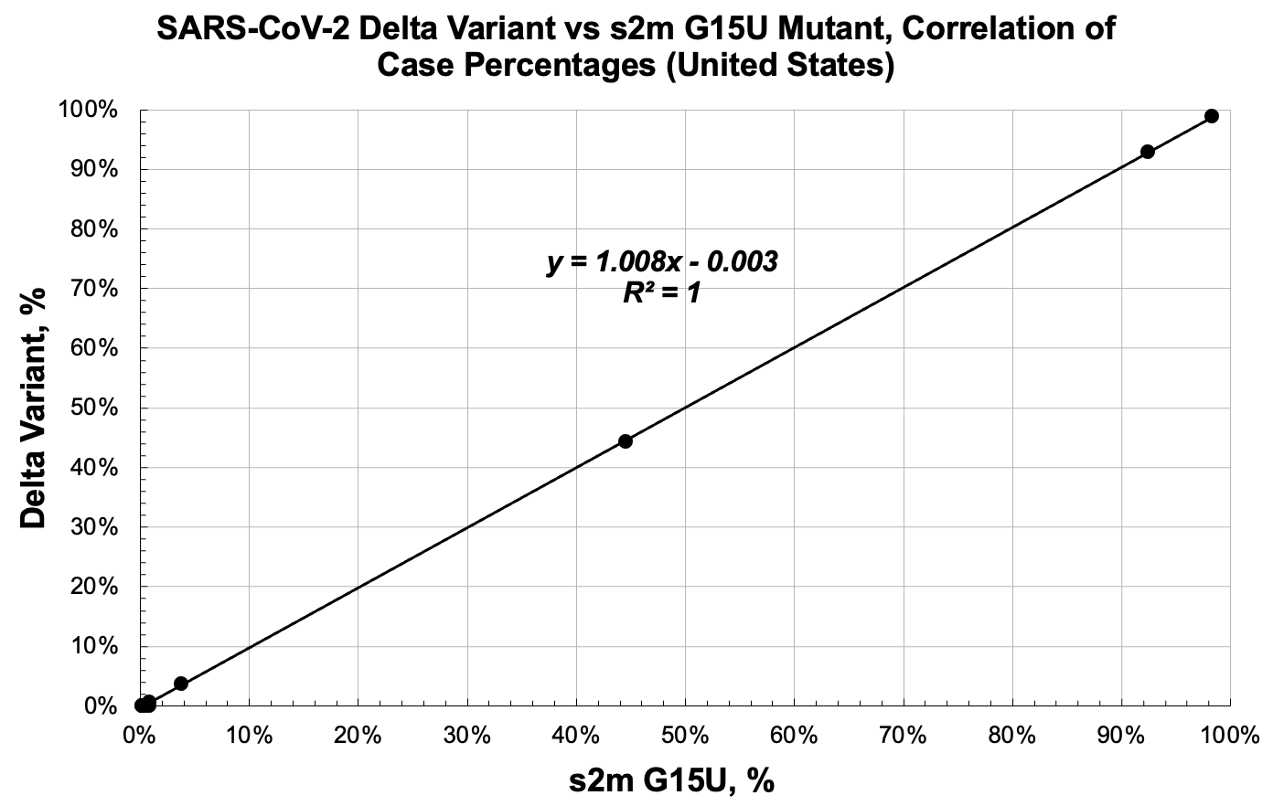
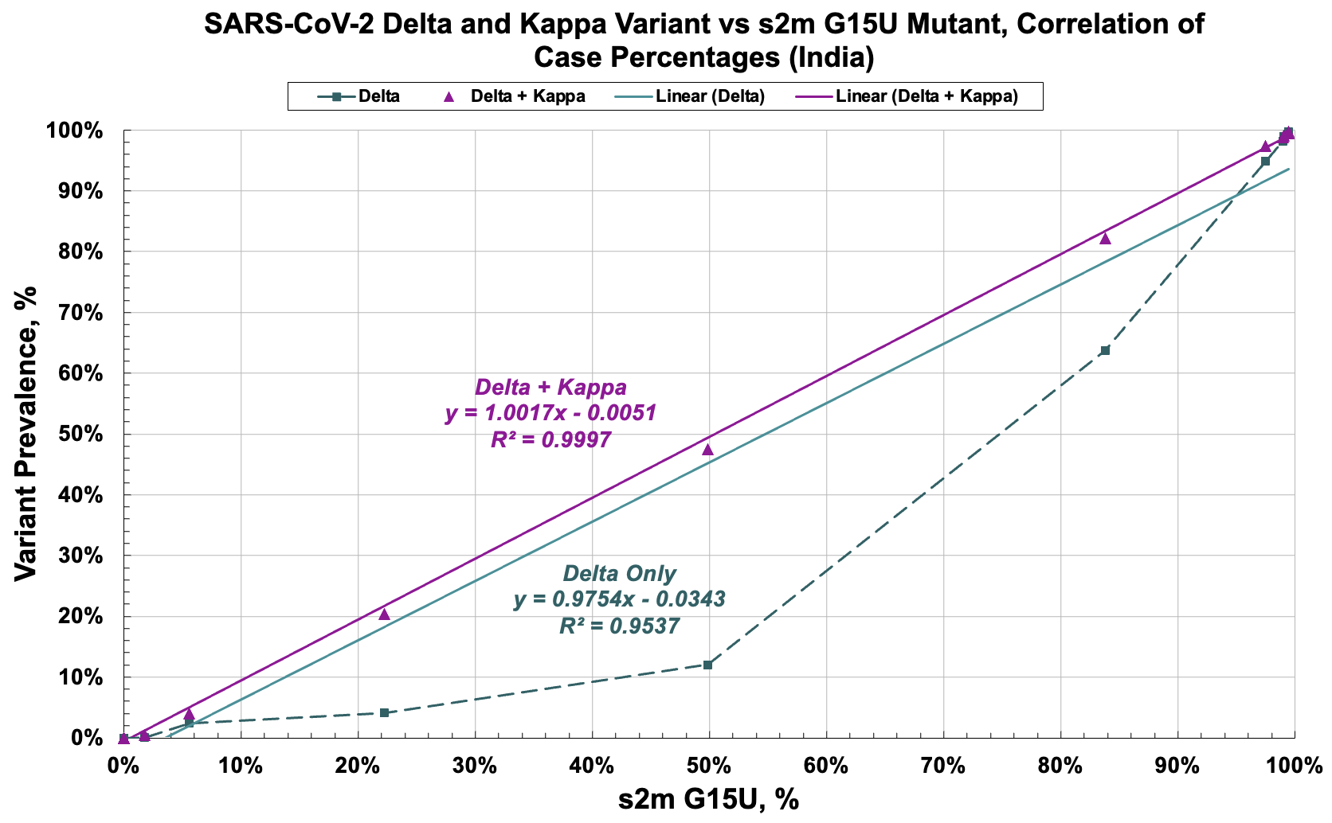
A
B
Supplemental Figure 1
C
Supplemental Figure 1: Correlation of the prevalence of the s2m G15U mutant and the Delta variant in the United Kingdom, United States, and India. The s2m G15U mutation and Delta prevalence, when plotted against another, reveal a strong correlation (R² = 0.9998, 1) for both the A) United Kingdom and B) United States, respectively. C) The s2m G15U and Delta prevalence revealed a positive correlation (R² = 0.9537, green) in India. Combination of the Delta and Kappa variants revealed a strong correlation (R² = 0.9997, purple) that mirrors those observed in the UK and US.

Slide 2
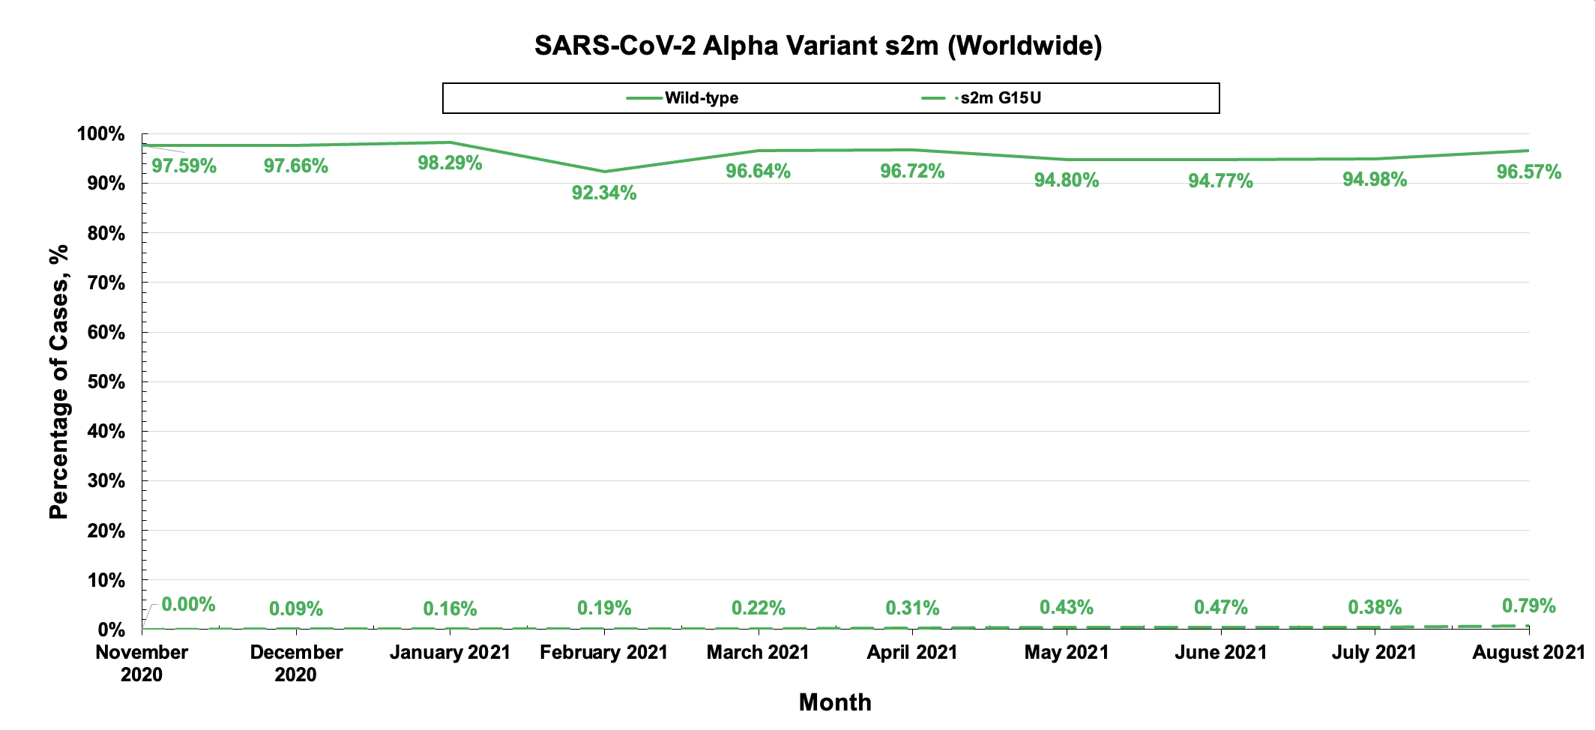
Supplemental Figure 2: Analysis of the s2m phenotype within the Alpha variant. Sequence analysis of the Alpha variant revealed that over time, Alpha comprised largely of the wild-type s2m and contained a small percentage of s2m G15U mutant.

Slide 3
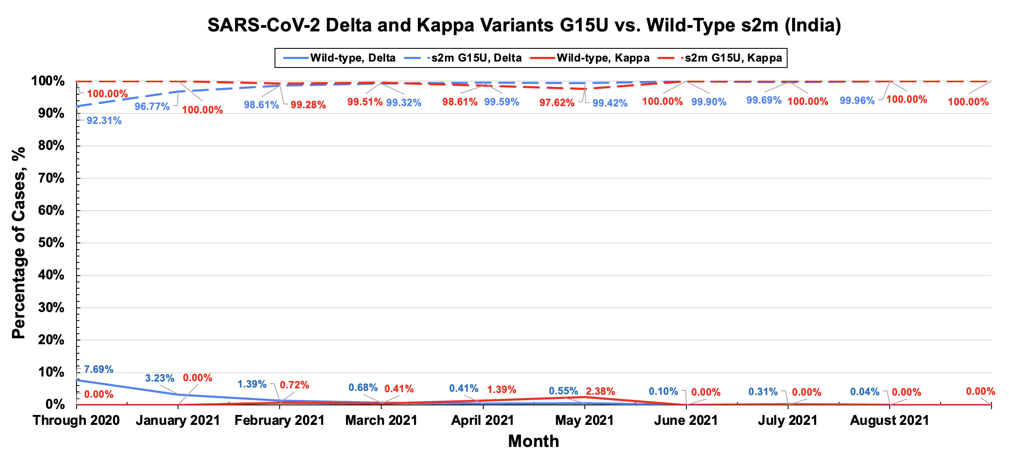
Supplemental Figure 3: Analysis of the s2m phenotype within the Delta and Kappa variants. Sequence analysis of the Delta and Kappa variants revealed that over time, both variants comprised largely of the s2m G15U mutant.

Slide 4
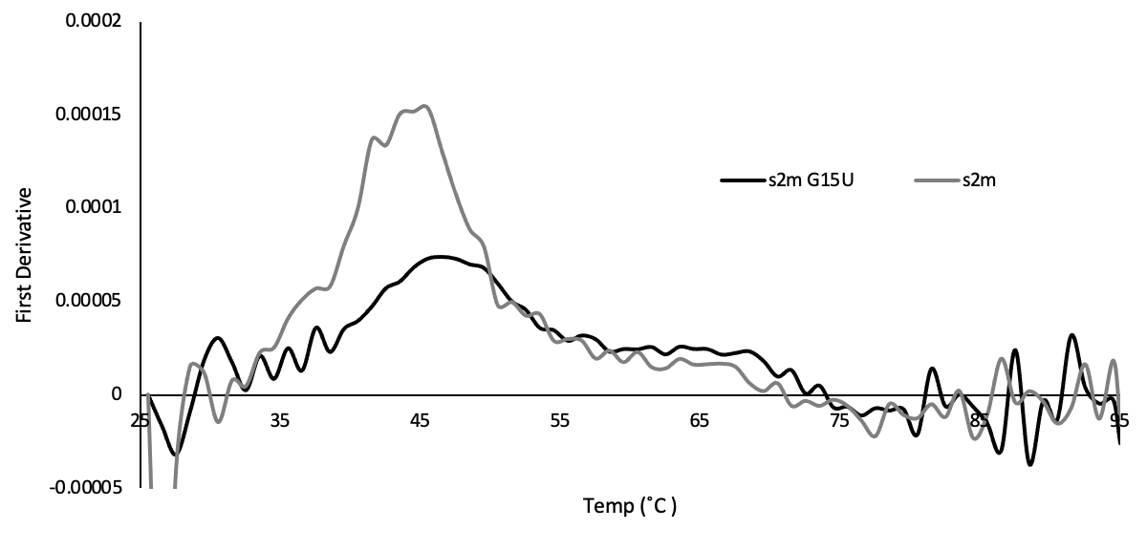
Supplemental Figure 4. First derivative data of UV thermal denaturation melt experiments for the
2m and s2m G15U.

