Slide 1
Consequences of depleting TNRC6, AGO, and DROSHA proteins on expression of microRNAs
SUPPLEMENTAL FIGURES
Krystal C. Johnson¹, Samantha T. Johnson², Jing Liu³, Yongjun Chu⁴, Carlos Arana⁵, Yi Han⁶, Tao Wang⁶, and David R. Corey¹

Slide 2
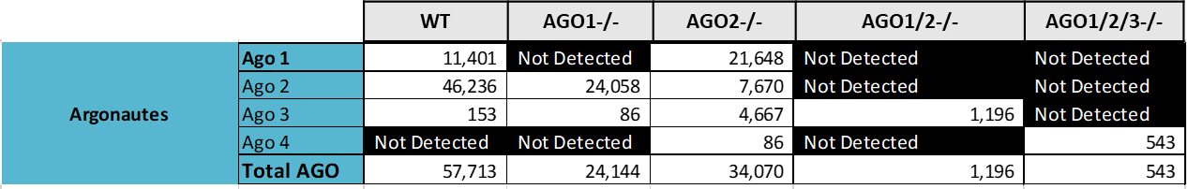
A
B
Supplemental Figure 1. (A) AGO4 mRNA expression level from whole cell RNA measured with whole transcriptome sequencing in HCT116 WT, AGO1-/-, AGO2-/-, AGO1/2-/-, and AGO1/2/3-/- cells (average of three biological replicates shown, whole transcriptome sequencing data from Chu et al. 2020). (B) Table describing semi-quantitative mass spectrometry results showing estimates of copy number per cell of AGO1, AGO2, AGO3, and AGO4 in HCT116 WT, AGO1-/-, AGO2-/-, AGO1/2-/-, and AGO1/2/3-/- cells.

Slide 3
Cell Line | RNA Integrity Number (RIN) | Hairpin Reads |  |  | Mature Reads
 |  | Mapped | Unmapped | Average Mapped | Mapped | Unmapped | Average Mapped
WT-1 | 10 | 1,241,453 | 2,596,056 | 1,188,383 | 2,914,161 | 3,698,136 | 2,770,099
WT-2 | 9.9 | 1,190,020 | 2,063,472 |  | 2,818,701 | 3,121,801
WT-3 | 10 | 1,133,676 | 2,778,649 |  | 2,577,435 | 3,772,466
WT-siTNRC6C-1 | 9.7 | 924,896 | 5,002,182 | 877,331 | 2,328,480 | 5,829,641 | 2,278,721
WT-siTNRC6C-2 | 9.8 | 839,177 | 4,354,293 |  | 2,200,438 | 5,102,894
WT-siTNRC6C-3 | 9.9 | 867,920 | 5,509,666 |  | 2,307,246 | 6,285,098
WT-siGL-1 | 9.7 | 961,881 | 3,102,320 | 1,015,762 | 2,389,127 | 3,948,630 | 2,560,588
WT-siGL-2 | 10 | 1,049,884 | 3,254,220 |  | 2,715,448 | 4,182,055
WT-siGL-3 | 9.4 | 1,035,522 | 3,432,661 |  | 2,577,188 | 4,346,786
AGO1KO-1 | 10 | 1,246,089 | 2,927,324 | 1,216,268 | 2,908,645 | 4,025,536 | 2,853,976
AGO1KO-2 | 10 | 1,176,193 | 2,124,019 |  | 2,696,887 | 3,160,239
AGO1KO-3 | 10 | 1,226,521 | 2,283,438 |  | 2,956,396 | 3,363,881
AGO2KO-1 | 10 | 1,229,026 | 2,175,239 | 1,128,661 | 2,559,208 | 3,291,328 | 2,389,085
AGO2KO-2 | 10 | 1,091,166 | 2,165,509 |  | 2,331,469 | 3,154,923
AGO2KO-3 | 10 | 1,065,790 | 1,901,273 |  | 2,276,577 | 2,867,319
AGO1/2KO-1 | 10 | 1,071,086 | 2,724,271 | 1,046,534 | 2,178,486 | 3,703,268 | 2,060,852
AGO1/2KO-2 | 10 | 981,581 | 3,392,742 |  | 1,945,672 | 4,287,033
AGO1/2KO-3 | 10 | 1,086,934 | 2,327,381 |  | 2,058,399 | 3,322,827
AGO1/2/3KO-1 | 10 | 789,422 | 3,183,939 | 801,701 | 1,324,122 | 3,905,127 | 1,382,294
AGO1/2/3KO-2 | 10 | 753,284 | 2,912,430 |  | 1,332,435 | 3,597,338
AGO1/2/3KO-3 | 10 | 862,398 | 2,783,925 |  | 1,490,326 | 3,571,722
TNRC6ABKO-1 | 9.9 | 1,053,427 | 4,065,333 | 1,198,046 | 3,027,992 | 5,006,402 | 3,434,959
TNRC6ABKO-2 | 9.4 | 1,069,406 | 5,950,065 |  | 2,832,625 | 6,899,871
TNRC6ABKO-3 | 9.9 | 1,471,305 | 2,532,066 |  | 4,444,261 | 3,838,375
TNRC6ABKO-siTNRC6C-1 | 9.9 | 1,065,536 | 6,098,167 | 957,097 | 2,977,508 | 7,026,554 | 2,666,311
TNRC6ABKO-siTNRC6C-2 | 9.4 | 935,352 | 9,676,080 |  | 2,588,547 | 10,493,056
TNRC6ABKO-siTNRC6C-3 | 9.9 | 870,403 | 10,262,574 |  | 2,432,878 | 11,032,480
TNRC6ABKO-siGL-1 | 9.8 | 1,283,843 | 3,801,590 | 984,056 | 3,666,018 | 4,934,676 | 2,712,357
TNRC6ABKO-siGL-2 | 9.8 | 853,069 | 3,392,062 |  | 2,310,178 | 4,144,931
TNRC6ABKO-siGL-3 | 10 | 815,255 | 4,336,094 |  | 2,160,874 | 5,061,393
DROSHAKO-1 | 9.6 | 83,227 | 4,074,953 | 87,629 | 197,912 | 4,148,445 | 215,102
DROSHAKO-2 | 9.4 | 91,455 | 5,855,500 |  | 233,584 | 5,935,849
DROSHAKO-3 | 9.5 | 88,206 | 4,325,593 |  | 213,811 | 4,402,731
Supplemental Table 1. Quality of Input RNA and Depth of Small-RNA-Sequencing. (A) Table describing mapped and unmapped hairpin/mature reads from small-RNA-sequencing of HCT116 WT, WT + siTNRC6C, WT + siGL, AGO1-/-, AGO2-/-, AGO1/2-/-, AGO1/2/3-/-, TNRC6AB-/-, TNRC6AB-/- + siTNRC6C, and Drosha-/- generated with MultiQC (N=3, each replicate shown). RNA Integrity Number for each sample is listed from Bioanalyzer measurement.

Slide 4
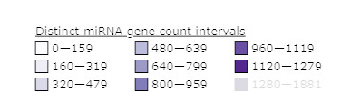
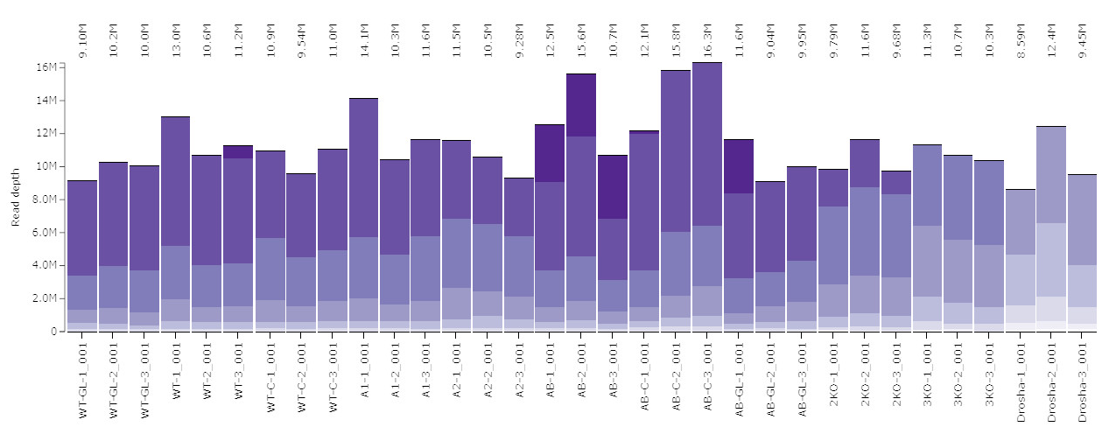
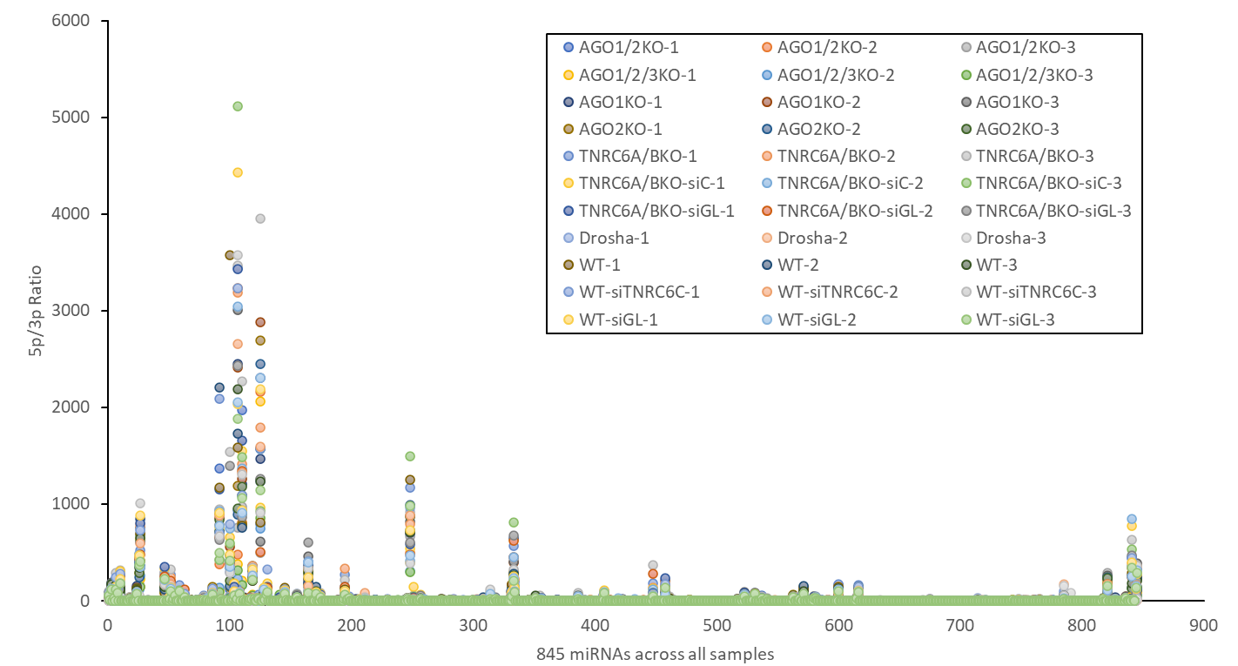
A
B
C
Supplemental Figure 2. Clustering of Samples Based on Small-RNA-Sequencing Results. (A) Plot of Multi-Dimensional Scaling (MDS) analysis describing small-RNA-sequencing of HCT116 WT, WT + siTNRC6C, WT + siGL, AGO1-/-, AGO2-/-, AGO1/2-/-, AGO1/2/3-/-, TNRC6AB-/-, TNRC6AB-/- + siGL TNRC6AB-/- + siTNRC6C, and DROSHA-/- generated with MultiQC (N=3, each replicate shown). (B) Graph generated with miRTools to show that the relative ratio of miRNA composition from small-RNA-seq is maintained across different samples. Shading corresponds to miRNA gene count intervals that show detection of miRNAs across different expression levels based on specified ranges of sequencing read counts. (C) Ratio of expression of 5p to 3p strand for 845 miRNAs across all samples.

Slide 5
A
B
Supplemental Figure 3. (A) CT values from RT-qPCR analysis of expression of three microRNAs in WT HCT116 and DROSHA-/- HCT116. Average of three replicates shown. (B) Comparison of differential expression of three microRNAs in DROSHA-/- relative to WT from RT-qPCR and small-RNA-sequencing.

Slide 6
A
B
C
D
E
Notes:
**Important to highlight why we chose these microRNAs as candidates for AGO-dependent stability:
Let-7a and miR-21 are the very top of the list for AGO1 and AGO2 pull-down (most closely-associated with the most abundant AGO paralogs; Fig. 7 & Table 1)
miR-27a is one of the most abundant and is in the top 60 list for AGO1 and AGO2 pull-down (Fig 7 & Table 1)
miR-17 is top 100 AGO2-eCLIP, one of the largest log2FC and most significantly reduced miRNAs after AGO1/2/3 deletion (Fig 2B), but not in top 60 AGO1/AGO2 pull-down

Slide 7
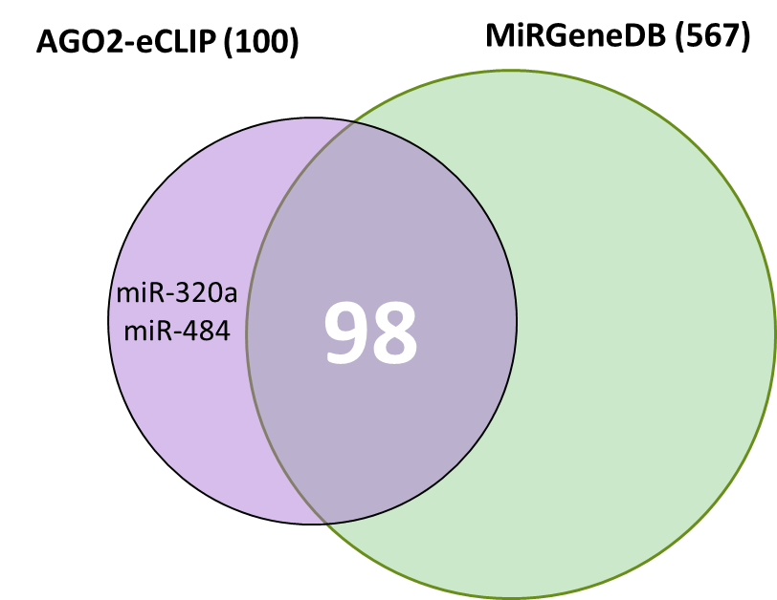
F
 | log2FC(Drosha-/-/WT) | Adjusted p-value (padj) | Drosha-dependent? (Kim 2021 | Annotated on MirGeneDB | WT HCT116 (Reads, TPM) |  |  | Drosha-/- HCT116 (Reads, TPM)
miR-3529 | -12.02 | 5.01E-23 | Not yet determined |  | 480 | 498 | 540 | 0 | 0 | 0
miR-484 | 3.04 | 2.46E-153 | DROSHA-independent, Capped miRNA |  | 1,967 | 1,897 | 2,294 | 125,313 | 104,374 | 122,674
miR-429 | -12.53 | 4.59E-33 | Not yet determined | Yes | 2,647 | 2,658 | 2,419 | 5 | 0 | 5
miR-142 | -4.98 | 1.19E-04 | Not yet determined | Yes | 49 | 41 | 44 | 0 | 0 | 0
miR-320a | 2.54 | 2.62E-84 | DROSHA-independent, Capped miRNA |  | 1,739 | 1,727 | 1,740 | 74,882 | 68,138 | 70,109
G
H
I
Supplemental Figure 4. Drosha-dependent miRNAs in different RNAi KO Cell Lines. (A) Plot of all detected miRNA reads in transcripts per million in Drosha-/- and WT cells. The color of each dot represents the log2 fold-change of each miRNAs in Drosha-/- relative to WT. (B) Plot of reads for all miRNAs (miRBase) that were upregulated in Drosha-/- relative to WT. (C) Volcano plot showing differential expression in Drosha-/- relative to WT of all miRNAs listed on MirGeneDB and annotated as Drosha-dependent, Drosha-independent, or not yet determined by Kim et al., 2021. (D) Volcano plot showing differential expression in Drosha-/- relative to WT of miRNAs that were listed on MirGeneDB and annotated as not yet determined as Drosha-dependent by Kim et al., 2021. (E) miRNA expression based on reads (TPM) in Drosha-/- and WT HCT116 for all miRNAs shown in Supp. Fig. 2J. (F) Table showing information about the 5 miRNAs highly associated with AGO2 (Top 100 AGO2-eCLIP, Chu et al., 2020) that were reported Drosha-independent or not yet determined (Kim et al., 2021). (G) Bar graph showing reads (TPM) detected for the 5 miRNAs from Table S2E in WT HCT116 and Drosha-/- cells. (H) Plot of relative abundance and differential expression of miRNAs that were reported as not yet determined for Drosha-dependency (1,313 total, Kim et al., 2021). (I) (F) Venn diagram showing overlap between miRNAs highly associated with AGO2 (Top 100 AGO2-eCLIP, Chu et al., 2020) and miRNAs that were annotated on MirGeneDB (Fromm et al., 2022).

Slide 8
A
B
C
Supplemental Figure 5. (A) Volcano plot, similar to Main Figure 3D, where pink dots represent differential expression of miRNAs that were reported as Drosha-dependent (Kim et al., 2021) in TNRC6AB-/- HCT116 transfected relative to WT HCT116. (B) Plot of detected miRNA reads for all Drosha-dependent miRNAs (Kim et al., 2021) in TNRCAB-/- + siTNRC6C relative to WT + siGL2. The color of each dot represents the significance of the miRNA expression change as negative log10 of the adjusted p-value. (C) Differential expression levels of miR-486-3p, passenger strand of miR-486 duplex, in AGO1-/-, AGO2-/-, AGO1/2-/-, and AGO1/2/3-/- relative to WT. Adjusted p-values are labeled above each bar.

Slide 9
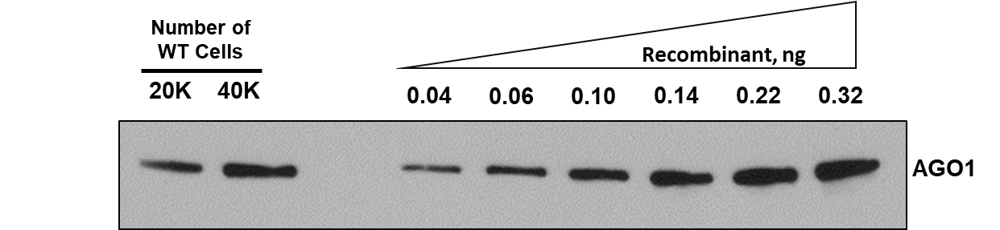
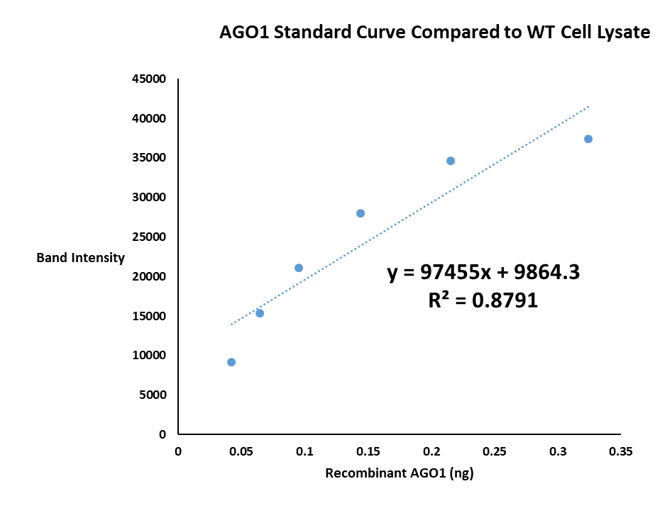
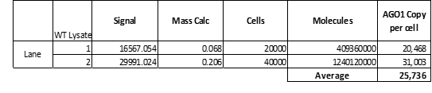
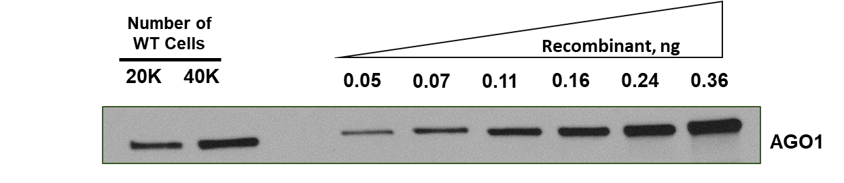
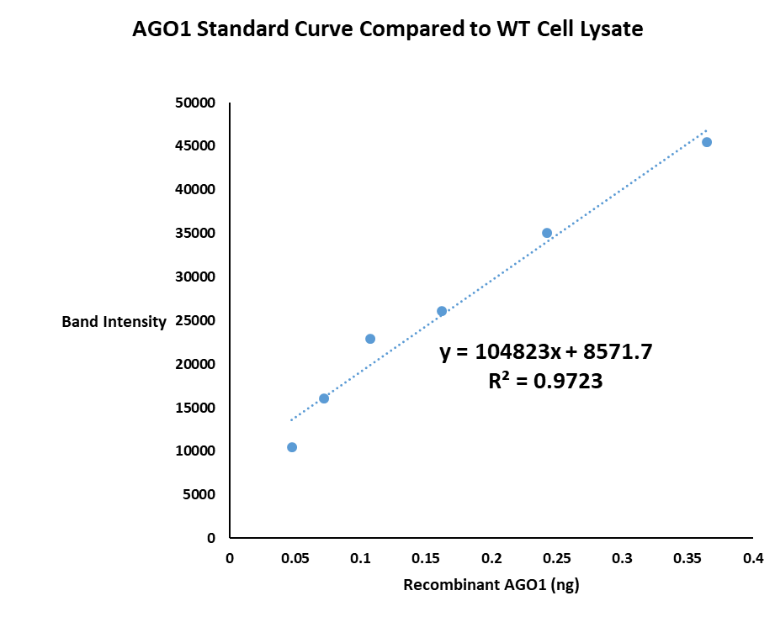

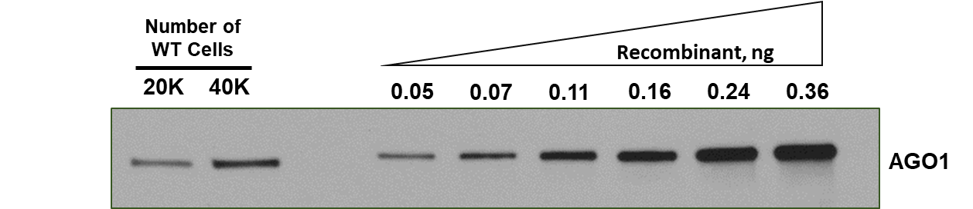
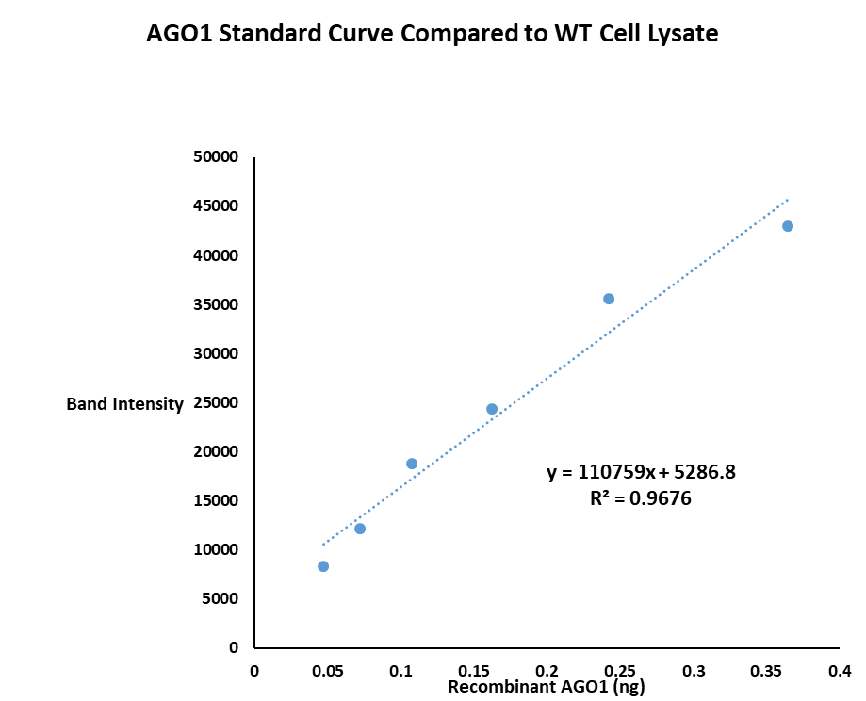
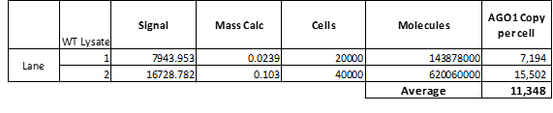
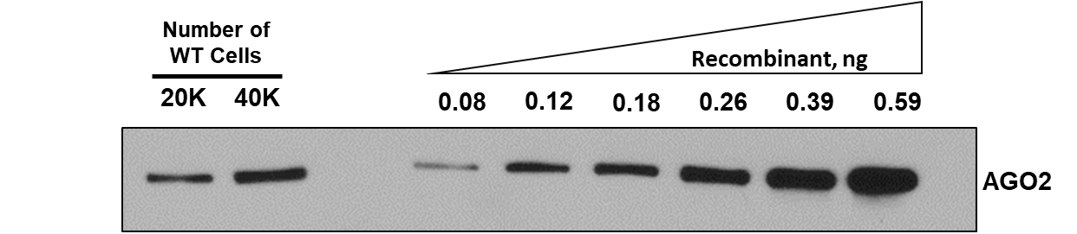
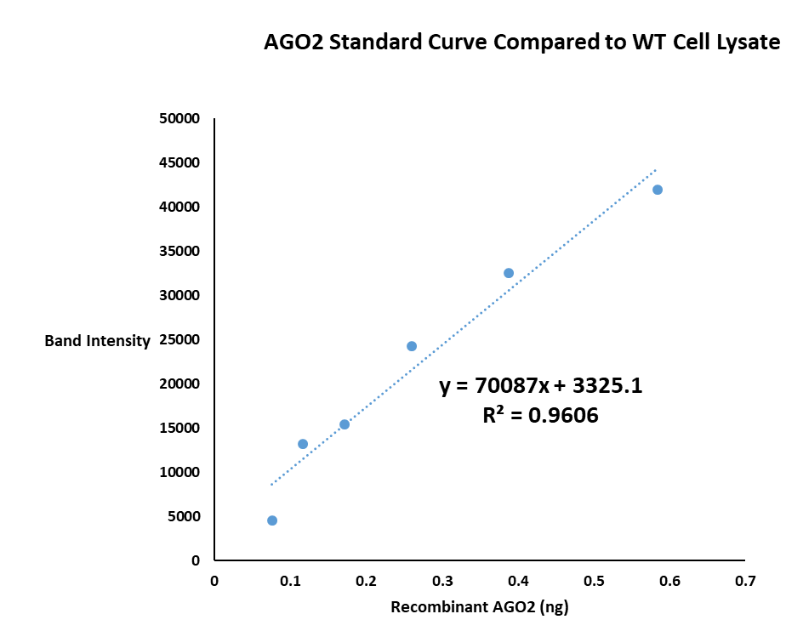

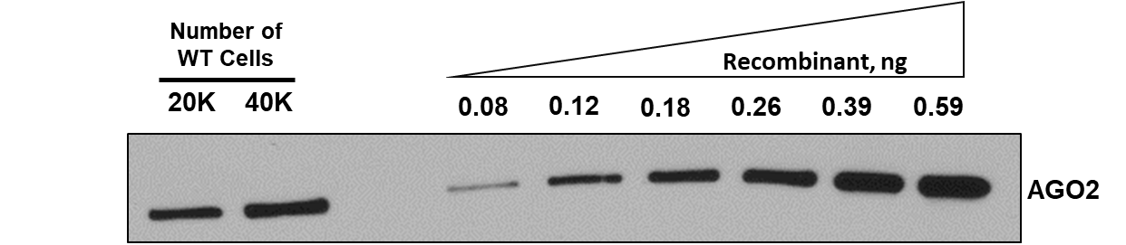
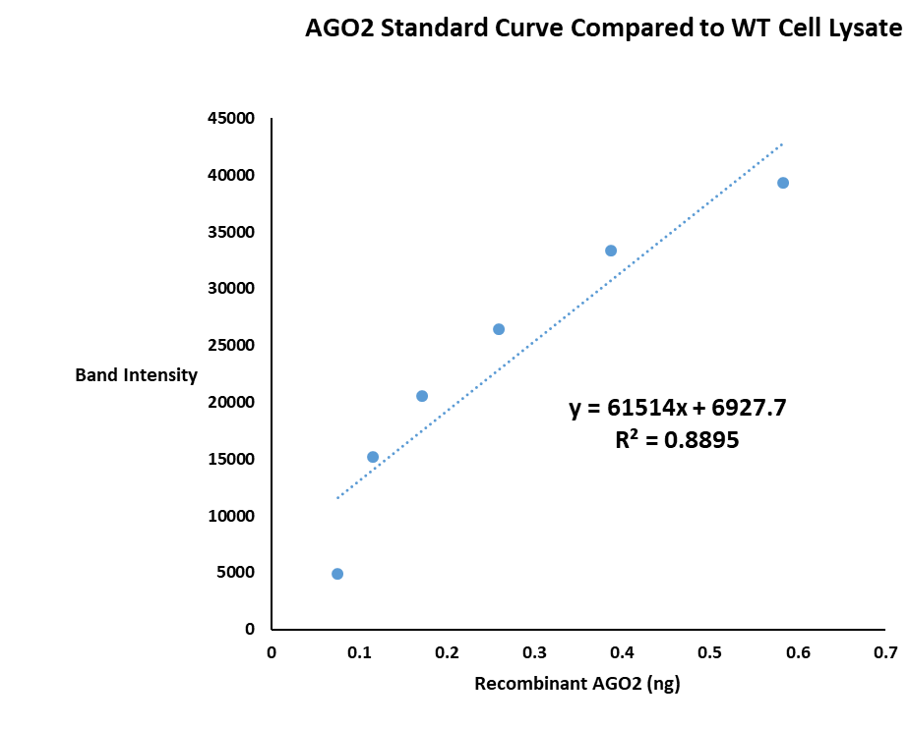

A
B

Slide 10
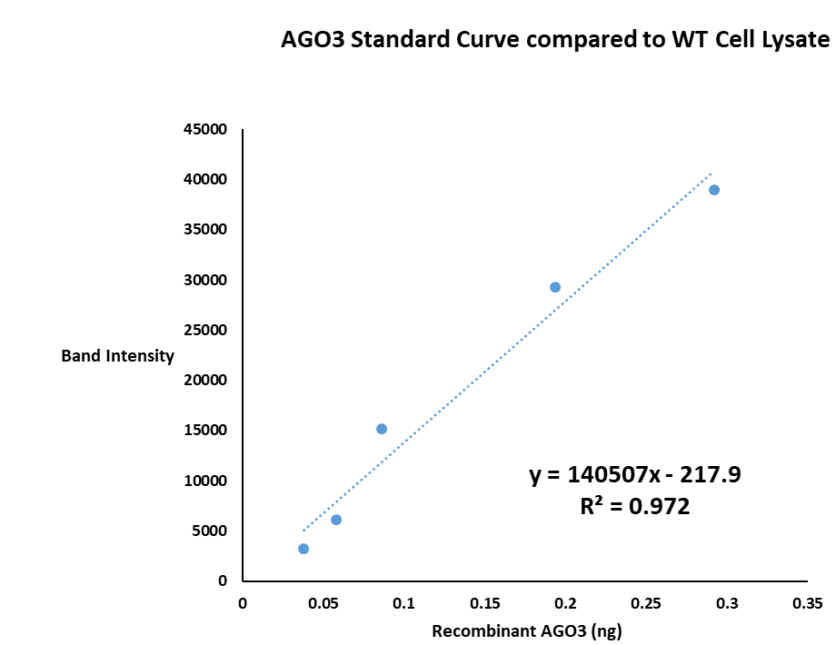
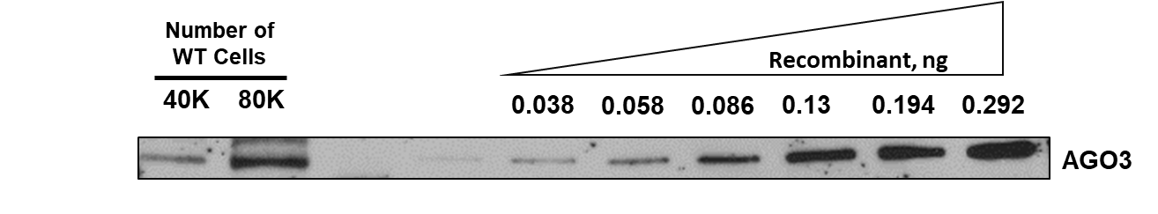
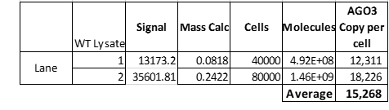
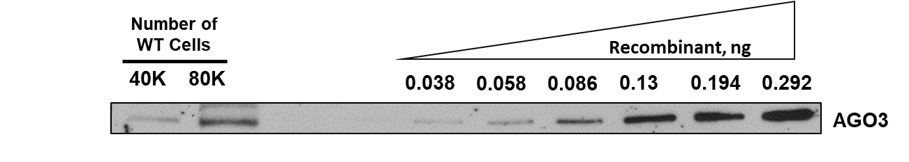
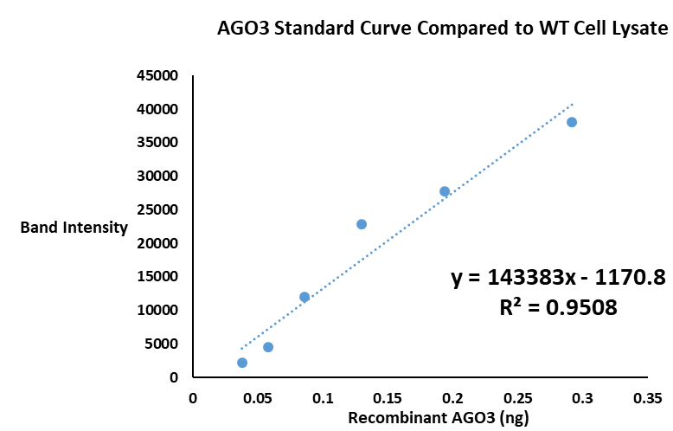
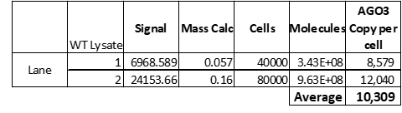
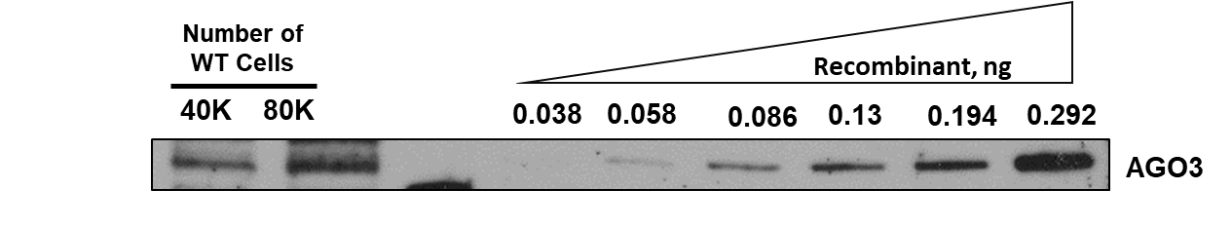
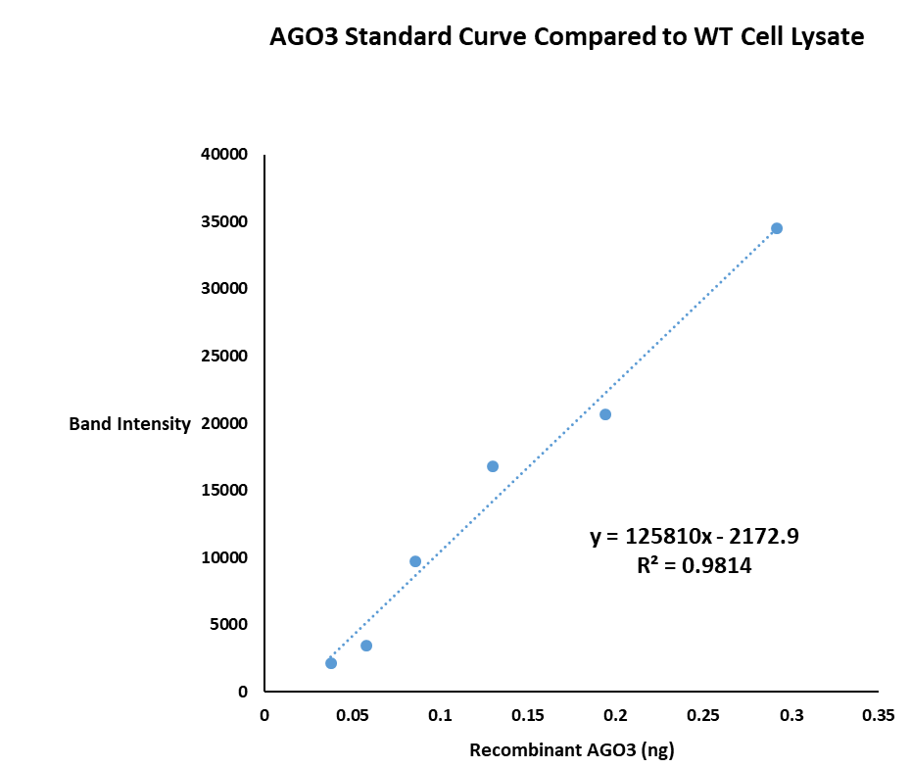
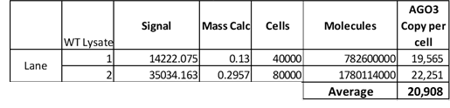
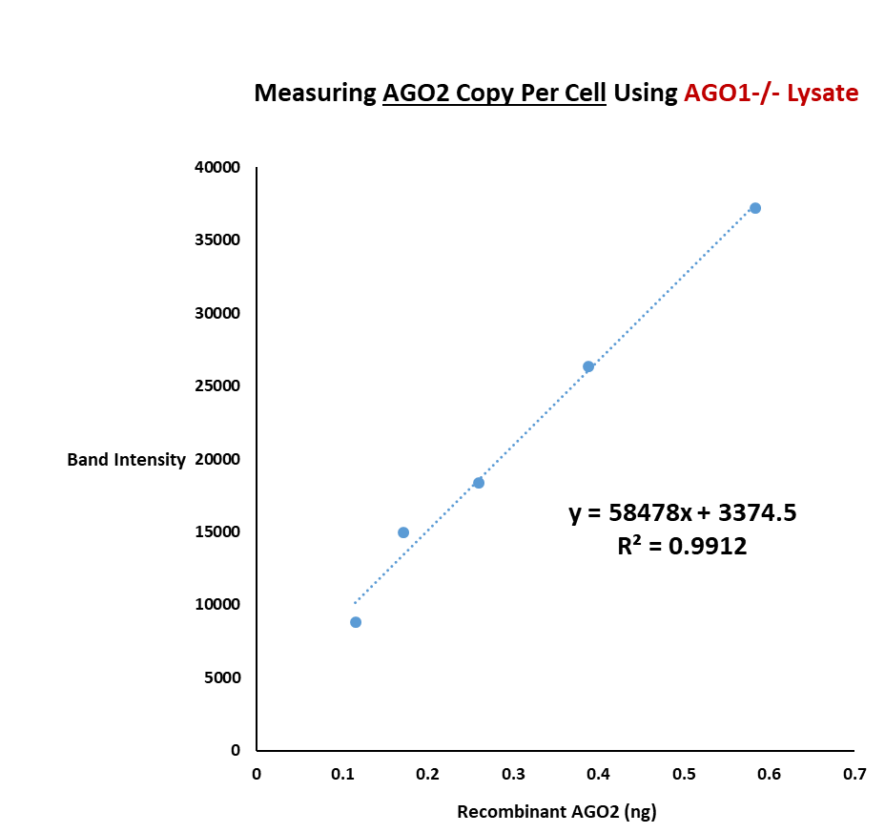
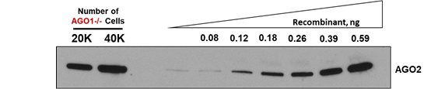
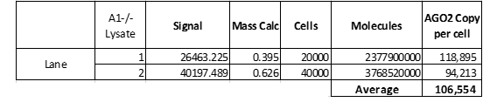
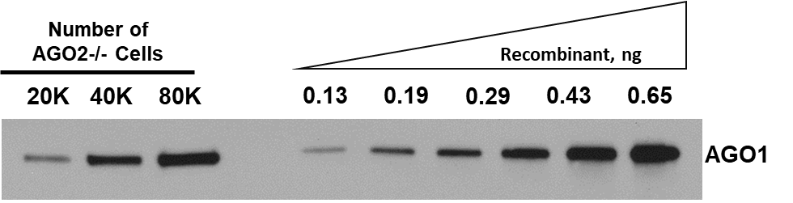
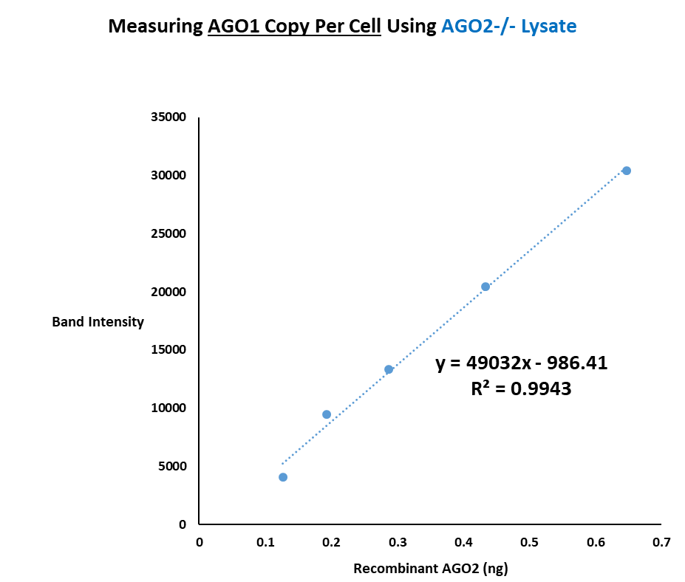
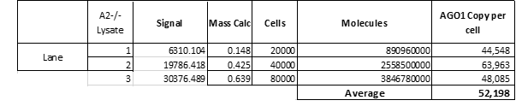
C
D
E

Slide 11
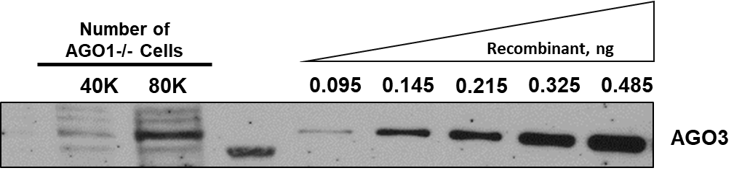
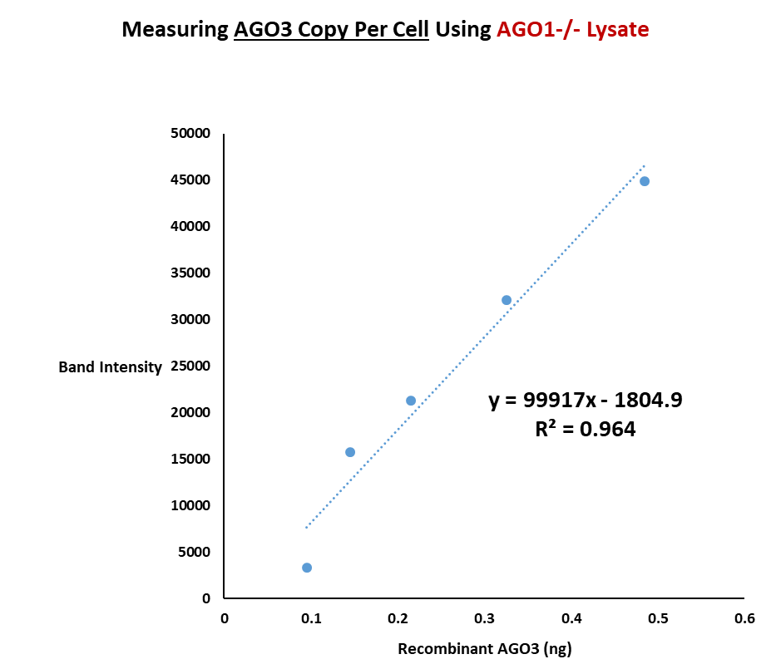
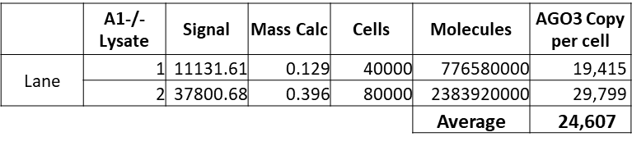
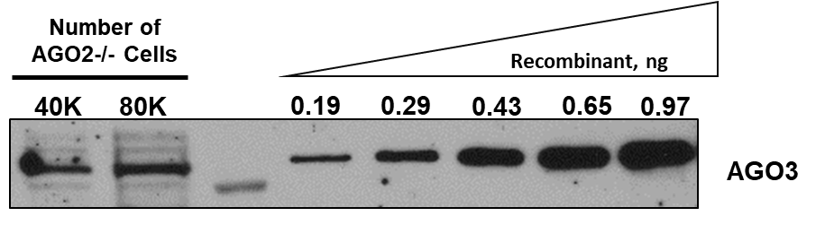
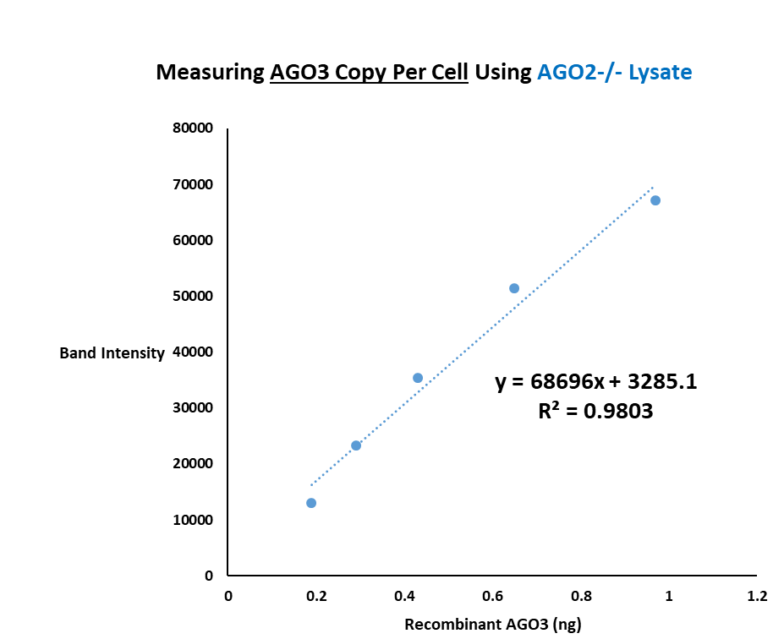
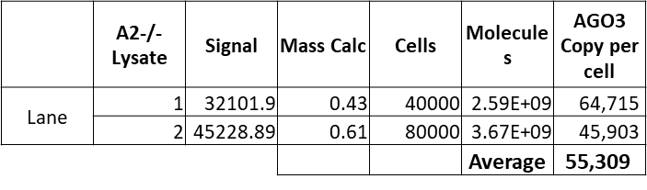
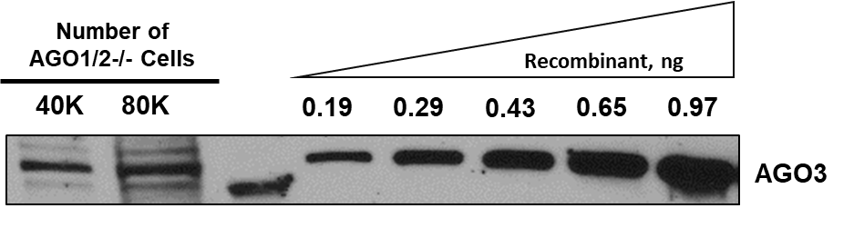
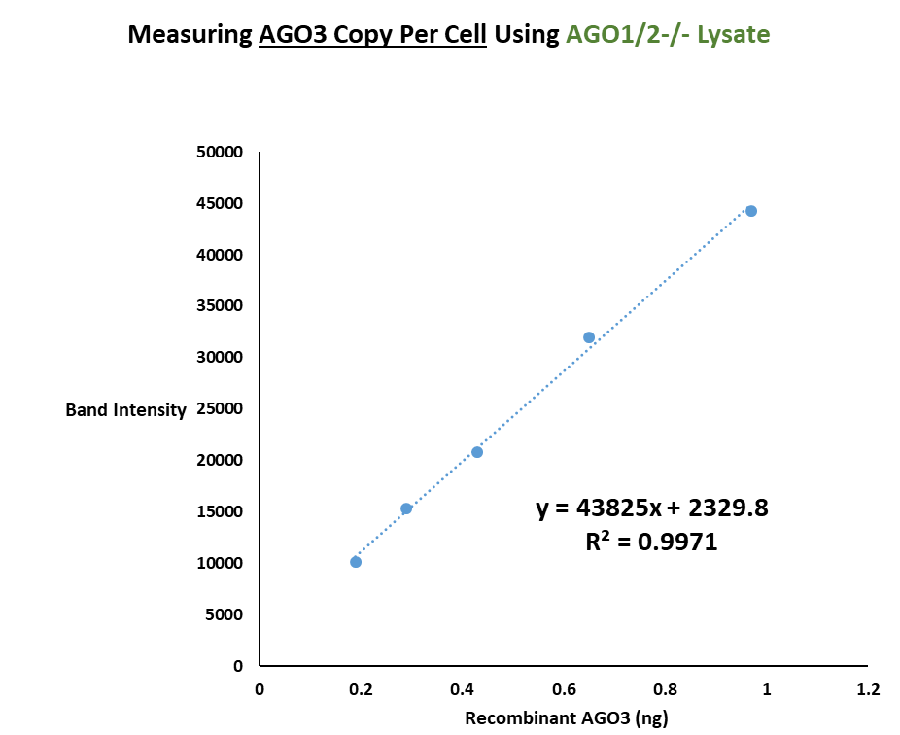
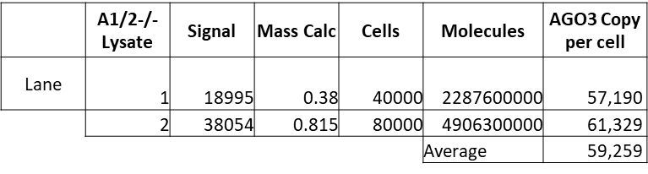
F
G
H
Supplemental Figure 6. Absolute Quantification of Argonaute proteins in WT, AGO1-/-, AGO2-/-, AGO1/2-/-, and AGO1/23-/- HCT116 Cells. (A-H) Recombinant AGO1, AGO2, and AGO3 protein (Active Motif) were used to generate standard curves to estimate the mass of AGO1, AGO2, or AGO3 in a given quantity of HCT116 lysate corresponding to a known number of cells. Western blot signals were quantified using a digital scanner and ImageJ (NIH). Quantification summarized in tables below blots. (A) Quantification of AGO1 in WT cells. (B) Quantification of AGO2 in WT cells. (C) Quantification of AGO3 in WT cells. (D) Quantification of AGO2 in AGO1-/- cells. (E) Quantification of AGO1 in AGO2-/- cells. (F) Quantification of AGO3 in AGO1-/- cells. (G) Quantification of AGO3 in AGO2-/- cells. (H) Quantification of AGO3 in AGO1/2-/- cells.

Slide 12
A
Cell Line | Antibody | Ago1 | Ago2 | Ago3 | Ago4
Wildtype | 3148 |  | ✓
Ago2-/- | 3148
Wildtype | 2A7 | ✓
Ago1-/- | 2A7
Wildtype | Pan | ✓ | ✓ | ✓ | ✓
Ago12-/- | Pan |  |  | ✓ | ✓
Ago123-/- | Pan |  |  |  | ✓
B
C
Supplemental Figure 7. (A) Table describing the different experimental approaches to immunoprecipitate each Argonaute protein in WT and AGO-/- cells with different antibodies. (B) Chart of Ago1 counts for the top 25 of the 60 overlapping top 100 miRNA. (C) Chart of Ago2 and PAN antibody counts for the top 25 of the 60 overlapping top 100 miRNA.

Slide 13
A
B
C
Supplemental Figure 8. (A) Correlation plots of miRNA reads for the top 60 miRNAs found in all pulldowns across WT, AGO1-/-, AGO2-/-, AGO12-/- and AGO123-/- cell lines, where r is the Pearson correlation value calculated using log-transformed values and p is significance. The top 20 miRNAs with the highest read count from the anti-pan-AGO antibody pulldown are highlighted in red. (B) Heatmap of Pearson correlation values for all of the IP pulldowns. P<0.0001 for all correlations calculated. (C) Total mapped reads (counts) from each AGO immunoprecipitation.

