Slide 1
Supplemental Figure S1

Slide 2
Supplemental Figure S2

Slide 3
Supplemental Figure S3

Slide 4
5.1e2
XIC @ m/z 259.147
m³U/Um
2 μg digest
13.40
4.4e2
13.50
2 μg
Relative abundance
7.1e3
3 μg
13.57
1.5e4
6 μg
13.55
12.4
13.0
13.6
14.2
14.8
Supplemental Figure S4
Time (min)

Slide 5
1.5e6
33.4
rRNA
Relative abundance
Ast RNA
33.51
32.0
33.0
34.0
35.0
Time (min)
Supplemental Figure S5

Slide 6
Supplemental Figure S6

Slide 7
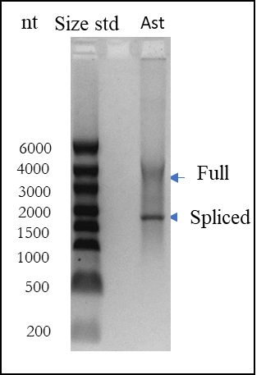
Supplemental Figure S7

Slide 8
Supplemental Figure S8

Slide 9
Supplemental Figure S9

Slide 10
Supplemental Figure S10

Slide 11
Supplemental Figure S11

Slide 12
Supplemental Figure S12

Slide 13
Supplemental Figure S13

Slide 14
Supplemental Figure S14

Slide 15
Supplemental Figure S15

Slide 16
Supplemental Figure S16

