Slide 1
RPS12 (5’ UTR “Form B”)
76
75
74
72
68
ES
73
71
70
69
67
66
65
64
63
62
61
60
59
Edited
CUAAUACACUUUUGAUAACAAACUAAAGUAAuAAAuuuuGuuuuuuuuGCGuAuGuGA*UUUUUGuAuG*GuuGuuGuuuAC*GuuuuGuuuuAuuuGu
uuuAuGuuAuuAuAuGAGuCCG**CGAuuGCCCAGuuCCGGuAACCGACGuGuAuuGuAuGC**C****GuAuuuuAuuUAuAuAAuuuuGuuuGGAuGu
uGCGuuGuuuuuuuuGuuGuuuuAuuGGuuuAGuuAuG**UCAuuAuuuAuuAuAGA***GGGUGGuGGuuuuGuuGAuuuACCC***G****GuG*UAA
AGuAuuAuACA*CG**UAuuGuAAGuuAGA*UUUAGAuAUAAGAUAUGUUUUU[AAUA]POLYA
Pre-edited
CUAAUACACUUUUGAUAACAAACUAAAGUAA AAA G GCG A G GAUUUUUUG A GUG G G ACUG G A G
A G A A A GAG CCGUUCGA GCCCAG CCGG AACCGACG G A G A GCUUCUUUUG A A UA A AA G GGA G
GCG G G G A GG AG A GUUUCA A A A AGAUUUGGGUGG GG G GA ACCCUUUGUUUUG GUUAA
AG A A ACAUCGUUUA G AAG AGAUUUUAGA AUAAGAUAUGUUUUU[AAUA]POLYA
T-stripped
1 -- ---- -- +------ ---+ -- --- - --- + - -- - - - - - - +- - - - - 45
58
57
56
55
47
44
54
53
52
51
50
49
48
46
45
43
42
41
40
39
38
37
36
35
34
33
46
- - - - + --- --- --- +----- ---- +------- - - + - -- - - - - - - +- - --- - 96
32
31
30
29
28
27
26
25
24
23
22
21
20
19
18
17
16
15
14
13
11
12
97
--- + - - - -- -- - - +- - - - --- --+ -- -- - -- --+- - - - -- 136
10
9
8
7
6
5
4
3
2
1
137
-- - + --- -- - - --+ --- --- - --+- - - 163
Fig. S1

Slide 2


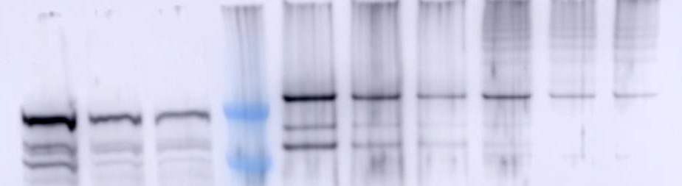
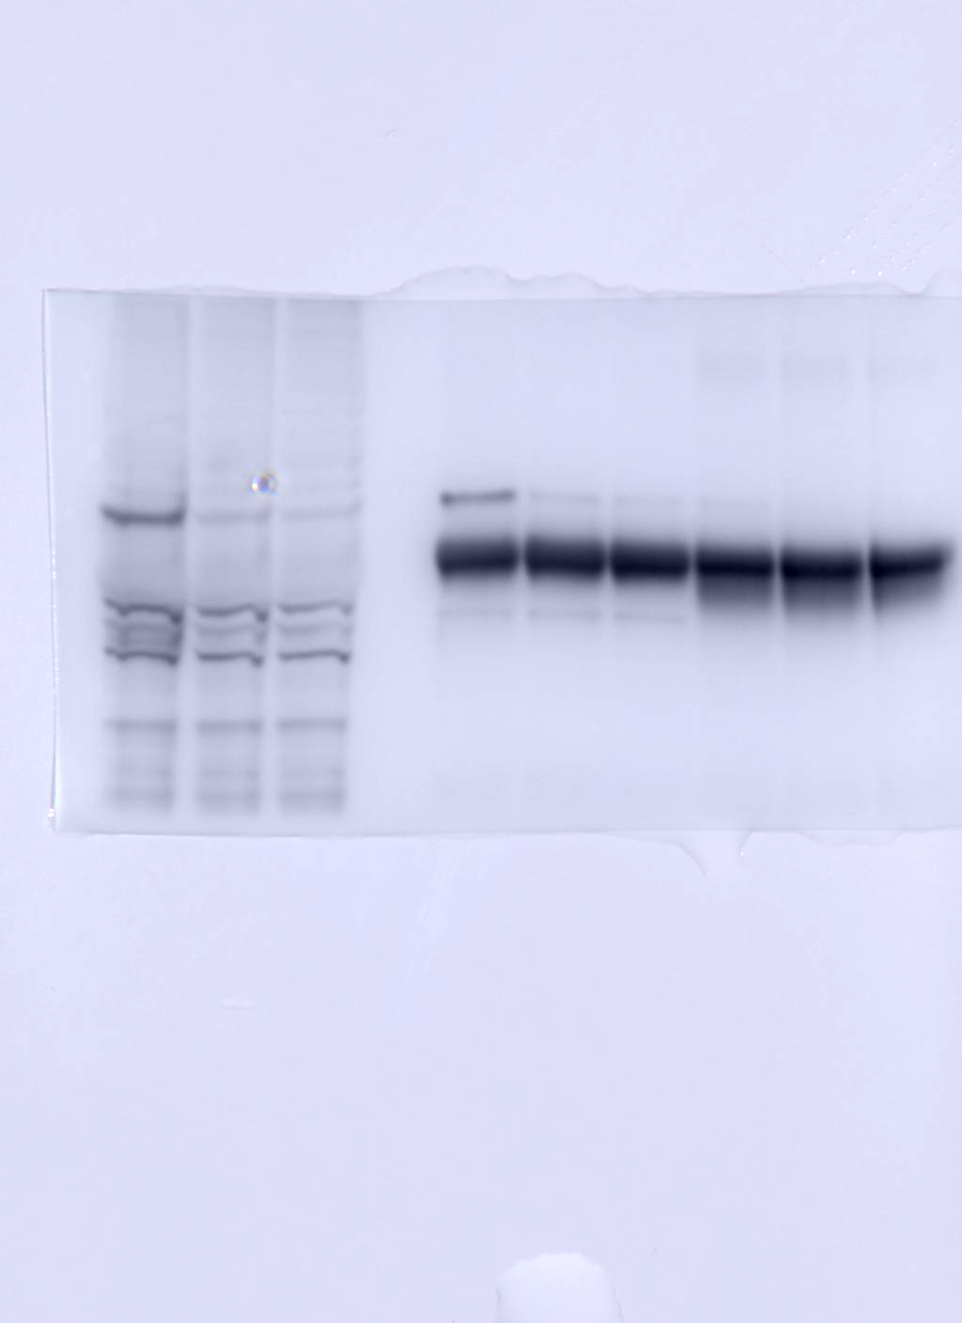
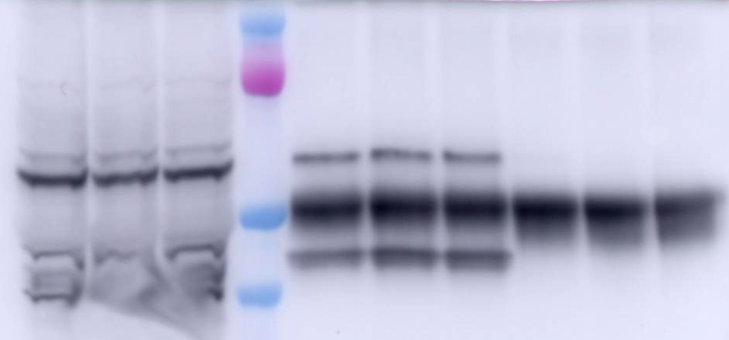
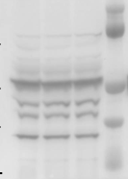
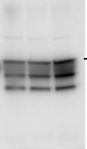
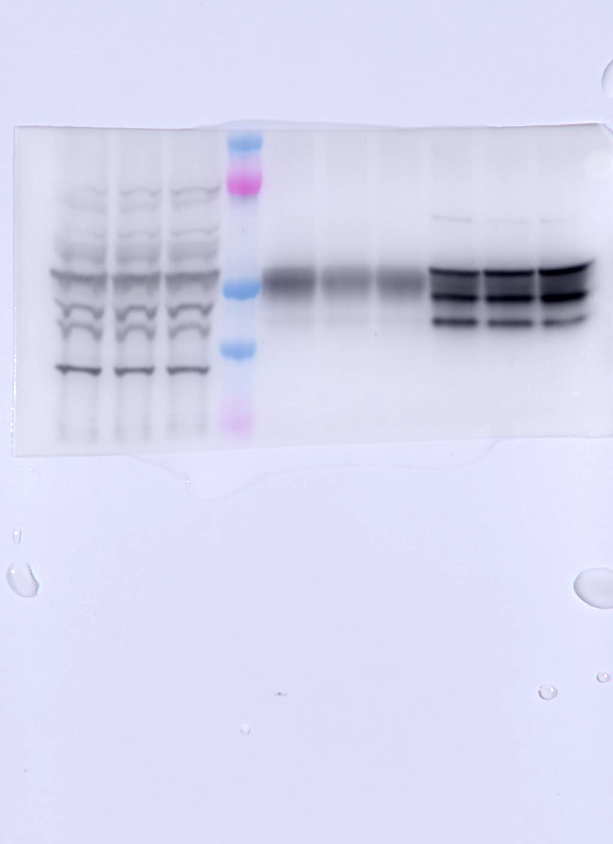


A
KH2F1-RNAi
B
KREH2-RNAi
Extract
RESC6-IP
Extract
KH2F1-IP
RESC6-IP
0 3 4 M 0 3 4 Tet (days)
0 3 4 M 0 3 4 0 3 4 Tet (days)
250
KREH2
250
KREH2
150
150
100
100
75
75
KH2F1
KH2F1
KH2F1
50
IgG
50
IgG
37
37
100
100
75
75
50
RESC2
50
RESC2
IgG
IgG
37
37
1 2 3
KREL1
KREL1
50
50
4 5 6
1 2 3
4 5 6 7 8 9
C
D
10⁵
KH2F1-RNAi
10⁵
KREH2-RNAi
10⁴
10⁴
10³
10³
CUMUATIVE GROWTH (MILLIONS)
CUMUATIVE GROWTH (MILLIONS)
10²
10²
10¹
10¹
-Tet
-Tet
10⁰
10⁰
+Tet
+Tet
0
0
Fig. S2
0
50
100
150
200
250
0
50
100
150
200
250
HOURS
HOURS

Slide 3
A
A
100
mtRNA
TOTAL EDITS
KH2F1-IP
80
RESC6-IP
60
T-str 51 (ES54)
SITE-BY-SITE EDITS (%)
***
*
40
*
20
0
+
+
+
+
+
+
+
+
+
+
+
+
31
+
+
+
+
+
+
+
+
+
+
+
+
151
8-
7-
6-
66-
46-
4-
3-
72-
64-
62-
54-
53-
52-
51-
50-
49-
44-
41-
35-
19-
ES
70-
68-
60-
58-
56-
48-
43-
33-
28-
20-
39-
26-
22-
37-
30-
24-
18-
16-
32-
27-
15-
11-
B
1200
3000
1000
T-str 51 (ES54)
2500
800
2000
CUM. EDITS
600
1500
400
1000
200
500
0
0
+
+
+
+
+
+
+
+
+
+
+
+
+
+
+
+
+
+
+
+
+
+
+
+
+
T-str
31
50
70
90
110
130
151
8-
7-
6-
66-
46-
4-
3-
72-
64-
62-
54-
53-
52-
51-
50-
49-
44-
41-
35-
19-
ES
70-
68-
60-
58-
56-
48-
43-
33-
28-
20-
39-
26-
22-
37-
30-
24-
18-
16-
32-
27-
15-
11-
Fig. S3

Slide 4
mtRNA
KREH2-IP
A
RESC6-IP
B
128
CORRECT
CORRECT
100 %
32
64
32
16
16
SITE-BY-SITE EDITS %
8
8
4
2
4
+
+
GAG
1
AGG
17
+
+
+
+
+
+
+
+
+
+
+
+
+
+
151
48-
46-
71-
73-
47-
72-
ES
8-
7-
6-
4-
74-
66-
46-
3-
64-
62-
54-
53-
52-
76-
72-
51-
50-
49-
44-
41-
35-
19-
70-
68-
60-
58-
56-
48-
43-
33-
28-
20-
39-
22-
37-
30-
26-
24-
18-
16-
32-
27-
15-
11-
START
10-
STOP
C
D
64
INCORRECT
INCORRECT
16
8
4
4
SITE-BY-SITE EDITS %
2
1
1
0.25
0.5
0.063
0.25
0.016
0.004
+
+
AGG
GAG
17
+
+
+
+
+
+
+
+
+
+
+
+
+
+
151
Fig. S4

Slide 5
A
T-str 48 (ES57)
T-str 80 (ES46)
mtRNA
INCOR/COR
0.8
**
KH2F1-IP
0.6
RESC6-IP
0.4
SITE-BY-SITE EDITS (%)
0.2
0
+
+
+
+
+
+
+
+
+
+
+
+
151
31
8-
7-
6-
66-
46-
4-
3-
72-
64-
62-
54-
53-
52-
51-
50-
49-
44-
41-
35-
19-
70-
43-
68-
60-
58-
56-
48-
33-
28-
20-
39-
22-
37-
26-
24-
18-
16-
ES
30-
15-
11-
32-
27-
13-
B
7
T-str 48 (ES57)
INCOR/COR
12
6
10
5
T-str 80 (ES46)
8
CUM. EDITS
4
6
3
4
2
1
2
0
+
+
+
+
+
+
+
+
+
+
+
+
0
T-str
31
50
70
90
110
130
151
8-
7-
6-
66-
46-
4-
3-
72-
64-
62-
54-
53-
52-
51-
50-
49-
44-
41-
35-
19-
70-
43-
68-
60-
58-
56-
48-
33-
28-
20-
39-
22-
37-
26-
24-
18-
16-
ES
30-
15-
11-
32-
27-
13-
Fig. S5

Slide 6
-Tet
KH2F1-RNAi RESC6-IP
A
+Tet d3
B
+Tet d4
CORRECT
CORRECT
128
100 %
64
32
32
16
SITE-BY-SITE EDITS (%)
16
8
4
2
+
AAA
39-
37-
1
38-
17
+
+
+
+
+
+
+
+
+
+
151
ES
8-
7-
6-
4-
74-
66-
46-
3-
64-
62-
54-
53-
52-
76-
72-
51-
50-
49-
44-
41-
35-
19-
70-
68-
60-
58-
56-
48-
43-
33-
28-
20-
39-
22-
37-
30-
26-
24-
18-
16-
32-
27-
15-
11-
START
STOP
C
D
64
INCORRECT
INCORRECT
16
16
4
1
SITE-BY-SITE EDITS (%)
4
0.25
0.063
2
0.016
+
AAA
0.004
17
+
+
+
+
+
+
+
+
+
+
+
+
+
+
151
Fig. S6

Slide 7
A
CORRECT
64
64
32
32
32
16
16
16
8
8
8
SITE-BY-SITE EDITS (%)
4
4
4
2
2
2
KH2F1-RNAi RESC6-IP
1
47
48
49
1
79
80
81
82
1
87
88
89
T-str
-Tet
INCORRECT
+Tet day 3
32
+Tet day 4
16
16
16
8
8
8
FULLY EDITED
4
4
4
PRE-EDITED
2
2
2
SITE-BY-SITE EDITS (%)
1
1
1
0.5
0.5
0.5
0.25
0.25
0.25
0.12
0.12
0.12
0.06
47
48
49
0.06
79
80
81
82
0.06
87
88
89
T.str
B
3.2
48 (ES57)
3.2
80 (ES46)
3.2
88 (ES39)
1.6
1.6
1.6
1.0
0.8
0.8
0.8
-TET
RELATIVE TO –TET
0.4
0.4
0.4
0.2
0.2
0.2
0.1
0.1
0.1
0.05
0.05
0.05
T-NUMBER
-TET (%)
Fig. S7

Slide 8
ATPase subunit 6 (A6)
ES
67
66
65
64
63
62
61
60
59
58
57
56
55
54
53
Edited
ACGGCGGGAAAuuAuCAuCCCAuUUUUUAuuGuuGAuGuuuuuuGAuuuuuuuUAuuuuAuuuuuGuuuuuuuuuuuuAuGGuGuuuuuuGuuAuuGAuu
ACGGCGGGAAA--A-CA-CCCA-UUUUUA--G--GA-G------GA-------UA----A-----G------------A-GG-G------G--A--GA--
uAuuuuAuuuAuuuuuGuGuuuuGuuuuuGuuuAuuAuuuuAUGuGuuuuuAuAuUUGuuGGAuuuAuUUGCC***GCCAuAuuAC****AGuuAuuuAu
-A----A---A-----G-G----G-----G---A--A----AUG-G-----A-A-UUG--GGA---A-UUGCCUUUGCCA-A--ACUUUUAG--A---A-
uuuuuGuAAuAuGAuuuuGCAGuuGAuAAuGG**AuuuuuuGuuGuuuuuGuuGuuuGuuuAGuuuuGuAuuuuGAuuuGAAGuuAuuAuAuuGuuGu
-----G-AA-A-GA----GCAG--GA-AA-GGUUA------G--G-----G--G---G---AG----G-A----GA---GAAG--A--A-A--G--G-
GAAAuuG**GuuuUGuuA**UUGGAGUUAUAGAAUAAGAUCAAAUAAGAAAA
GAAA--GUUG---UG--AUUUUGGAGUUAUAGAAUAAGAUCAAAUAAGAAAA
Pre-edited
T-stripped
1--------+- - -- ---- - + -- - -- - - - - +- - - - -- 36
52
51
50
49
48
47
46
45
44
43
42
41
40
39
38
37
36
35
34
33
32
31
37
- - - + - - - - - - - - - + - --- - --- -+-- - -- -- - - 69
29
28
30
27
26
25
24
23
22
21
20
19
18
17
16
15
14
13
12
11
10
9
8
7
6
70
+ -- - -- ---- +- -- -- - - - - + - -- - - -- --+- - - - - - 106
5
4
3
2
1
---+ - - - - ---- - +--- ---- --+- ------- 138
107
Fig. S8

Slide 9
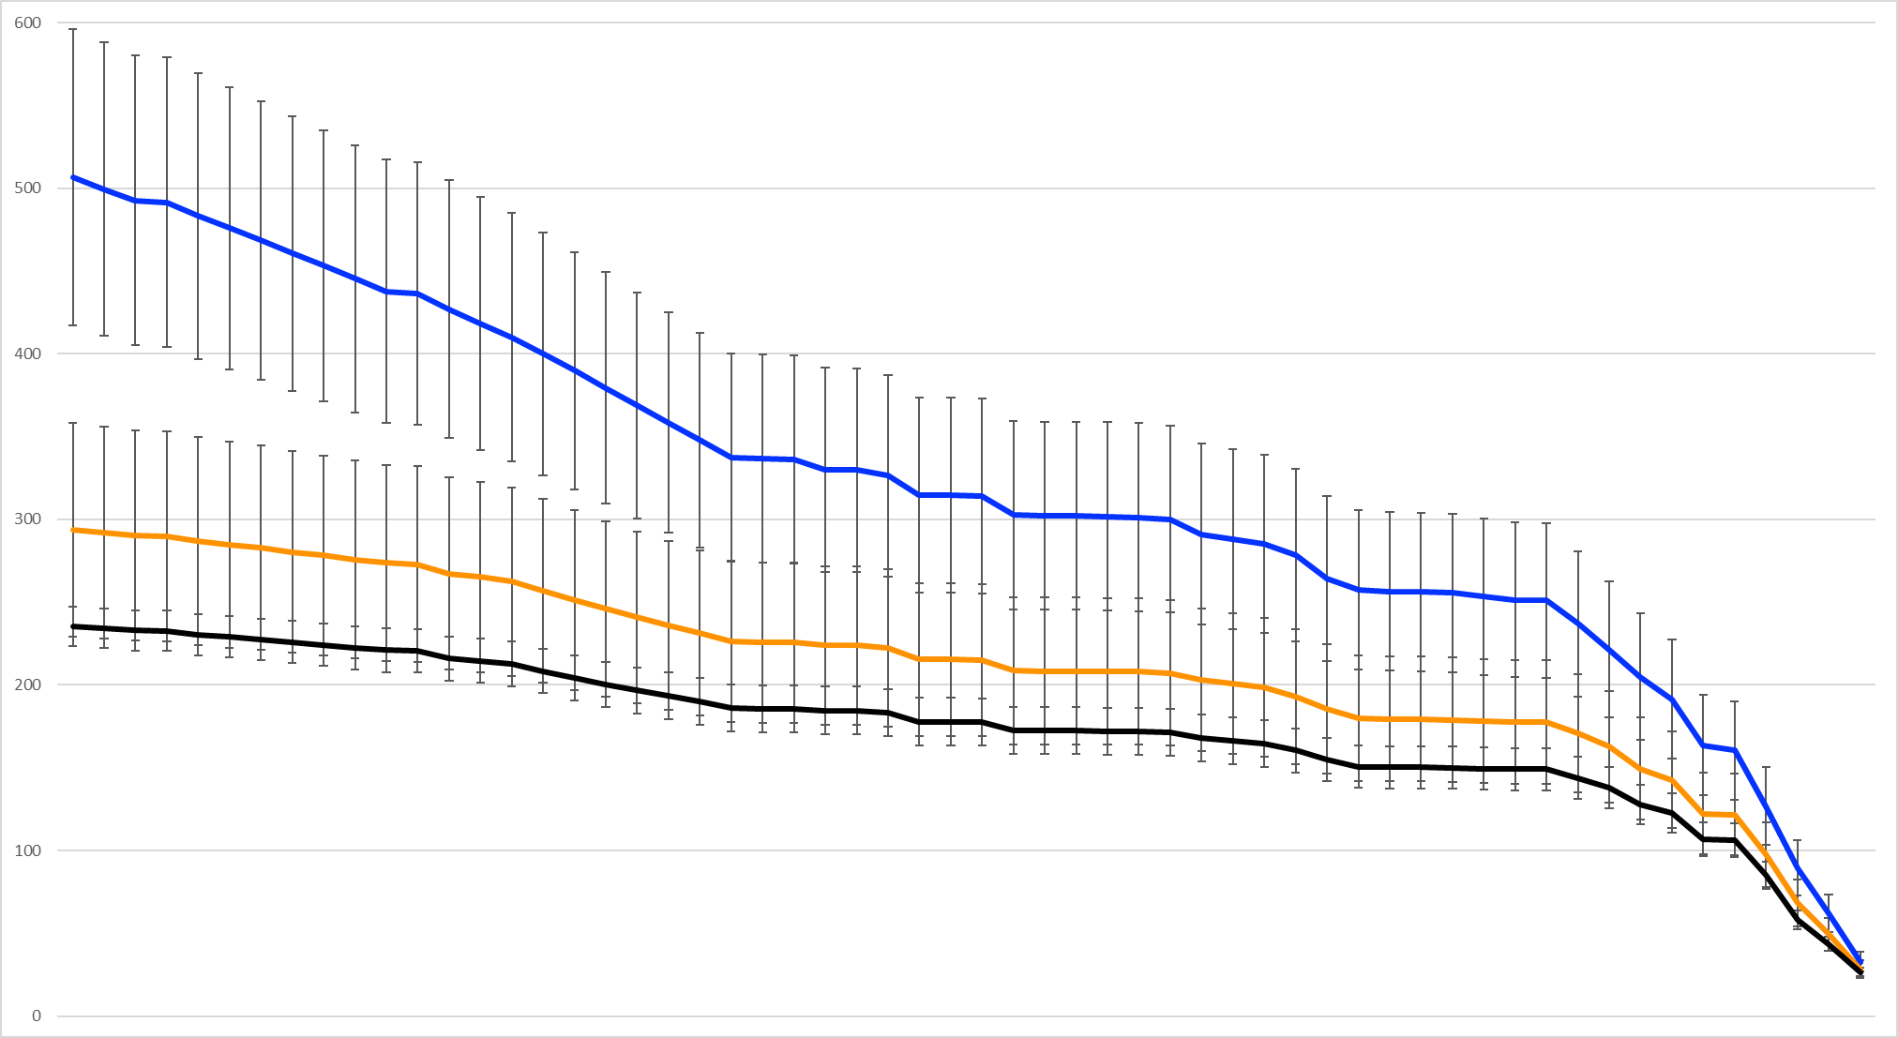
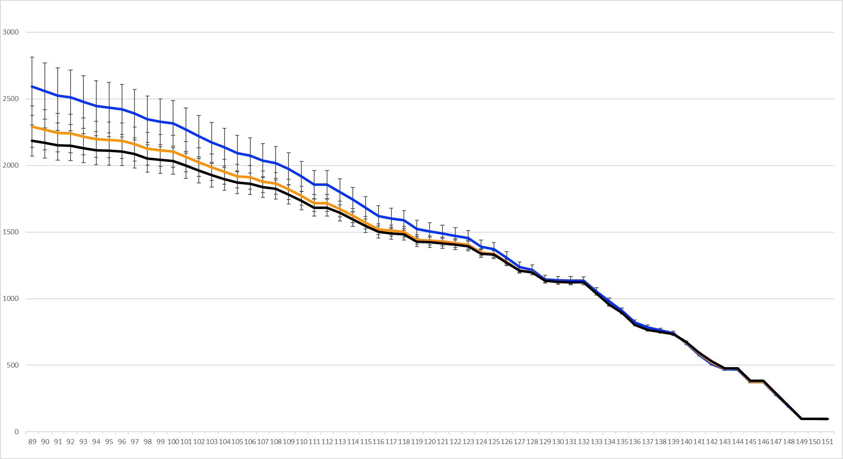
A
100
KH2F1-RNAi
RPS12
TOTAL EDITS
-Tet
mtRNA
80
+Tet day 3
**
+Tet day 4
*
60
*
SITE-BY-SITE EDITS (%)
T-str 51 (ES54)
***
40
***
***
20
***
0
31
+.
+
+
+
+
+
+
+
+
+
+
+
151
8-
7-
6-
66-
46-
4-
3-
72-
64-
62-
54-
53-
52-
51-
50-
49-
44-
41-
35-
19-
70-
60-
58-
56-
48-
43-
33-
28-
20-
39-
26-
22-
37-
30-
24-
18-
16-
ES
68-
32-
27-
15-
11-
13-
10-
B
T-str 51 (ES54)
600
3000
500
2500
400
2000
CUM. EDITS
300
1500
200
1000
100
500
0
+
+
+
+
+
+
+
+
+
+
+
+
0
T-str
31
50
70
90
110
130
151
13-
8-
7-
6-
66-
46-
4-
3-
72-
64-
62-
54-
53-
52-
51-
50-
49-
44-
41-
35-
19-
10-
70-
60-
58-
56-
48-
43-
33-
28-
20-
39-
26-
22-
37-
30-
24-
18-
16-
ES
68-
32-
27-
15-
11-
Fig. S9

Slide 10
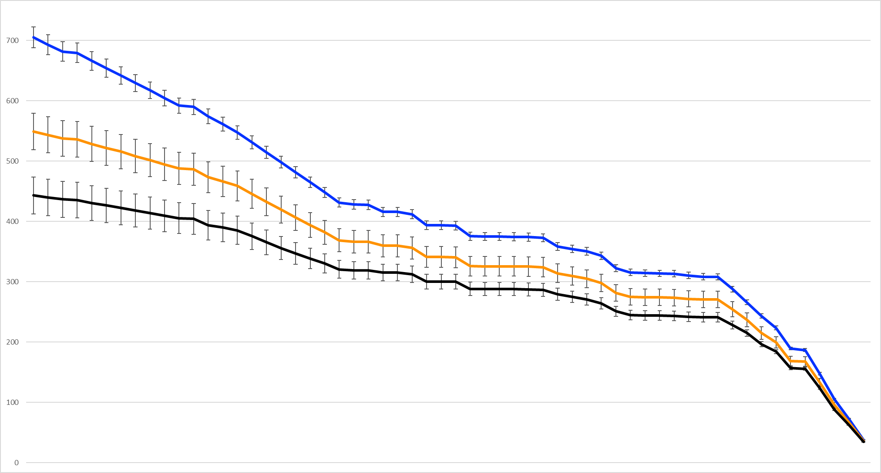

A
KREH2-RNAi
RPS12
TOTAL EDITS
100
mtRNA
-Tet
80
+Tet day 3
+Tet day 4
60
T-str 51 (ES54)
SITE-BY-SITE EDITS (%)
*
40
***
***
20
0
31
+.
+
+
+
+
+
+
+
+
+
+
+
151
8-
7-
6-
66-
46-
4-
3-
72-
70-
64-
62-
54-
53-
52-
51-
50-
49-
44-
41-
35-
19-
68-
60-
58-
56-
48-
43-
33-
28-
20-
39-
26-
22-
37-
30-
24-
18-
16-
ES
32-
27-
15-
11-
13-
10-
B
T-str 51 (ES54)
700
3000
600
2500
500
2000
CUM. EDITS
400
1500
300
200
1000
100
500
0
+
+
+
+
+
+
+
+
+
+
+
+
0
T-str
31
50
70
90
110
130
151
8-
7-
6-
66-
46-
4-
3-
72-
70-
64-
62-
54-
53-
52-
51-
50-
49-
44-
41-
35-
19-
11-
68-
60-
58-
56-
48-
43-
33-
28-
20-
39-
26-
22-
37-
30-
24-
18-
16-
ES
32-
27-
15-
13-
10-
Fig. S10

Slide 11
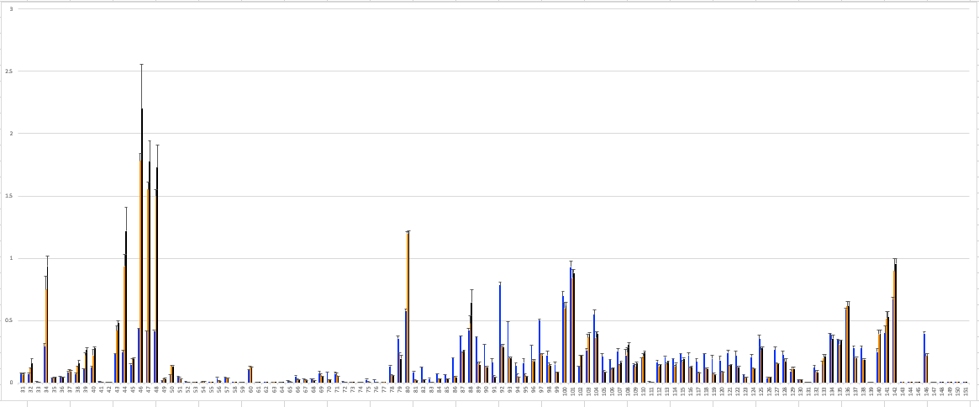
A
3.0
T-str 48 (ES57)
RPS12
INC/COR
KH2F1-RNAi
mtRNA
-Tet
2.5
+Tet day 3
2.0
T-str 80 (ES46)
+Tet day 4
1.5
INC/COR
1.0
0.5
0
31
151
16
*
16
B
*
*
KH2F1-RNAi
14
*
*
14
12
12
10
10
8
8
CUM. INC/COR
6
6
4
4
2
2
0
0
C
*
*
12
12
*
*
KREH2-RNAi
10
*
10
8
8
6
6
CUM. INC/COR
4
4
2
2
0
0
T-str
50
70
90
110
130
151
31
Fig. S11

Slide 12
A
5
INC/COR
KH2F1-RNAi
mtRNA
-Tet
4
A6
+Tet day 3
INC/COR
+Tet day 4
3
2
102
106
103
107
108
1
109
59
0
+
+
+
+
+
+
115
ES
36-
34-
33-
31-
29-
27-
26-
25-
24-
22-
20-
18-
16-
15-
13-
12-
10-
8-
6-
5-
3-
23-
1-
B
25
*
**
*
20
15
CUM. INC/COR
10
5
0
T-str
+
+
+
+
+
+
59
70
90
110
115
ES
36-
34-
33-
31-
29-
27-
26-
25-
24-
23-
22-
20-
18-
16-
15-
13-
12-
10-
8-
6-
5-
3-
1-
Fig. S12

