Slide 1
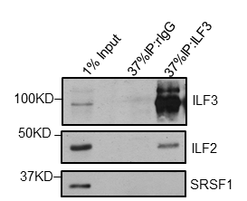
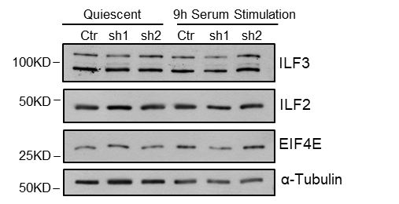
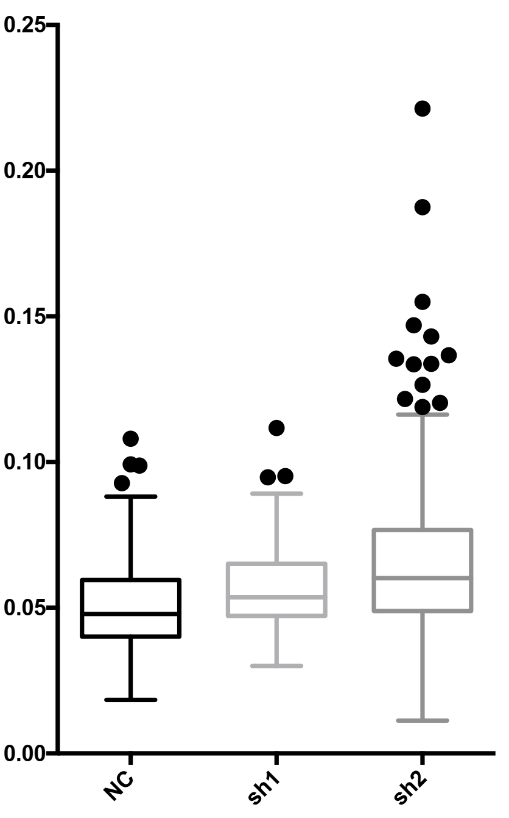
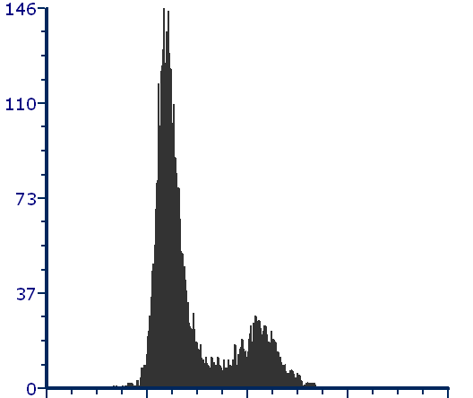
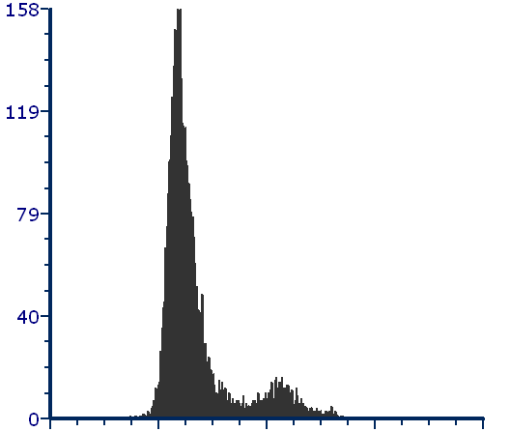
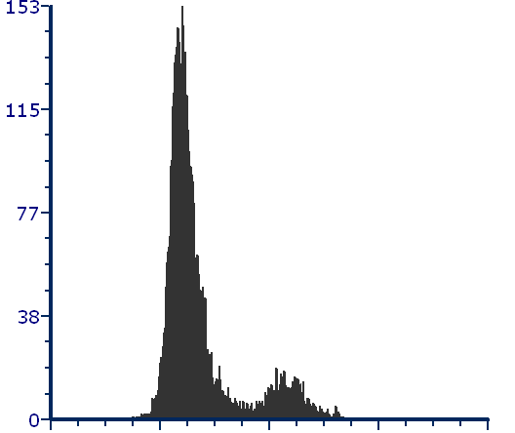
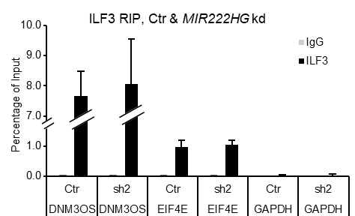
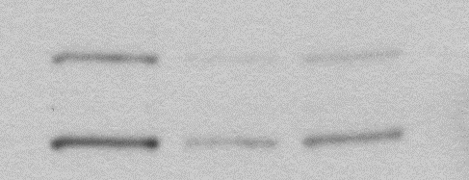
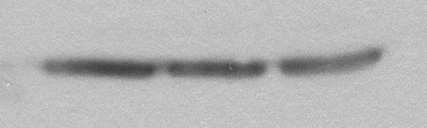
Supplemental Fig. S6
A
B
C
PLA (ILF3/ILF2)
****
MFI (a.u.)
****
D
E
Ctr
sh1
sh2
***
*
*
F
G
Scr
ASO70
ASO73
Count
Count
Count
*
*
0
PI-A
262.1
0
PI-A
262.1
0
PI-A
262.1
G1 % | S % | G2/M %
70.09 | 16.32 | 13.59
G1 % | S % | G2/M %
81.2 | 14.15 | 4.65
G1 % | S % | G2/M %
81.44 | 11.37 | 7.20
H
I
ILF3_sh7
Ctr
ILF3_sh6
100KD
ILF3
50KD
α-Tubulin

Slide 2
Supplemental Fig. S6. MIR222HG forms RNP complex containing ILF3/2 protein and other RNAs. (A) ILF3 RIP experiments followed by immunoblotting to examine the level of ILF3 and ILF2 in RIP samples. SRSF1 is used as negative control. (B) Immunoblot to detect the levels of ILF3, ILF2, and EIF4E, in control and MIR222HG-depleted quiescent and serum-stimulated (9h) WI-38 cells. Both NF90 and NF110 isoforms are identified by ILF3 antibody. α -Tubulin is used as loading control. (C) PLA assay to quantify the interaction between ILF3 and ILF2 in control and MIR222HG-depleted cells. Signal intensity represents the interaction strength. Statistical significance between Ctr and sh1 as well as Ctr and sh2 is due to the large sample size (n=352 in Ctr, 268 in sh1, and 366 in sh2). Biological significance could not be concluded from the PLA results. MFI: Mean Fluorescence Intensity, with artificial units (a.u.). (D) RT-qPCR to quantify the levels of EIF4E mRNA in control and MIR222HG-depleted quiescent and 6h serum-stimulated WI-38s cells. (E) RT-qPCR to quantify the levels of DNM3OS in WI-38 cells incubated with control (Scr) and DNM3OS-targeting ASOs (ASO70 and ASO73). (F) PI-flow cytometry analyses in control and DNM3OS-depleted WI-38 cells at 24h post serum stimulation. Quantification is performed using FCS Express. (G) Taqman assay to quantify the levels of miR-214 in control and MIR222HG-depleted WI-38 cells. (H) Immunoblot to detect the ILF3 levels in control and ILF3-depleted WI-38 cells (sh6 and sh7). α-Tubulin is used as loading control. (I) ILF3 RIP followed by RT-qPCR to quantify the levels of EIF4E (3’-UTR region) and DNM3OS in control and MIR222HG-depleted (sh2) WI-38s. GPADH is used as negative control. *:p≤0.05, **:p≤ 0.01, ***:p ≤0.001, ****: p ≤0.0001 by two-tailed student’s t-test, n=3 for all figures, except Fig. S6C (PLA). Error bars represent standard deviation.

