Slide 1
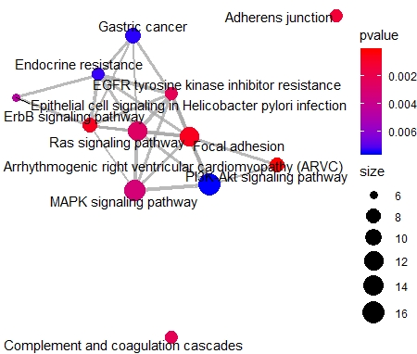
Supplemental Fig. S5
A
**
**
*
**
B
C
N.S
N.S
Supplemental Fig. S5. Spliced mature MIR222HG facilitates cell cycle re-entry post quiescence in a micro-RNA independent manner. (A) RT-qPCR to quantify the levels of spliced MIR222HG in (a) nuclear fraction or (b) cytoplasmic fraction, of control and MIR222HG shRNA treated WI-38 cells. (B) Top events from Kegg pathway analyses of 398 DEGs in MIR222HG-depleted cells. (C) Reporter assay (luciferase assay) to measure the luciferase activity, using a p27 3’-UTR reporter system, in control and MIR222HG-depleted cells. *:p≤0.05, **:p≤ 0.01, ***:p ≤0.001, ****: p ≤0.0001 by two-tailed student’s t-test, n=3 for all figures. Error bars represent standard deviation.

