Slide 1
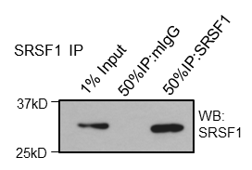
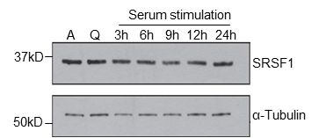
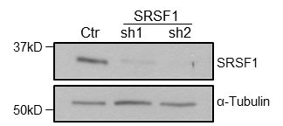
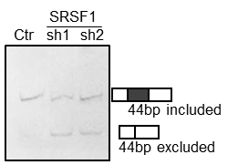
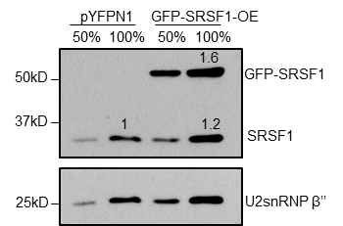
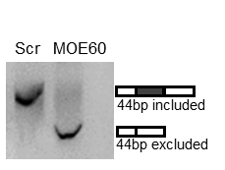
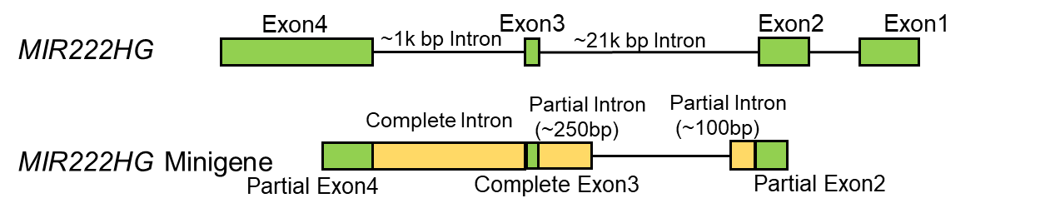
Supplemental Fig. S4
A
Ba
Bb
*
C
D
E
F
Ga
Gb
H
I
J
 | Half Life (hr)
gl3 (ctr) | 0.29+/-0.10
Drosha kd | 1.07+/- 0.40
DGCR8 kd | 1.1+/- 0.33
*
**
K

Slide 2
Supplemental Fig. S4. Mature spliced MIR222HG lncRNA is processed via the competition between SRSF1 and microprocessor complex. (A) Immunoblot to detect the level of SRSF1 in SRSF1 RIP samples. (B) SRSF1 RIP in quiescent and 6-hour serum-stimulated (SS) WI-38 cells followed by RT-qPCR to quantify the levels of (a) MIR222HG using primers from intronic region and (b) MALAT1. (C) Immunoblot to detect the level of SRSF1 in asynchronous, quiescent, and serum-stimulated (3,6,9,12,24 hours) WI-38 cells. α -Tubulin is used as loading control. (D) Immunoblot to detect the level of SRSF1 in control and SRSF1-depleted WI-38 cells. α -Tubulin is used as loading control. (E) Gel electrophoresis showing PCR products of MIR222HG amplified from control and SRSF1-depleted (sh1 and sh2) WI-38s, using the same RT-qPCR primers targeting spliced MIR222HG. Schematic of 44 bp mini-exon-included (144 bp amplicon) and 44 bp mini-exon-excluded (100bp amplicon) isoforms are drawn on the right side of the gel picture. (F) Taqman assay to quantify the levels of miR-222 in control and SRSF1-depleted WI-38 cells. (G) (a) Immunoblot to detect the level of SRSF1 in control (pYFP transfected) and SRSF1 over-expressed (GFP-SRSF1 transfected) WI-38 cells. U2snRNP β’’ is used as loading control. The levels of endogenous and over-expressed SRSF1 are quantified by ImageJ and normalized to U2snRNP β’’ levels in samples with 100% loading (lane 2 and lane 4). Then, both endogenous and over-expressed SRSF1 levels in overexpression sample (lane 4) are compared to control (lane2) to calculate the relative SRSF levels, which are labelled above their corresponding protein bands. (b) Taqman assay to quantify the levels of miR-222 in control and SRSF1 over-expressed WI-38 cells. (H) Half-life of pri-MIR222HG calculated from RNA stability assay as represented in Fig. 4D. T^{1/2} is calculated using coefficients from model ‘log(% remaining RNA)~ActD treatment time’. Mean and standard deviation from three biological replicates are represented. (I) RT-qPCR to quantify the levels of pri-MIR222HG in control (gl3), Drosha-depleted, and DGCR8-depleted WI-38 cells. (J) Gel electrophoresis showing PCR products of MIR222HG amplified from control (Scr) and MOE60-treated WI-38 cells, using the same RT-qPCR primers targeting spliced mature MIR222HG. Schematic of 44 bp mini-exon-included (144 bp amplicon) and 44 bp mini-exon-excluded (100 bp amplicon) isoforms are drawn on the right side of the gel picture. (K) Schematic of MIR222HG Minigene used in the present study. Wild-type of MIR222HG isoform is presented at the top, Minigene structure is drawn at the bottom. Green blocks represent the exonic portions and yellow blocks represent the intronic portions contained in the minigene clone. *:p≤0.05, **:p≤ 0.01, ***:p ≤0.001, ****: p ≤0.0001 by two-tailed student’s t-test, n=3 for all figures. Error bars represent standard deviation.

