Slide 1
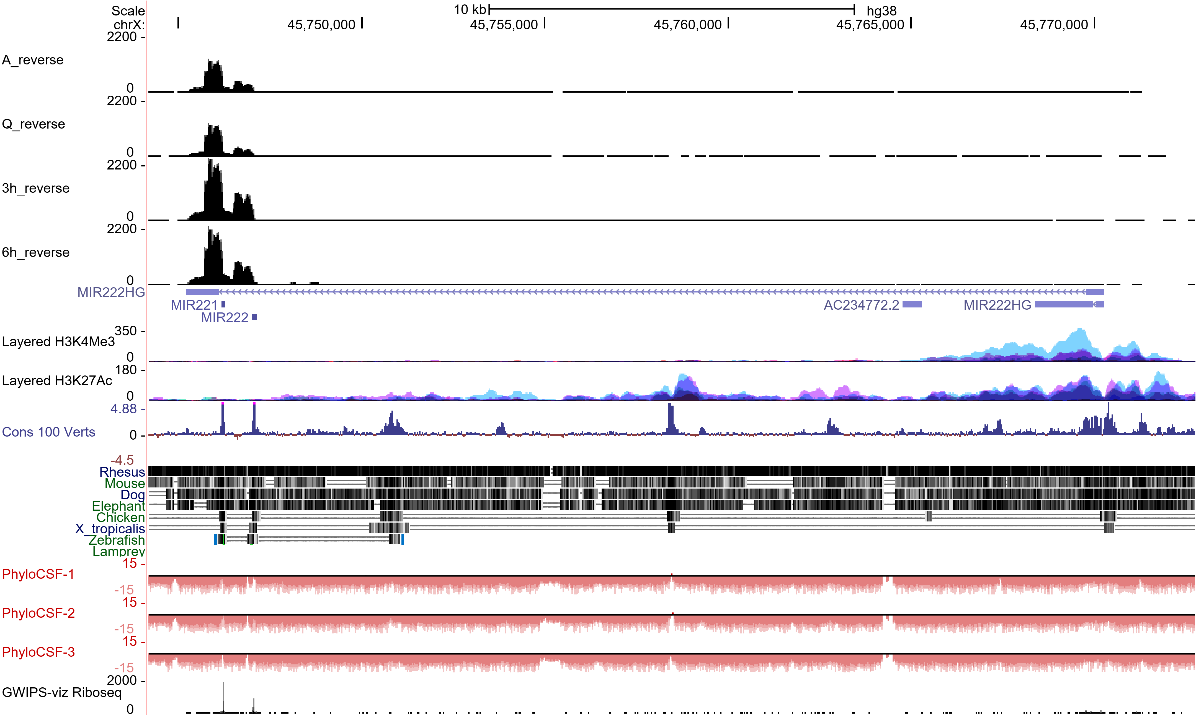
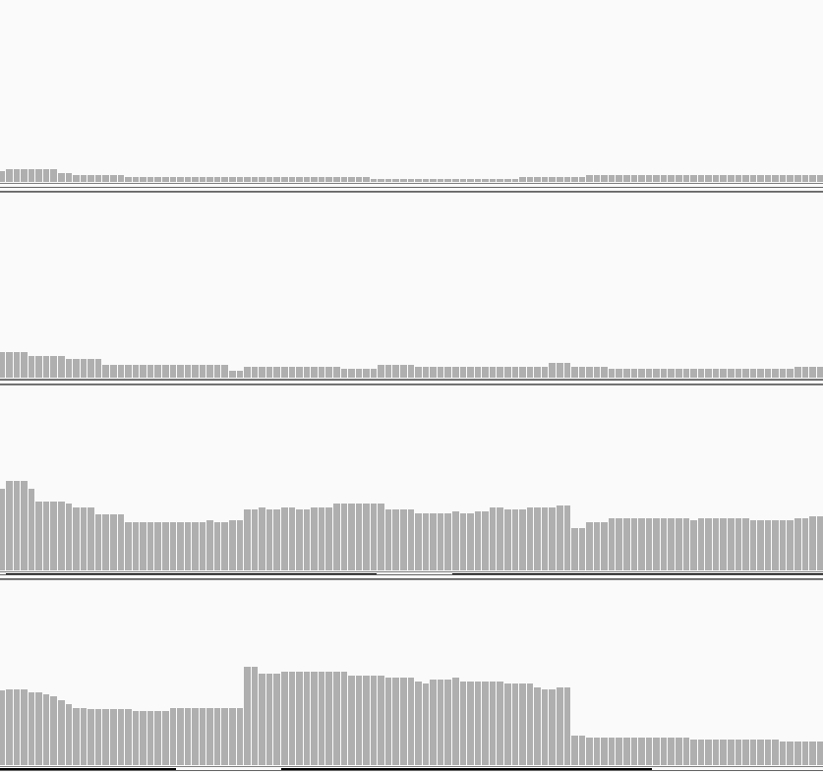
Supplemental Fig. S3
A
Ba
A
Bb
Q
3h
6h
miR-221
miR-222
C
D
miR-221
miR-222
MIR222HG schematic
Exon4
Exon3
Exon2
Exon1
Spliced
Reverse
Forward
pri-MIR222HG
Reverse
Forward
Spliced-2
Reverse
Forward
RT-qPCR primers
Exonic
Reverse
Forward
Intronic
Reverse
Forward
Intronic-2
Reverse
Forward
For SRSF1 RIP
Reverse
Forward
Northern blot clone primer
Reverse
Forward

Slide 2
Supplemental Fig S3 (Cont.)
E
Spliced-2
Exonic
Intronic
Intronic-2
Relative RNA levels
Relative RNA levels
Relative RNA levels
Relative RNA levels
A Q 3h 6h 9h 12h 24h
A Q 3h 6h 9h 12h 24h
A Q 3h 6h 9h 12h 24h
A Q 3h 6h 9h 12h 24h
Fa
Fb
G
MIR222HG
H
Serum stimulation
Quiescent
3h
6h
12h
MIR222HG
DAPI
5μm
5μm
5μm
5μm

Slide 3
Supplemental Fig. S3. MIR222HG is induced during the cell cycle re-entry post cellular quiescence. (A) Detailed UCSC genomic browser view of MIR222HG genomic locus and RNA-seq coverage tracks (BigWig files, merged from two biological replicates). Max value of y-axis of RNA-seq coverage is set at 2200 for a full view of 3’end of the transcript. The negative strand phyloCSF score tracks and Ribo-seq track are presented at the bottom. Schematic of MIR222HG isoform expressed in WI-38 is drown on the top to represent its genomic location. (B) Detailed representation of 44 bp mini-exon in WI-38 RNA-seq bam files. (a) RNA seq shows the RNA-seq read signal of 44 bp exon in all four time points and (b) shows the representative RNA-seq raw reads at 44 bp mini-exon region. Data is visualized using IGV. (C) Ribosome fractionation followed by RT-qPCR to quantify the relative percentage of overexpressed MIR222HG and endogenous GAPDH mRNA or NORAD lncRNA associated with the RNP, monosome (M), light polysome (LP), or heavy polysome (HP), in HEK293T cells. GAPDH and NORAD serve as protein-coding mRNA and lncRNA controls respectively. (D) Schematic of MIR222HG and the location of different primers used in this study. (E) RT-qPCR to quantify the levels of pri-MIR222HG and spliced MIR222HG transcripts using primers spanning intronic, exonic and exon-exon junction regions in WI-38s during quiescence and cell cycle re-entry. Primer locations are shown in Fig. S3D. (F) RNA Copy number analyses of (a) spliced and (b) pri-MIR222HG transcripts in asynchronous, quiescent, and 6h post serum-stimulated WI-38s. Standard line is created by RT-qPCR using predetermined amount of DNA template (full-length MIR222HG plasmid). (G) RT-qPCR to determine the relative cellular distribution of pri- and spliced MIR222HG in nuclear and cytoplasmic fractions of WI-38 cells. MALAT1 and ACTB RNAs are used as nuclear and cytoplasmic markers respectively. (H) Single molecule RNA-FISH of MIR222HG in quiescent and serum stimulated post quiescence (3-hour, 6-hour, and 12-hour) WI-38 cells. DNA is counterstained with DAPI. The magnification bar represents 5 µm. Arrows in red indicate Barr body. *:p≤0.05, **:p≤ 0.01, ***:p ≤0.001, ****: p ≤0.0001 by two-tailed student’s t-test, n=3 for all figures. Error bars represent standard deviation.

