Slide 1
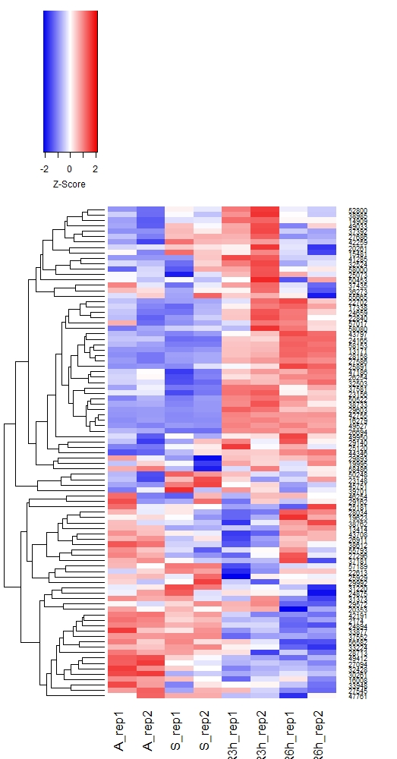

Supplemental Fig. S2
B
91 lnc-MIRHGs in WI38
A
1149 MIRHGs
A
Q
3h
6h
1028 MIRHGs
hosting single miRs
121 MIRHGs
hosting multiple miRs
Z-score
Ca
MIR222HG
Cb
Cc

Slide 2
Supplemental Fig. S2. MIRHGs show dynamic expression during cellular quiescence and upon cell cycle re-entry. (A) Categorization of MIRHGs with respect to the number of miRs that they host. Detailed list is available in Supplementary Table S5. (B) Heatmap showing the relative expression levels of 91 lnc-MIRHGs that are expressed in WI-38 RNA-seq. Duplicates are represented. Genes (rows of heatmap) are hierarchically clustered using average-linkage clustering method. Arrow indicates MIR222HG. (C) Fold change (log2 scale) of DE-lnc-MIRHGs from: (a) asynchronous to quiescent, (b) quiescent to 6h post serum stimulation, and (c) 3h to 6h post serum stimulation. Numbers in parenthesis refer to the number of miRNAs encoded in each lnc-MIRHG. See Supplementary Table S5 for detailed DE-lnc-MIRHGs information.

