Slide 1
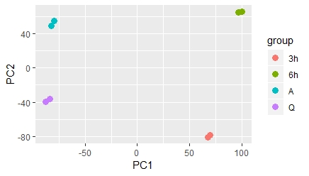
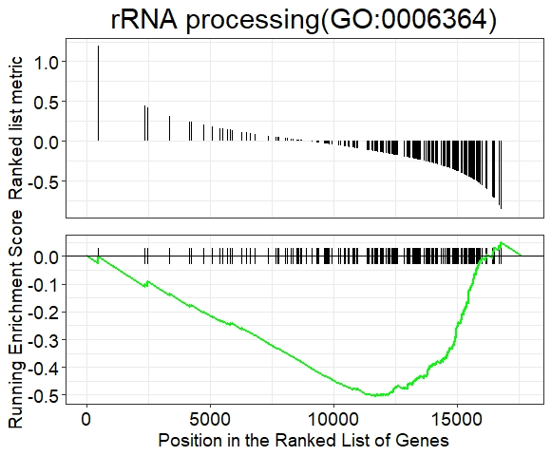
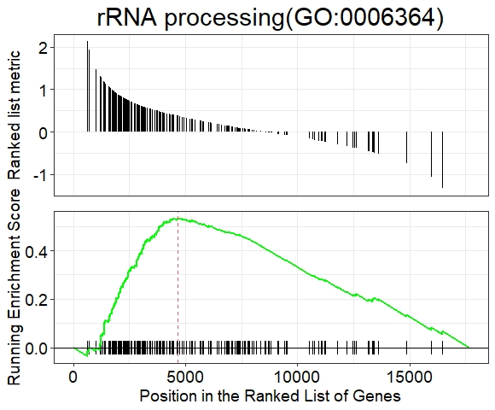
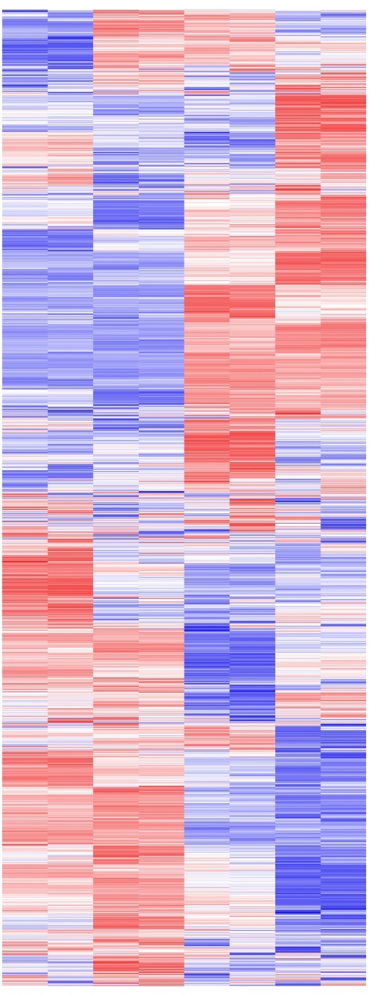
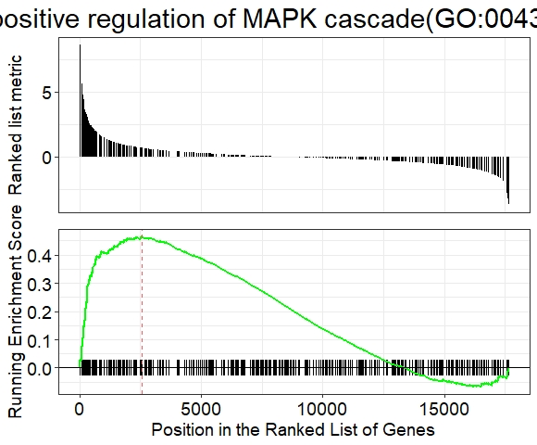
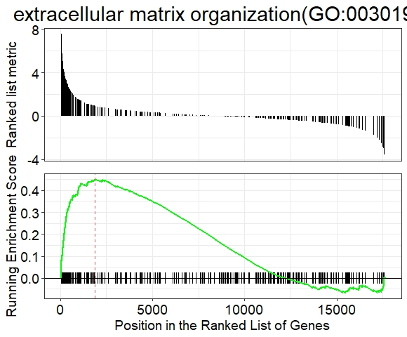

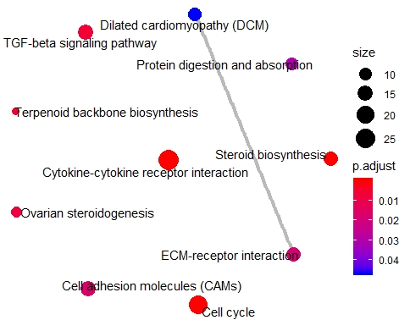
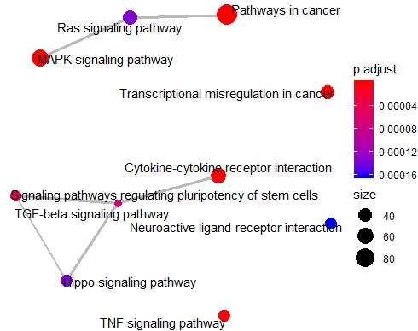
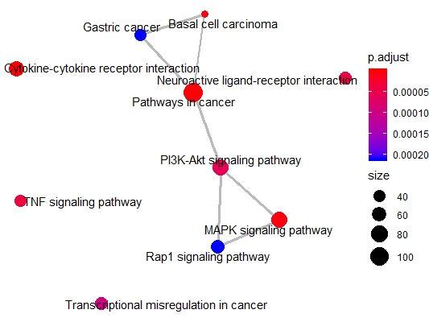
Supplemental Fig. S1
A
 | Number of Reads (paired) | Overall alignment rate
A-Rep1 | 127294769 | 98.13%
A-Rep2 | 109777160 | 98.30%
Q-Rep1 | 105288634 | 98.40%
Q-Rep2 | 125076450 | 98.30%
3h-Rep1 | 120866458 | 98.06%
3h-Rep2 | 106161388 | 98.16%
6h-Rep1 | 127658588 | 97.32%
6h-Rep2 | 112951921 | 98.34%
B
C
D
17640 genes in WI-38
Ea
A to Q
Eb
Q to 6h
A
Q
3h
6h
Ec
Q to 3h
Ed
Q to 6h
positive regulation of MAPK cascade(GO:0043410)
extracellular matrix organization(GO:0030198)
Z-score
Fa
A to Q
Fb
Q to 3h
Fc
Q to 6h

Slide 2
Supplemental Fig. S1. Transcriptome landscape of human lung fibroblasts during quiescence and cell cycle re-entry. (A) Table representing the number of paired-end reads and alignment rate of each RNA-seq sample. (B) Principle component analysis (PCA) of 8 RNA-seq samples. Plot showing PC1 and PC2, biological duplicates are marked using the same color. (C) Categorization of 17640 expressed genes in RNA-seq. Detailed gene category information is available in Supplementary Table S1. (D) Heatmaps showing the relative expression levels of all 17640 genes detected from RNA-seq. Biological duplicates from four time points are represented. Genes (rows of heatmap) are hierarchically clustered using average-linkage clustering method. (E) Representative significant events from GSEA analyses including: rRNA processing from (a) asynchronous to quiescent and (b) quiescent to 6h serum stimulation, (c) MAPK cascade from quiescent to 3h serum stimulation, and (d) ECM organization from quiescent to 6h serum stimulation. Detailed GSEA results are available in Supplementary Table S3. (F) Top events from Kegg pathway analyses of DEGs from: (a) asynchronous to quiescent, (b) quiescent to 3h serum stimulation, and (c) quiescent to 6h serum stimulation. Nodes represent the gene size in each biological process, edges represent the overlapping of genes in different processes. Detailed analysis results are available in Supplementary Table S3.

