Slide 1
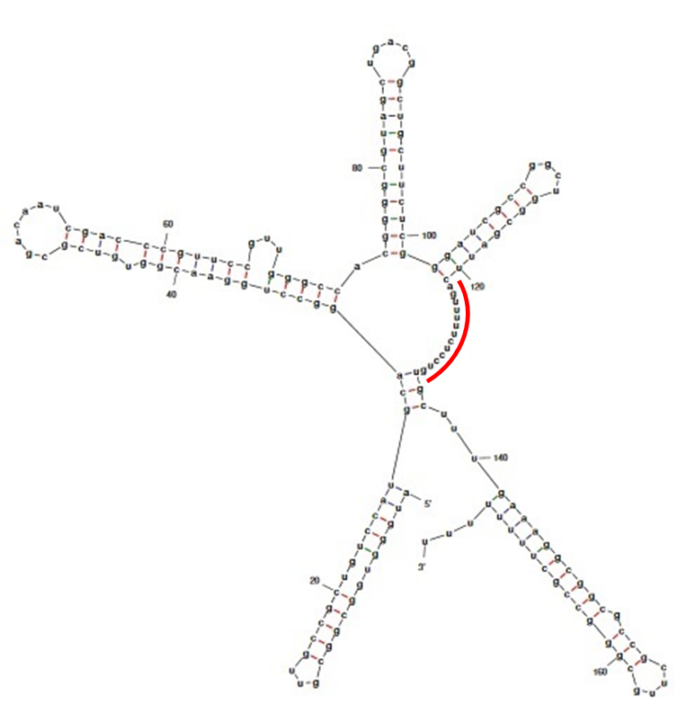
Keidel et al. Supplemental Figure S2

