Slide 1
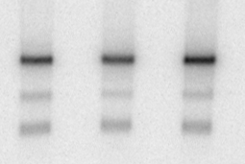
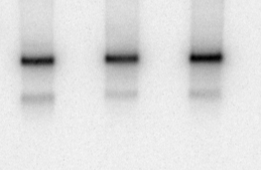
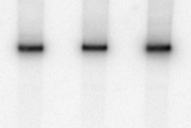
A
1344
1962
2365
2992
1
2
3
poly A signal
5’
3’ UTR
3’
ORF
29
24
9
predicted
miRNA site
(Targetscan)
183
361
182
203
219
25/92
203.1
221/222
3kb
2.4kb
1.9kb
1.4kb
B
HeLa
5B
Huh7
HeLa
5B
Huh7
HeLa
5B
Huh7
3kb
2.4kb
1.4kb
probe
1
2
3

