Slide 1
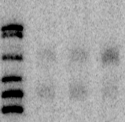
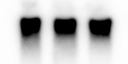
0 30 30 Time (min)
- + SHX
217-
- SraG
201-
- SraGp
190-
180-
-5S
131 240 SraG
100 100 70 SraGp
Figure S1
Figure S1; Higher level of SraG after induction of the stringent response
Serine hydroxamate (1 mg/ml) was added to a culture of the wild-type strain (MG1655) in exponential phase (time 0). Bacteria were grown for 30 min before sampling. Total RNA (10 μg) were separated on 6% acrylamide-urea gels and analyzed by northern blotting. The blots were probed for SraG and 5S rRNA, used for normalization of quantifications.

Slide 2
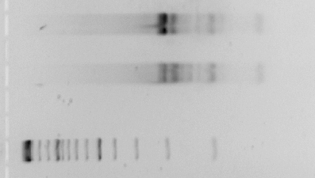
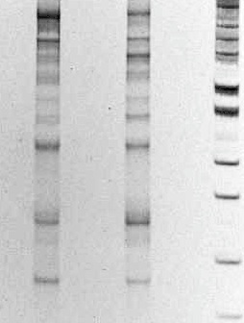
+
- + polyphosphatase
-
500-
---A---
-217
400-
---B---
-201
---C---
-190
300-
-180
200-
-A-
-160
-B-
-140
100-
-123
-110
-90
-76
Figure S2
Figure S2; Characterization of SraG transcripts by cRT-PCR.
Image of an ethidium bromide stained agarose gel (left side) and of acrylamide gel (right side) of PCR products amplified using the m423-442 primer for the RT in combination with m1 and rpsO441 for the PCR. The presence or absence of polyphosphatase treatment prior to the RNA ligation is indicated at the top of the lanes. PCR fragments from bands A, B and C were eluted and cloned.

Slide 3
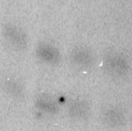
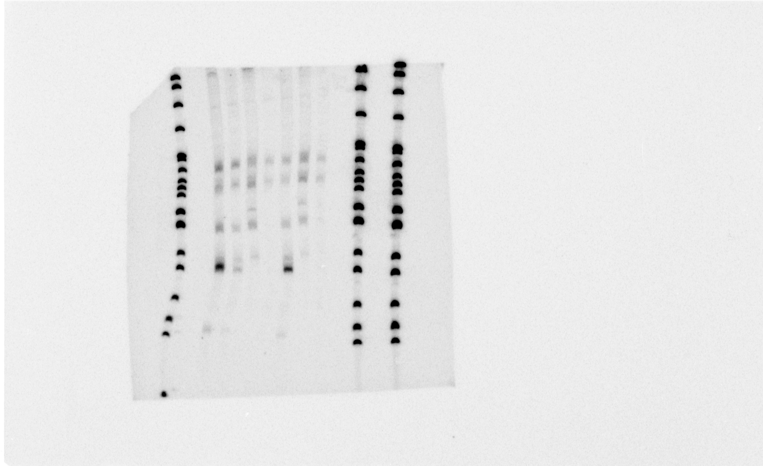
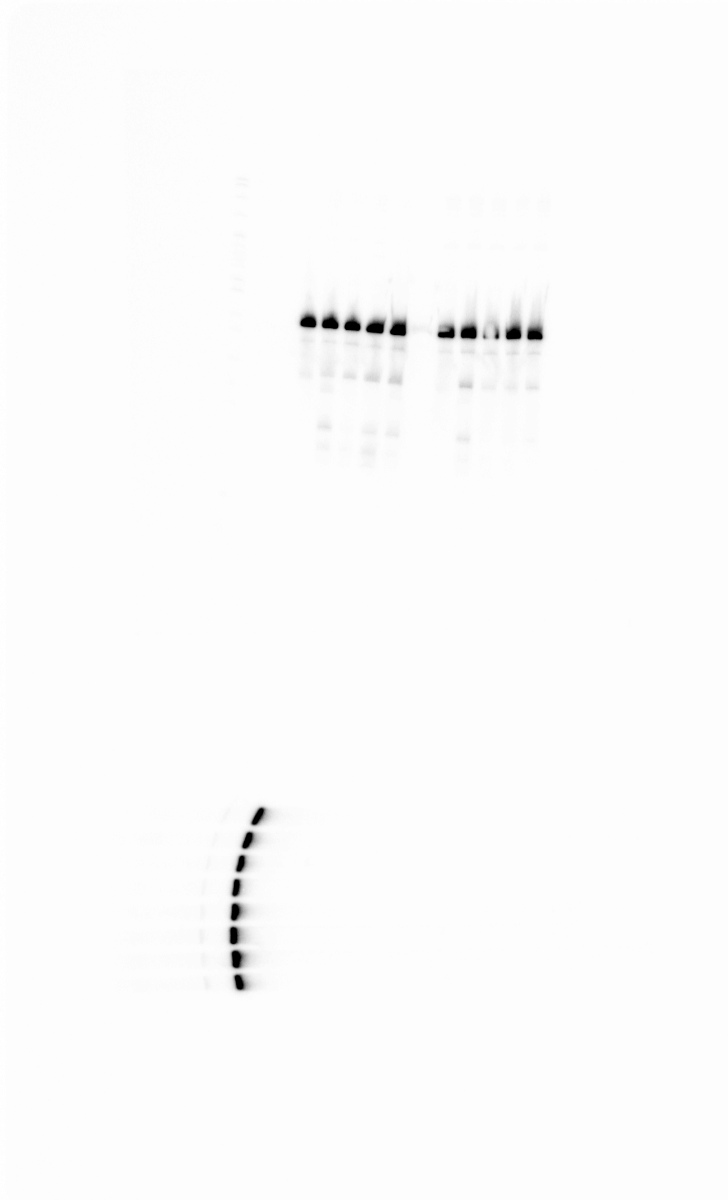
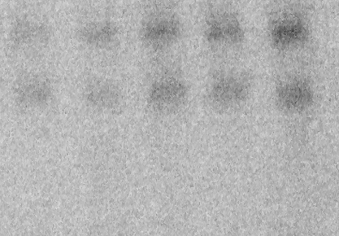
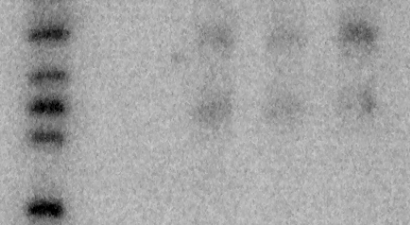
A
ybeY
pnp
rnc
ybeY
rnc
yhbJ
pcnB
ybeY
pnp
wt
wt
rnc
pnp
ybeY
pcnB
yhbJ
217-
217-
201-
-SraG
190-
-SraGp
201-
-SraG
180-
190-
160-
180-
147-
-SraGp
123-
-5S
110-
B
wt
rnpA
C
rna rnb
rbn rnd
30°C
44°C
30°C
44°C
wt
rbn
217-
217-
201-
201-
190-
190-
180-
180-
160-
160-
Figure S3
Figure S3; YhbJ, YbeY, RNase P and RNase BN (RNase BN) have no effects on SraG RNA.
Northern blot analysis of SraG sRNA in strains carrying the mutations in the genes indicated at the top of the autoradiograph. A) All strains were derived from N3433. yhbJ and ybeY mutations were introduced by P1 transduction. B) RNA from NHY312 (wt) and NHY322 (rnpA49^{ts}) strains were used. Strains were grown at 30°C and shifted to 44°C for 30 min to inactivate thermosensitive RNase P. C) RNA from MG1655-rph⁺ (wt), MG1655-rph⁺-BN⁻ (rbn) and CAN20-12E (RNase I⁻ II⁻D⁻BN⁻) (rna rnb rbn rnd). Total RNA (10 μg) were separated on 6% acrylamide-urea gels and analyzed by northern blotting, which were probed for SraG and 5S rRNA.

Slide 4
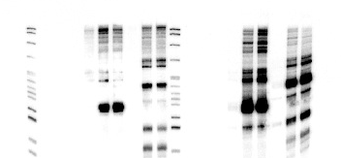
wt
rnc
pBR
pBRSraG-S
pBRSraG
pBR
pBRSraG-S
pBRSraG
Time (min)
0
20
40
0
20
40
0
20
40
0
20
40
0
20
40
0
20
40
527-
404-
307-
238-242-
*
217-
201-
*
190-
**
180-
**
160-
147-
123-
110-
SraG-S 1 43 58 3 120 125
SraG 1 33 25 4 130 150
Figure S4
Figure S4; SraG overexpression in wt and rnc strains.
The wild-type strain (FF4) and the rnc mutant (FF19) were transformed with the pBRpLac empty vector (pBR), the pBR-SraG encoding the 216 nt SraG (pBRSraG) and the pBR-SraG-S encoding the 174 nt SraG reported in (2) (pBRSraG-S). IPTG 100 μM is added in exponential phase (time 0) and samples were taken 20 and 40 min later. Cells containing the empty vector express the small RNA SraG from the endogenous gene. Faint bands of SraG are detected in wt and rnc cells containing pBRSraG or pBRSraG-S at T0 indicating that the P_{LacO-1} promoter is not totally repressed. SraG relative levels at different time after the addition of IPTG 100 μM are indicated. * and ** indicate SraG and SraGp respectively. Longer readthrough transcripts are detected as well as shorter fragments in addition to SraGp.

Slide 5
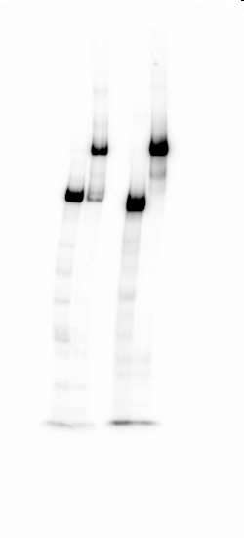
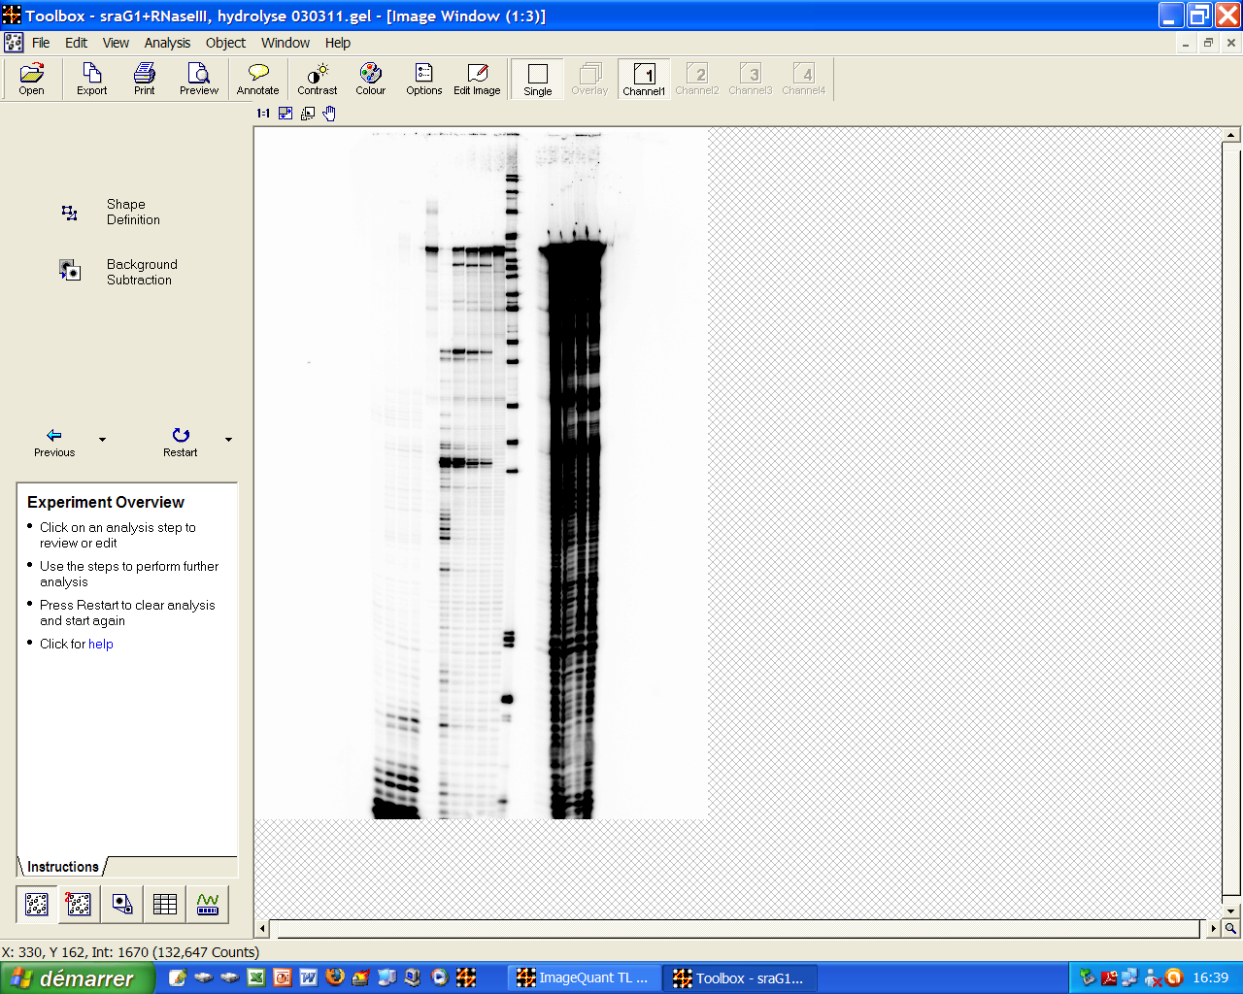
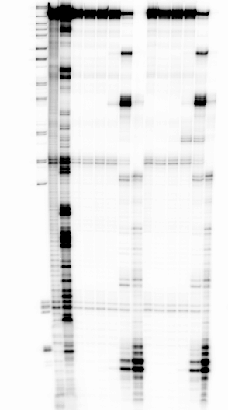
SraG*/pnp 1:1
A
pnp*/SraG 1:1
pnp*
SraG*
C
SraG*5’ SraG*5’/pnp
0.003
0.01
0.05
0.003
0.005
0.01
0
0.005
0.05
RNase III
(units)
238+242-
0
217-
201-
-RIII3’
190-
B
180-
160-
147-
RNase III
(units)
SraG*3’ SraG*3’/pnp
T1
10⁻²
10⁻⁴
10⁻¹
10⁻⁴
10⁻¹
123-
10⁻⁵
10⁻³
10⁻⁵
10⁻²
NaOH
10⁻³
-RIII1’
238+242-
0
0
110-
217-
201-
190-
180-
90-
160-
-RIII2’
147-
76-
123-
-RIII1’
-RIII2’
110-
67-
90-
-RIIIA’
76-
67-
34-
34-
26-
-RIIIB’
26-
-RIII3’
-RIIIC’
8-
Figure S5

Slide 6
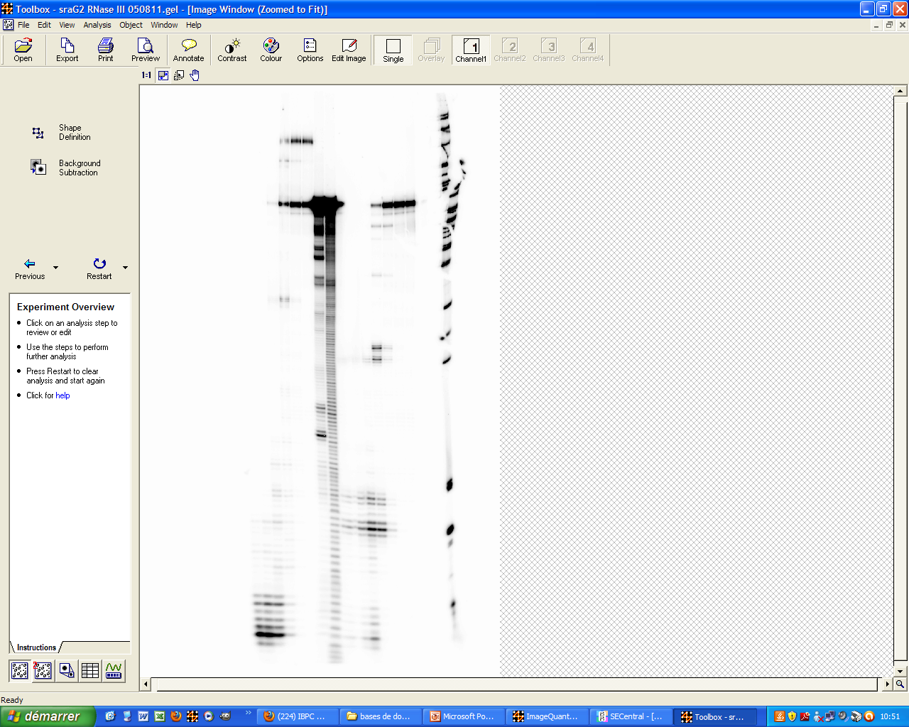
D
SraG-S*5’ SraG-S*5’/pnp
5.10⁻⁵
5.10⁻²
5.10⁻⁵
5.10⁻²
5.10⁻³
RNase III
(units)
5.10⁻³
T1
5.10⁻⁴
0.5
5.10⁻⁴
0.5
NaOH
0
0
160-
147-
123-
110-
90-
-RIIIA’
76-
67-
-RIII1’
34-
26-
-RIII2’
8-
-RIIID’

Slide 7
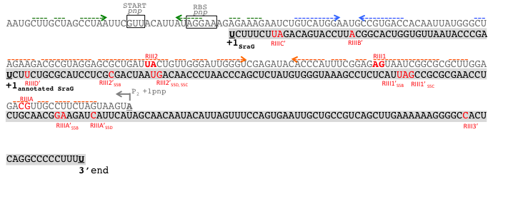
E
Figure S5
Figure S5; RNase III promotes cleavages of SraG and SraG-S alone or in association with pnp mRNA. A) Interaction between SraG and pnp mRNA was monitored on native polyacrylamide gels. The 5’-labelled pnp mRNA (pnp*) was incubated alone or with an equimolar amount of unlabelled SraG (left side). The 5’-labelled SraG sRNA (SraG*) was incubated alone or with an equimolar amount of pnp mRNA. B) The 3’-labelled SraG RNA (SraG*3’) C) the 5’-labelled SraG sRNA (SraG*5’). D) the 5’-end labelled SraG-S (SraG-S*5’) were incubated alone or with a equimolar amount of unlabelled pnp mRNA. Increasing amounts of RNase III have been added. Lanes T1, NaOH: RNase T1 and alkaline ladders, respectively of SraG*3’ (A) or SraG-S*5’ (C). E) Localization on the pnp, SraG and SraG-S RNAs of the RNase III cleavages sites (in red) detected in figures 5, S5BCD. The mentions S5B, S5C, S5D close to the cleavage sites referred to the corresponding figure. Inverted arrows in green, blue and orange indicate the different stem-loops containing the RNase III cleavage sites (in orange) as well as the hairpin which partially sequester the SD sequence of the pnp mRNA (in green).

Slide 8
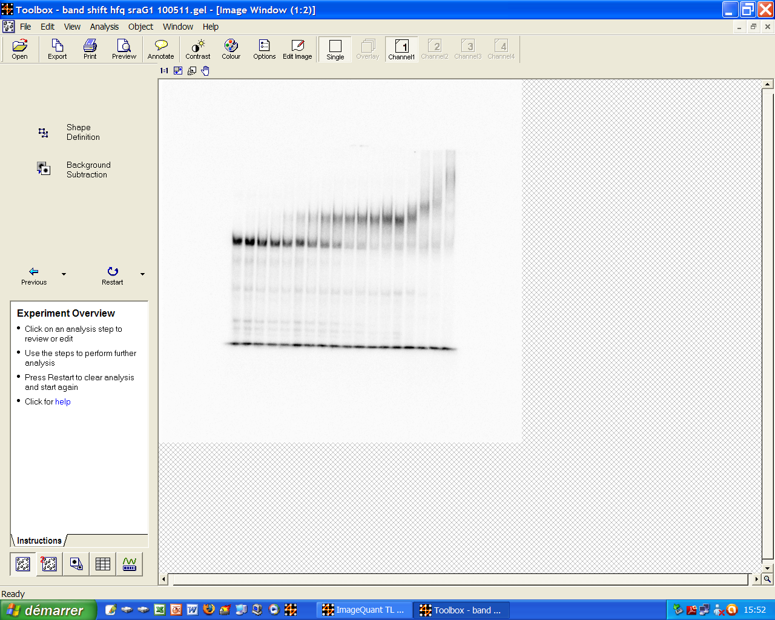
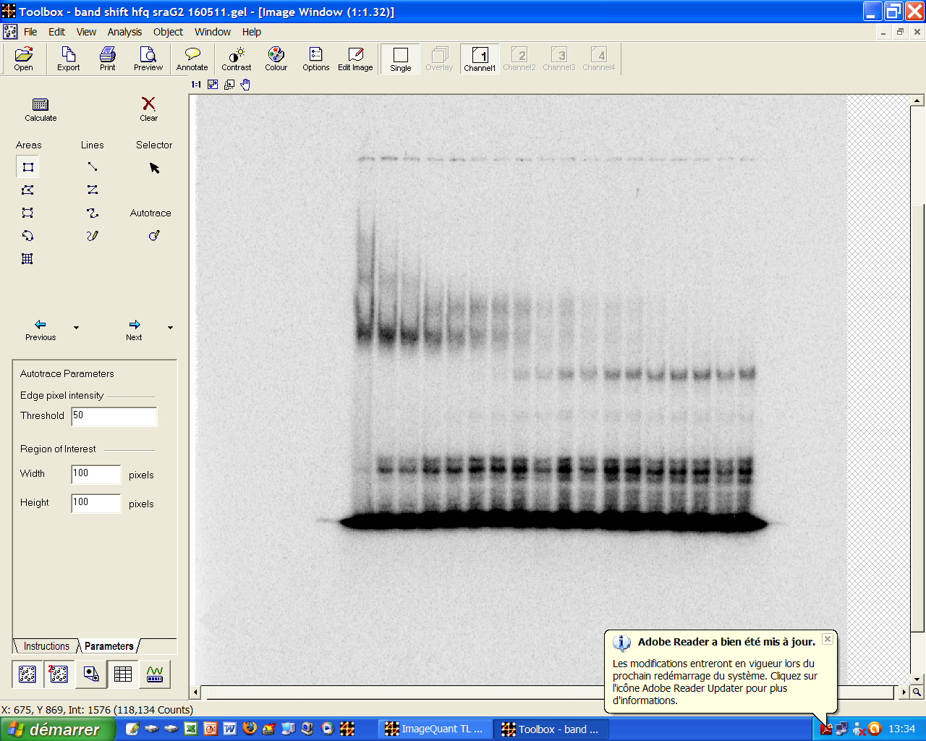
A
[Hfq] pM
25
50
100
200
400
600
800
1000
1500
2000
5000
7500
10000
50000
0
2500
25000
100000
Hfq-SraG
*
Kd_{SraG}=0.49nM
B
[Hfq] pM
0
2500
25000
100000
25
50
100
200
400
600
800
1000
1500
2000
5000
7500
10000
50000
Hfq-SraG-S
*
Kd_{SraG-S}=1.08nM
Figure S6
Figure S6; Band shift analysis of Hfq binding to SraGs.
50pM of 5’-end labeled SraG (A) and SraG-S (B) transcripts were incubated with increasing amount of Hfq (0 to 100000pM). Free form of each SraG are annotated with a star (*), and Hfq-RNA complexes with bracket. The Kds are calculated as mentioned in supplementary materials and methods and indicated at the bottom of each gel.

Slide 9
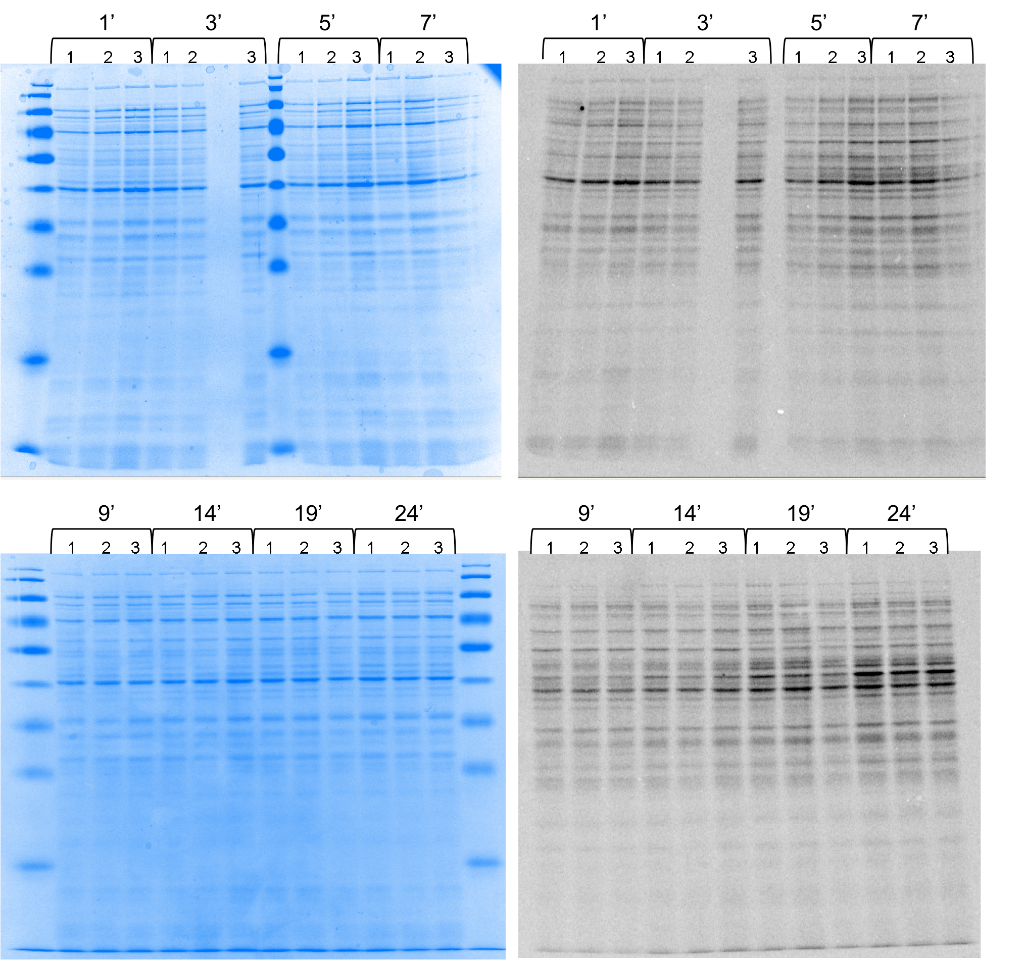
Figure S7
Figure S7; Effect of SraG and SraG-S overproduction on protein synthesis.
Cultures of MG1655 transformed by pBR (lane 1), pBRSraG (lane 2) and pBRSraG-S (lane 3) were grown in LB medium until mid-log phase then IPTG was added to induce SraG and SraG-S overexpression (time 0). Samples were withdrawn at the times indicated and pulse-labelled for 1 min with a mixture of radioactive methionine and cysteine. The protein-synthesizing capacity of the samples was monitored after 1, 3, 5, 7, 9, 14, 19 and 24 min of induction. Soluble proteins were analyzed on SDS-PAGE. Left panel; Coomassie blue staining, Right panel; autoradiograph.

Slide 10
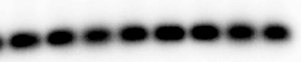
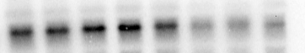
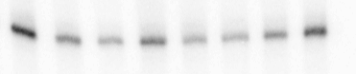
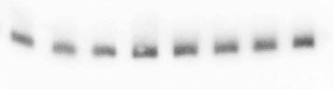
A
pBRSraG-S
pBRSraG
IPTG μM
0 20 50 100 0 20 50 100
pnp-
5S-
pnp mRNA
Relative level
B
Ile tRNA
precursor -
-160
-147
5S-
Ile tRNA precursor
Relative level
Figure S8
Figure S8; SraG overexpression affects the amount of tRNA^{Ile} precursor.
Northern blot analysis of pnp mRNA on agarose formaldehyde gel (A) and tRNA^{Ile} precursor on acrylamide-urea gel (B), in MG1655 (wt) containing pBRSraG-S or pBRSraG plasmids. Overexpression was induced by adding IPTG (0, 20, 50, 100 μM) at the beginning of the culture. Membrane was probed for tRNA^{Ile} precursor with the 5’-radiolabelled oligonucleotide GTAGAGGTTTTACTGCTCATTTTCATCAGACAATC which is complementary to the region -1 to -35 upstream of ileT. Quantification of tRNA precursor and pnp transcript radioactivity (in arbitrary units relative to 5S RNA) is indicated below the corresponding gel.

Slide 11
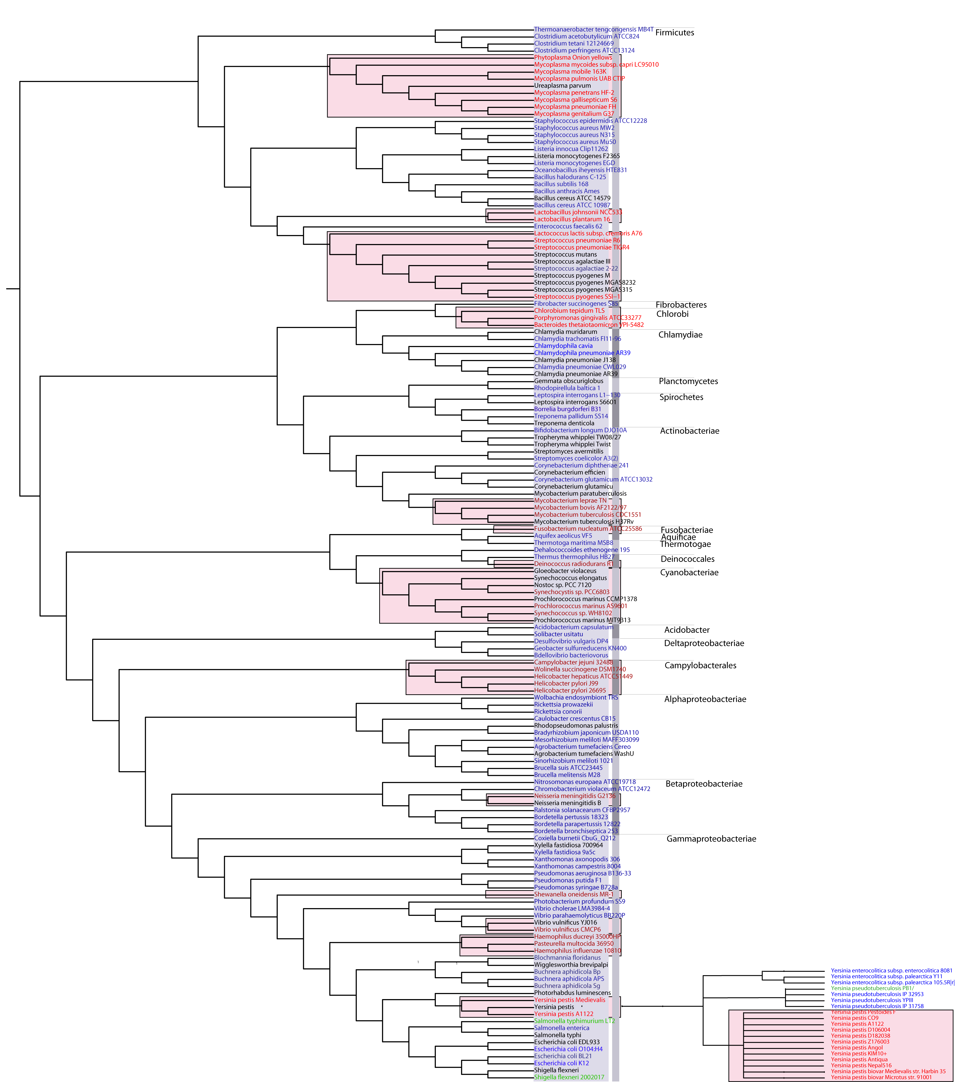
Figure S9
Figure S9; rpsO and pnp co-occurrence across bacteria representative of the general bacterial phylogenic tree (http://itol.embl.de/). The names of the bacteria with the rpsO-pnp synteny are in blue those lacking the synteny are in red (http://mbgd.genome.ad.jp/). Boxes in light red indicate species which do not present a rpsO-pnp co-occurence. Bacteria named in black are those where no information is available SraG homologues have been described in different species, which are colored in green. The example of the genus Yersinia is more precisely described.

